Slide 1
List the factors of 36
Which number is not a factor of 14?
1 4 7 14
What fraction of the multiples of 7 are odd?
Less than half Half More than half
64 ____ 48 ____ 32

Slide 2
List the factors of 36
Which number is not a factor of 14?
1 4 7 14
What fraction of the multiples of 7 are odd?
Less than half Half More than half
64 ____ 48 ____ 32
1, 2, 3, 4, 6, 9, 12, 18, 36
56
40

Slide 3
L.C. Can I identify common factors?
Toolkit

Slide 4

1 row of 8 is equal to 8
1 and 8 are factors of 8
Have a think
2 rows of 4 are equal to 8
2 and 4 are factors of 8
The factors of 8 are: 1, 2, 4 and 8

Slide 5


Have a think
1, 2, 3, 4, 6 and 12
The factors of 12 are: ________________
The factors of 8 are: 1, 2, 4 and 8
1, 2 and 4 are factors of 12 and 8
1, 2 and 4 are common factors of 12 and 8
Whitney and Dexter both have dark hair.
They have dark hair in common.

Slide 6
Factors of 15
Factors of 25
1, 5, 25
1, 3, 5, 15
Common factors of 15 and 25
Have a think
1
2
3
5
15
25

Slide 7
What is the highest common factor of 27 and 90?
9
The factors of 27 are 1, 3, 9 and 27
Have a think
The factors of 90 are ________________________________
1, 2, 3, 5, 6, 9, 10, 15, 18, 30, 45 and 90
3 and 30
1 and 90
5 and 18
90
2 and 45
6 and 15
9 and 10

Slide 8

Rosie has 14 tennis balls.
Amir has 24 tennis balls.
Ball containers can hold 2, 4, 8 or 10 balls.
Each child wants to buy containers all of the same size and to have only full containers.
Have a think
1) Which container size could both Amir and Rosie use? _____
2) Which container size could neither Amir nor Rosie use? ______

Slide 9
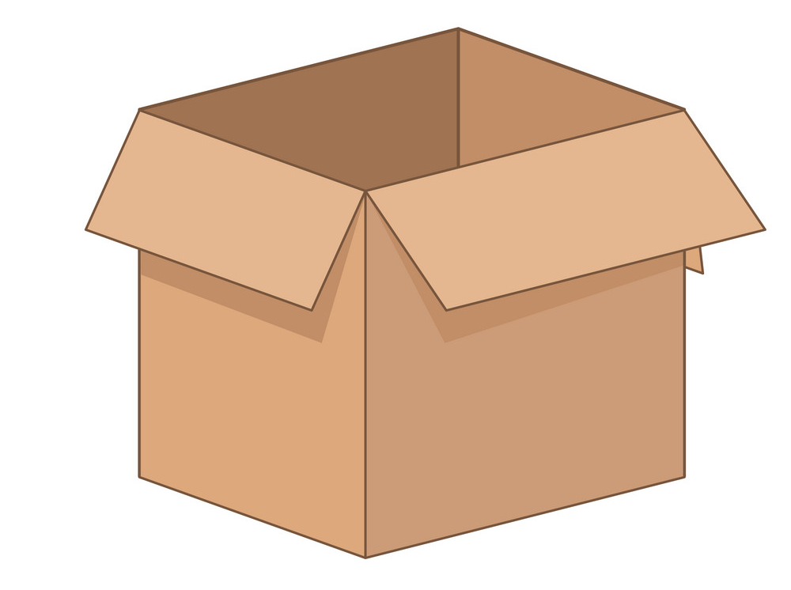
Rosie has 14 tennis balls.
Amir has 24 tennis balls.
Ball containers can hold 2, 4, 8 or 10 balls.
Each child wants to buy containers all of the same size and to have only full containers.
1) Which container size could both Amir and Rosie use? ______
2

Slide 10
Rosie has 14 tennis balls.
Amir has 24 tennis balls.
Ball containers can hold 2, 4, 8 or 10 balls.
Each child wants to buy containers all of the same size and to have only full containers.
2) Which container size could neither Amir nor Rosie use? ______
10

