Slide 1
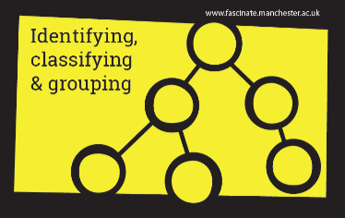
LC: Can I explain light and shadows?
Week 1 Light

Slide 2
Can you remember our science principles?
- We are curious
- We ask scientific questions
- We develop our scientific knowledge
- We use scientific vocabulary
- We complete practical investigations

Slide 3

How can you make shadows?
How can you make different shapes?
What could you use to make shadows?
How could you modify your shadow?

Slide 4
Short task: What do you know about light and shadows?
Explain all that you already know about light by:
Creating a mind map
Designing a poster
Writing a paragraph
Drawing a diagram
Challenge include the words:
Light
Dark
Shadow
Source
Reflection
Illuminate
Straight
Travel

Slide 5
You should have remembered…
recognise that light appears to travel in straight lines
use the idea that light travels in straight lines to explain that objects
are seen because they give out or reflect light into the eye
explain that we see things because light travels from light sources to
our eyes or from light sources to objects and then to our eyes
use the idea that light travels in straight lines to explain why shadows
have the same shape as the objects that cast them.
What would you like to discover?
What questions do you have?

Slide 6
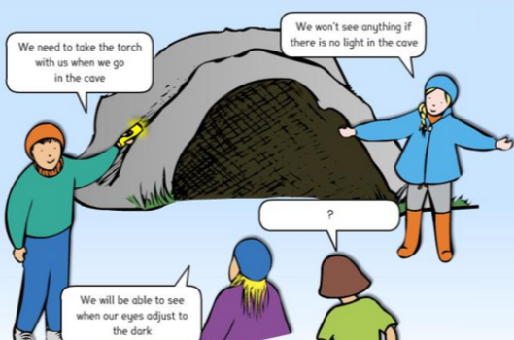
Think about the concept cartoon, what might the fourth person have to say?

Slide 7
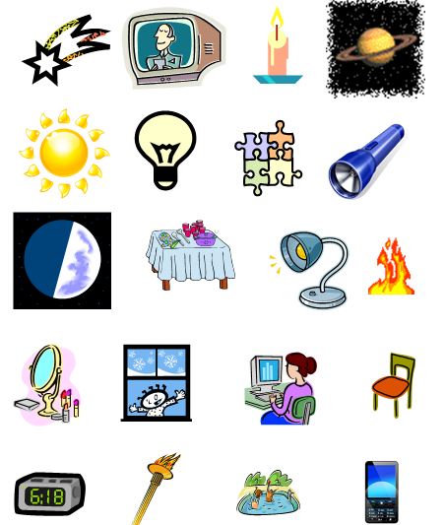
These images represent things which can be seen because they either give out light or reflect light.

Slide 8
Sort the images into one of three categories.
Natural sources of light.
Man-made sources of light.
Not a source of light.

Slide 9
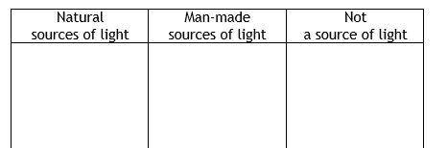
You may wish to create a table like the one below.
What goes where?

Slide 10
Light and dark
https://www.bbc.co.uk/bitesize/clips/z8vfb9q

Slide 11
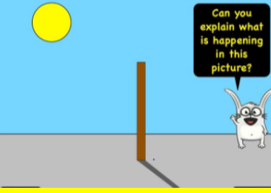
Using scientific vocabulary explain what is happening in this image

Slide 12
Unjumble the words to give a definition of a shadow is
Blocked A is a area light from a dark source is by an opaque where object. Shadow light
A shadow is a dark area where light from a light source is blocked by an opaque object.

Slide 13
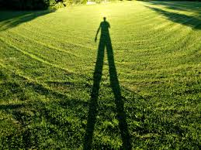
Making shadows
Next time you are outside notice the shadows you cast, think about how long it is and how that changes over time.

