Slide 1
English Autumn 2
Week 1 Day 2

Slide 2
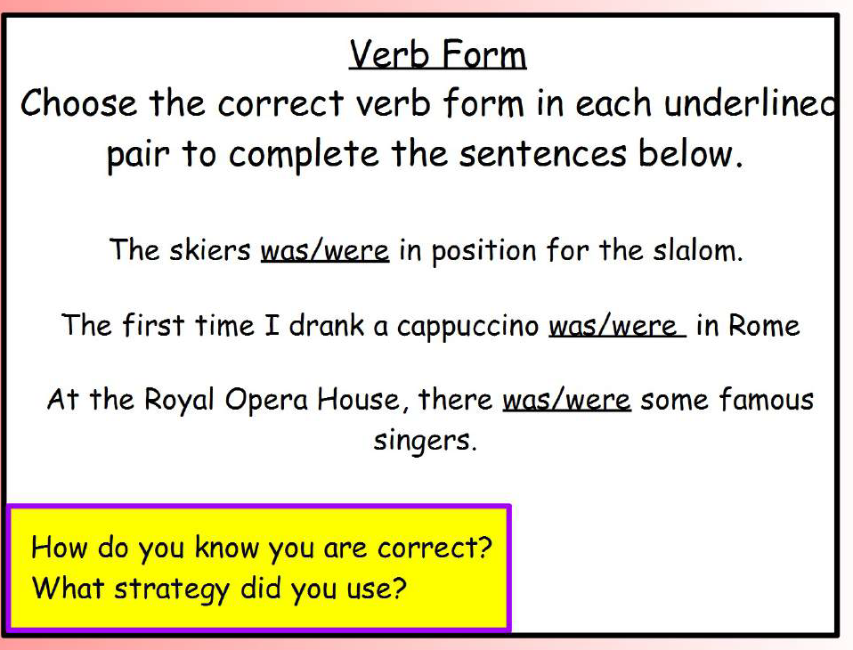
SPaG warm up

Slide 3
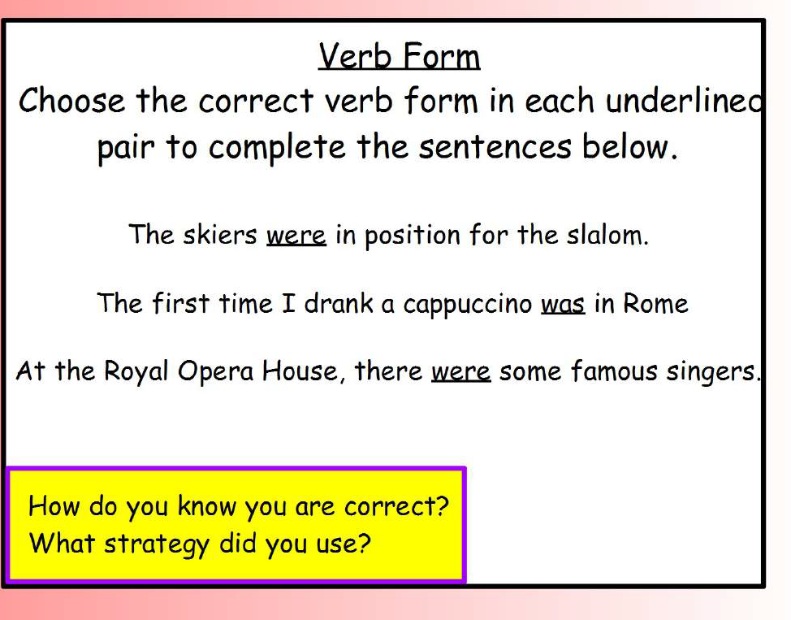
SPaG warm up

Slide 4
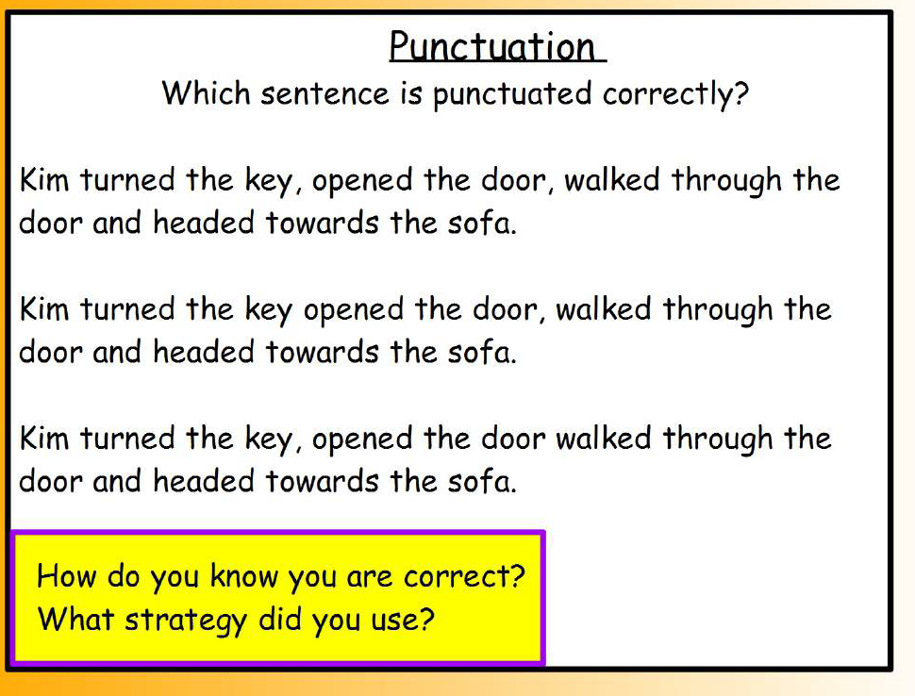
SPaG warm up

Slide 5
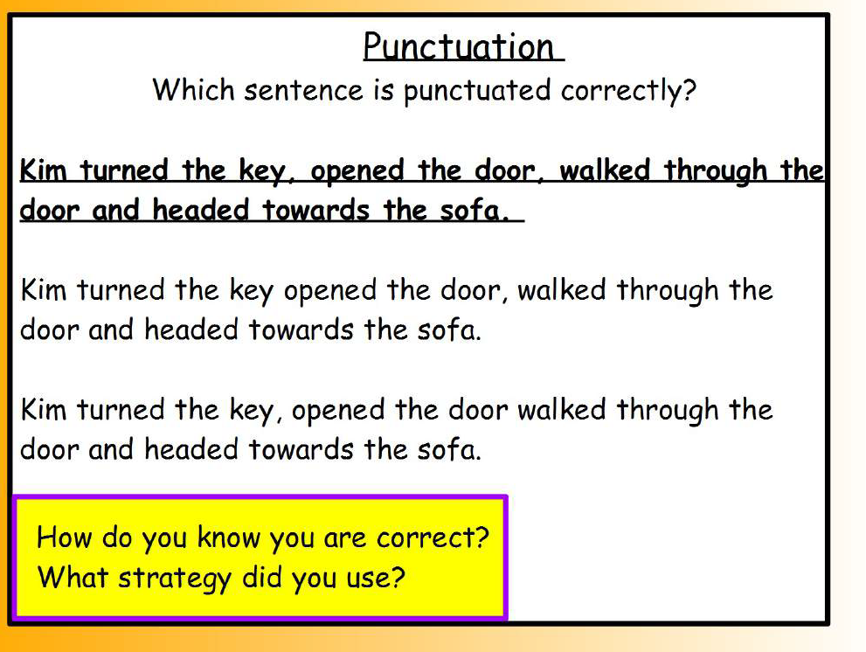
SPaG warm up

Slide 6
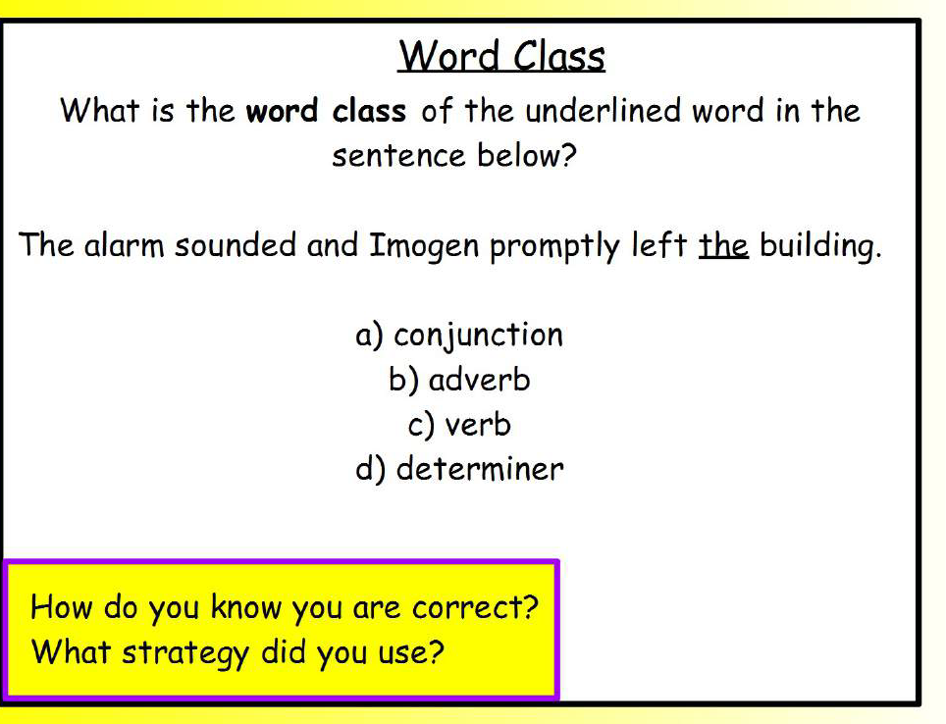
SPaG warm up

Slide 7
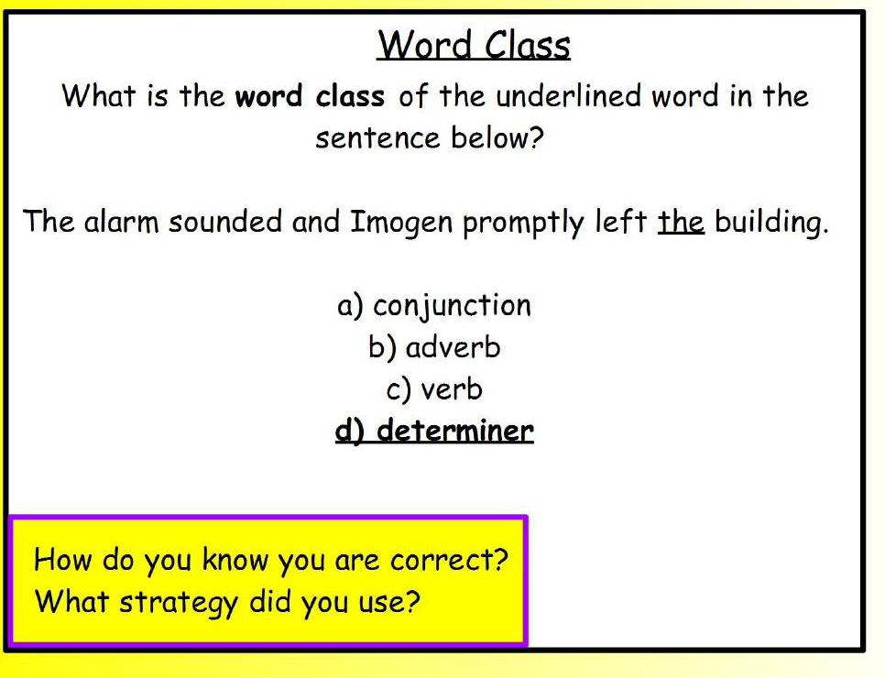
SPaG warm up

Slide 8
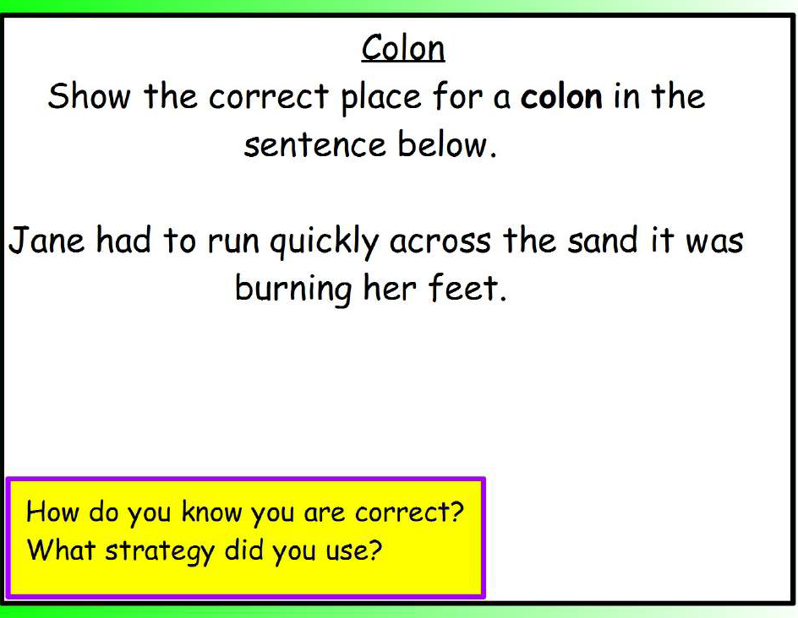
SPaG warm up

Slide 9
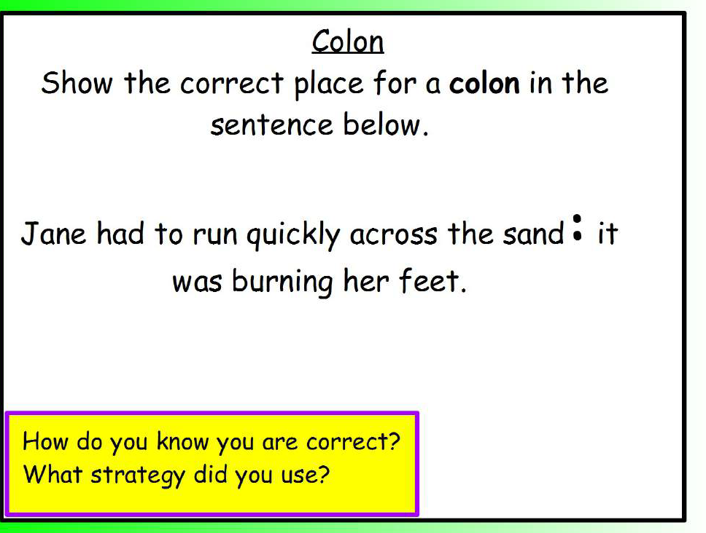
SPaG warm up

Slide 10
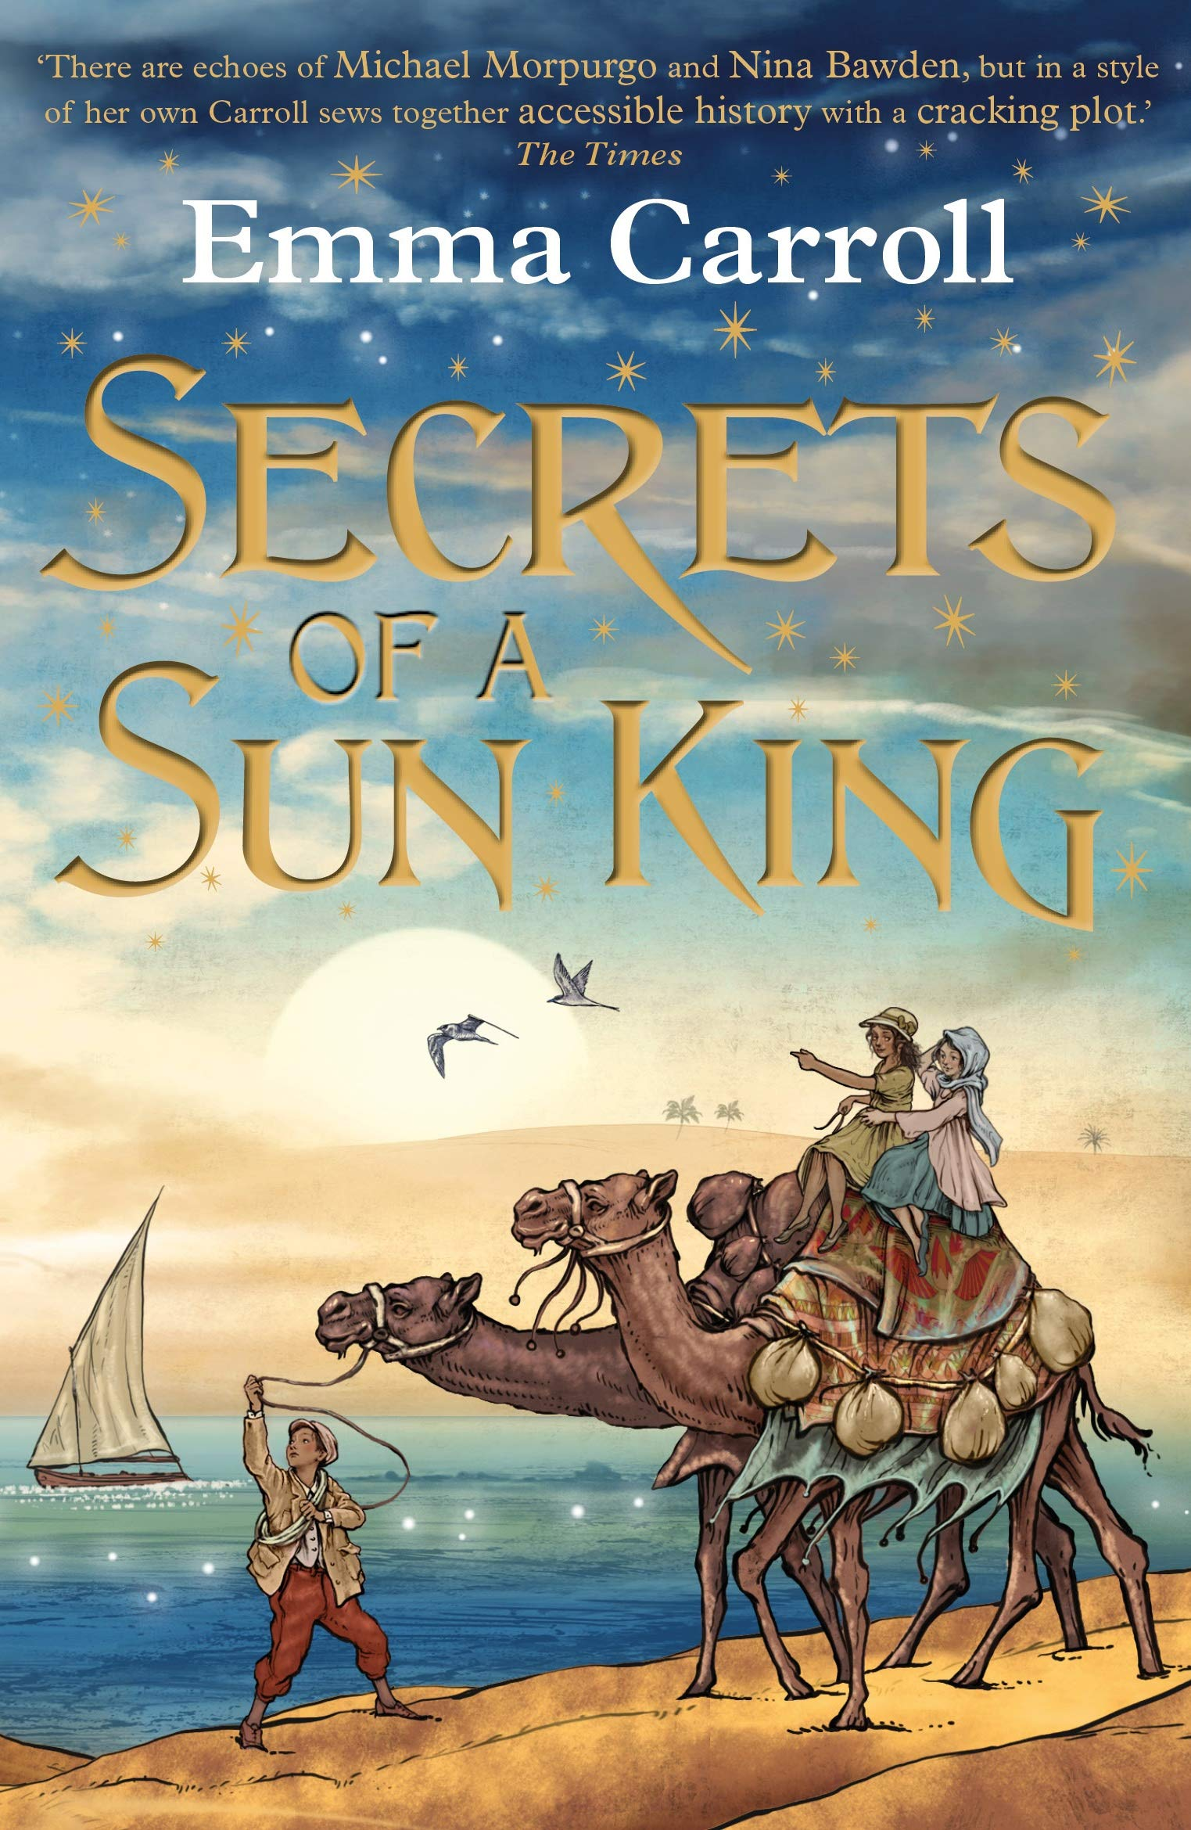
Our text for this half term is:

Slide 11
Read Chapter 2 and answer the RIC (retrieval, interpret and choice) questions.
Retrieval
Why had Lilian’s Granddad travelled all over the
world?
Why could Lilian not visit her Grandad?
Who was Howard Carter?

Slide 12
Read Chapter 2 and answer the RIC (retrieval, interpret and choice) questions.
Interpret
Why does Lilian believe that Granddad’s sickness
is suspicious?
How do you know that Lilian is determined?
Why did the story of Tutankhamun capture
people’s hearts?

Slide 13
Read Chapter 2 and answer the RIC (retrieval, interpret and choice) questions.
Choice
Why do you think Lil chose to hide the jar
from her mum? Do you think this was the right
choice?

Slide 14
Vocabulary
Use a dictionary to write a definition of the
following words:
musty
hieroglyphics
malaria
coincidence
pharaoh
stunned

Slide 15
L.C. Can I write a description?
Writer’s toolkit

Slide 16
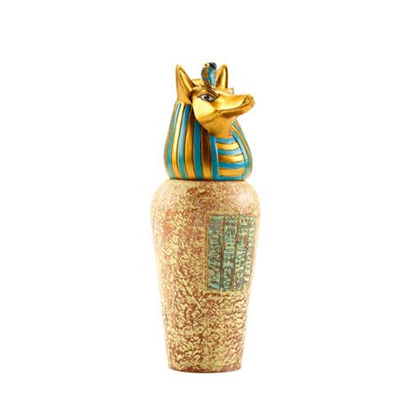
Draw the jar in the box based on the description given.
Label the parts of the jar.
Anubis
long pointy snout
stand-up ears
hieroglyphics
gold

