Slide 1
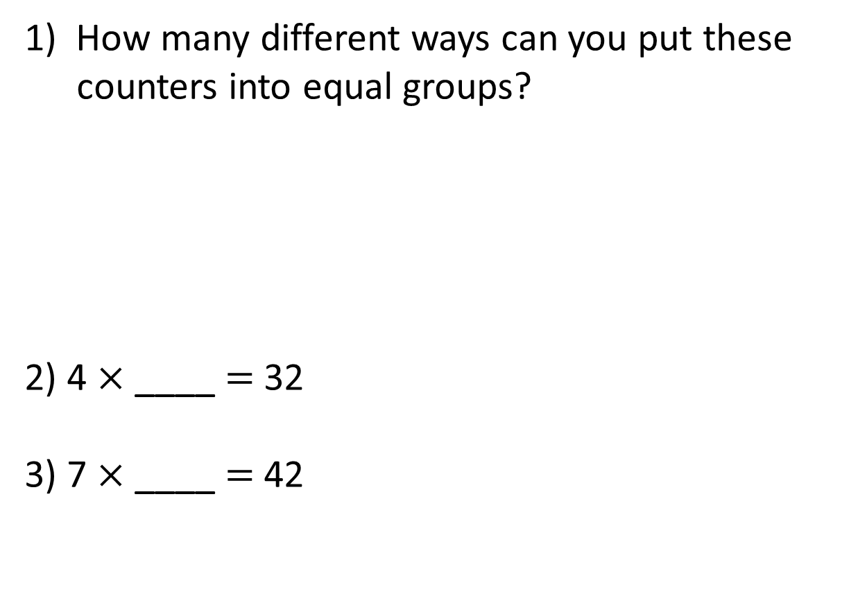
1) How many different ways can you put these counters into equal groups?
2) 4 $×$ ____ $=$ 32
3) 7 $×$ ____ $=$ 42

Slide 2
1) How many different ways can you put these counters into equal groups?
2) 4 $×$ ____ $=$ 32
3) 7 $×$ ____ $=$ 42
1 group of 6
3 groups of 2
2 groups of 3
6 groups of 1
8
6

Slide 3
L.C. Can I identify factors?
Toolkit

Slide 4

Which of these numbers are factors of 14?
1
0.5
14
7
28
2
3
Have a think

Slide 5
1
7
0.5
14
28
2
3
1 and 14
14

Slide 6
1
7
0.5
14
28
2
3
1 and 14
14
2 and 7

Slide 7
1
7
0.5
14
28
2
3
1 and 14
14
2 and 7

Slide 8
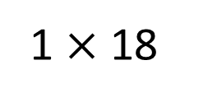
Find all the factors of 18
How do you know when you’ve found them all?
1 $×$ 18
1 and 18
18
Have a think

Slide 9
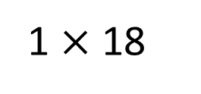
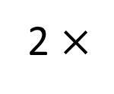
Find all the factors of 18
1 $×$ 18
2 $×$
9
1 and 18
18
2 and 9

Slide 10
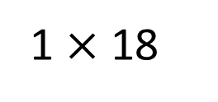
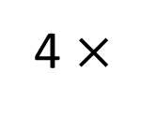
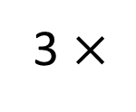
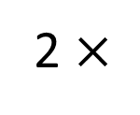
Find all the factors of 18
1 $×$ 18
2 $×$
9
3 $×$
6
4 $×$
1 and 18
18
2 and 9
3 and 6

Slide 11
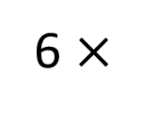
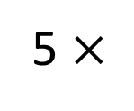
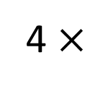
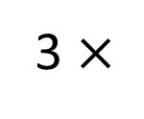
Find all the factors of 18
1 $×$ 18
2 $×$
9
3 $×$
6
5 $×$
4 $×$
6 $×$
1 and 18
18
2 and 9
3 and 6
1, 2, 3, 6, 9, 18

Slide 12

Alex is thinking of a number between 30 and 40 It only has two factors.
What could Alex’s number be?
31
32
33
34
35
36
37
38
39
Prime numbers only have 2 factors: 1 and themselves.
Have a think

Slide 13

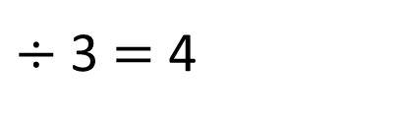
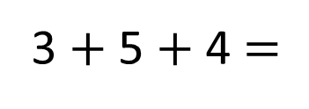

Is 5 a factor of 162?
162 $÷$ 5
Numbers in the 5 times table end in 0 and 5
Is 3 a factor of 354?
3 $+$ 5 $+$ 4 $=$
12
$÷$ 3 $=$ 4
354 $÷$ 3
If the sum of the digits is divisible by 3 then
the number will be divisible by 3
Have a think

Slide 14

16 is a square number
Have a think
The number 16 has 6 factors.
1 and 16
16
4 and 4
2 and 8
1, 2, 4, 4, 8, 16
1, 2, 4, 8, 16

