Slide 1
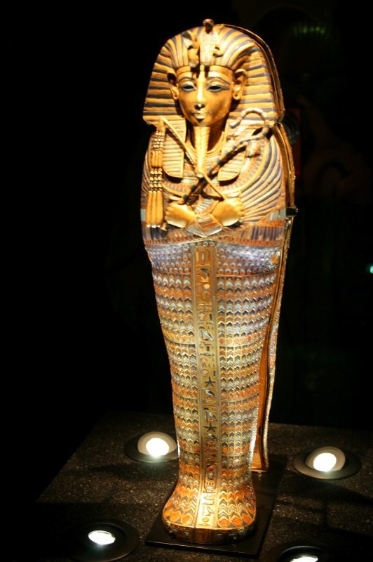
Tutankhamun
5/6M Art Lesson

Slide 2
Hi, 5/6M. We were meant to be beginning our Tutankhamun embossed foil portraits today but don't worry, we will still do them! It might be a bit hard for you to do at home so I think it would be good for you to familiarise yourself with Tutankhamun and have a go at drawing his death mask. Follow the link below and then have a go at sketching the death mask (next slide) in preparation for our foil embossing art lesson when you return.
Tutankhamun Information

Slide 3
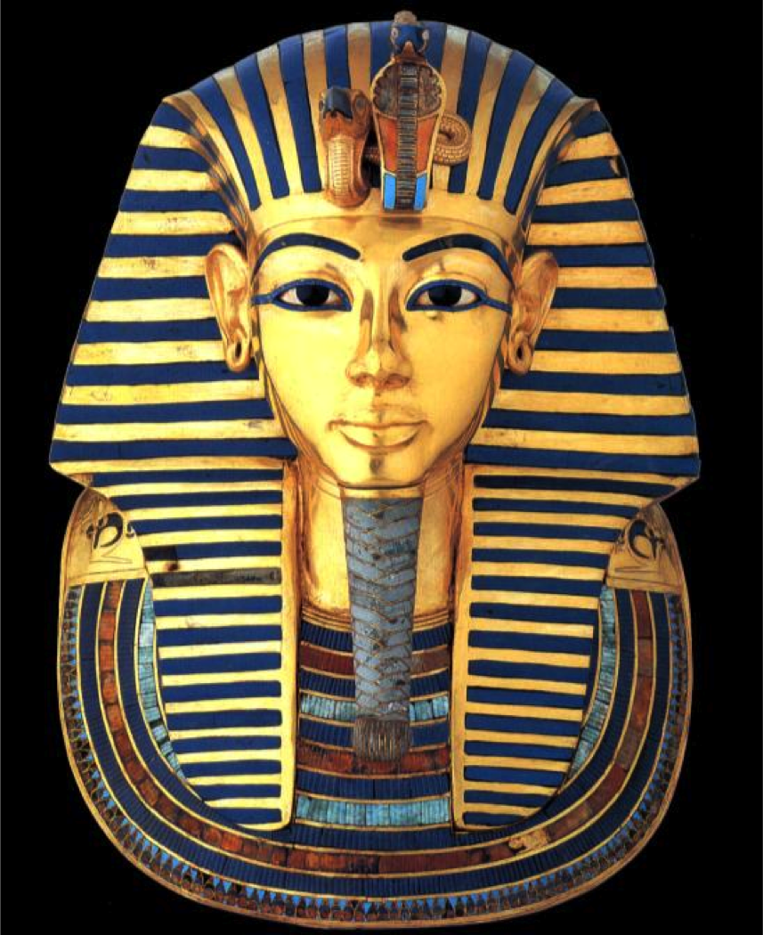
Tips
Mark out roughly how big you
would like your sketch to be by
drawing a little line for the top,
bottom and sides of your sketch
Try to sketch the outline first
Sketch it very lightly until you
are happy with the shape
Once you have drawn your
detail you can add colour if you
wish
You could use any media you
like (colouring pencils, felt tips,
paint, crayons, pastels)
Most importantly HAVE FUN
and please feel free to send any
photos through to me at
harriet.heald@bramhopeprimaryschool.co.uk
Have a look at some photos of
Tutankhamun art on the next slide
for inspiration.
Mrs Heald ☺

Slide 4


