Slide 1
English Autumn 2
Week 1 Day 1

Slide 2
Remote learning day 1
Expectations
English lesson with input
Independent English work
Break
Maths (factors, separate for years 5&6.)
Art
Feedback and extra support from the morning lessons

Slide 3


Slide 4
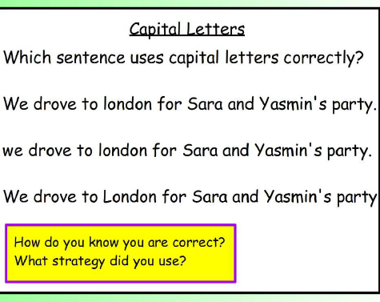
SPaG warm up
Write a sentence of your own which must contain five capital letters.

Slide 5
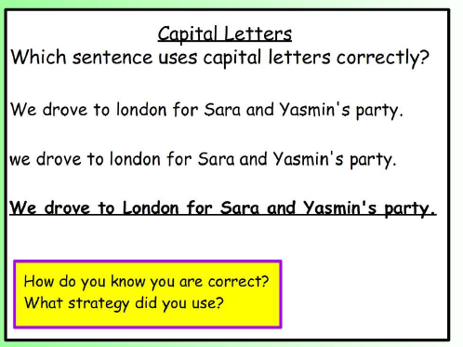
SPaG warm up

Slide 6
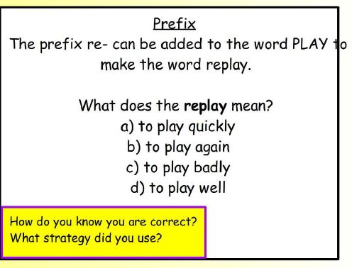
SPaG warm up
Write a sentence of your own using the word replay.

Slide 7
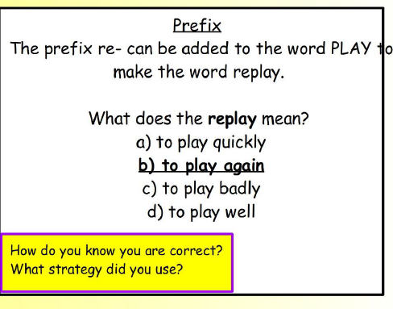
SPaG warm up

Slide 8
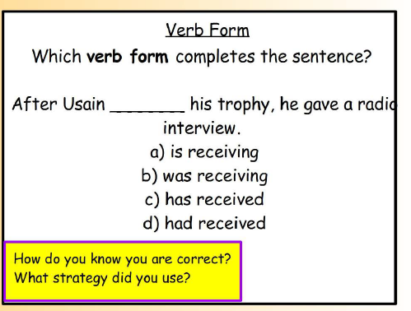
SPaG warm up
Write a sentence of your own using the word received.

Slide 9
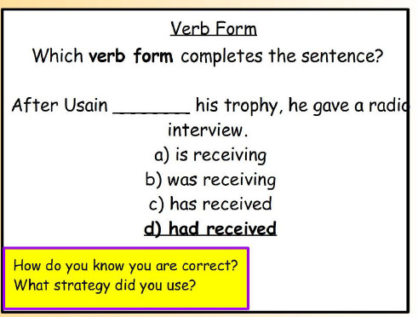
SPaG warm up

Slide 10
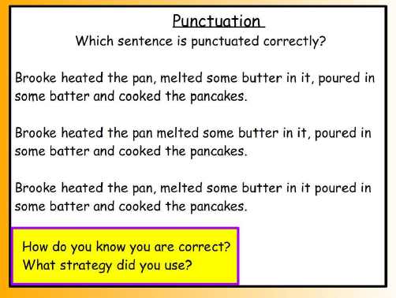
SPaG warm up
Write a sentence of your own using commas in a list.

Slide 11
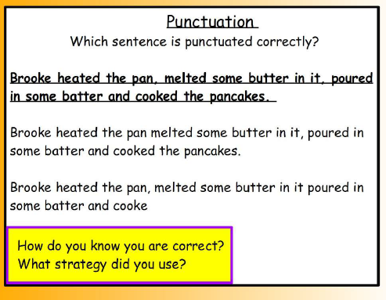
SPaG warm up

Slide 12
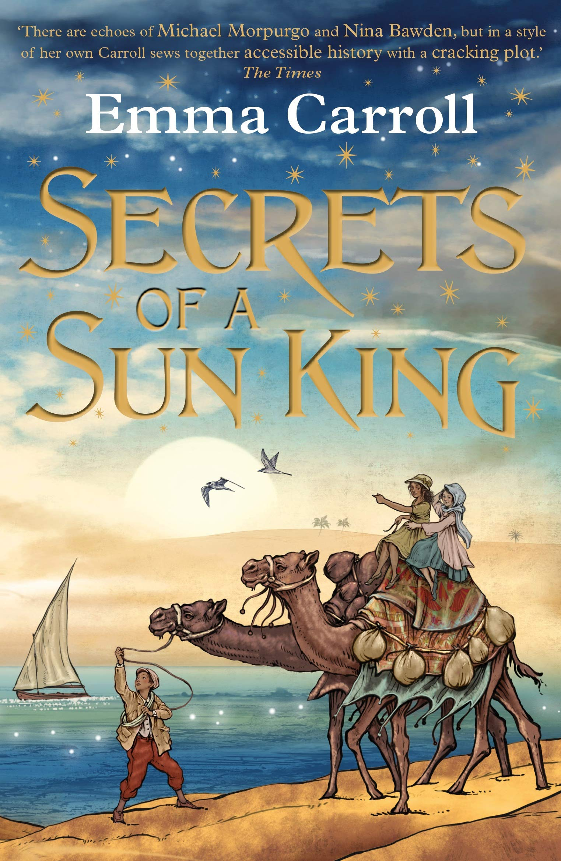
Our text for this half term is:

Slide 13
What do you think
the book is about?
What are the clues?

Slide 14
Why do you think Emma Carroll
chooses to start the blurb with:
London, 1922
A discovery from Ancient Egypt.....
A cursed package......
The untold story of a young pharaoh.....
What sort of story is it going to be?
What makes you think that?

Slide 15
Read Chapter 1 and answer the RIC (retrieval, interpret and choice) questions.
Retrieval
When and where is the story set?
What job does dad do?
Whose feet were discovered?
Why is mum not taken with Howard Carter?
What is Grandad’s cat called?

Slide 16
Read Chapter 1 and answer the RIC (rerieval, interpret and choice) questions.
Interpret
Find evidence that the family don’t have much money.
How has the war affected London?
Does Lilian enjoy school? How do you know?

Slide 17
Read Chapter 1 and answer the RIC (retrieval, interpret and choice) questions.
Choice
Explain the proverb ‘the nut doesn’t reveal the
tree it contains’.

Slide 18
Vocabulary
Use a dictionary to write a definition of the
following words:
archaeologist
spontaneous
civil
rarities
antiquities

Slide 19
L.C. Can I gather historical evidence?
Writer’s toolkit

Slide 20
Collect evidence that the story is set in 1922.
Read through Chapter One again. If you can, highlight clues that it is set in 1922.
Record your ideas in a mind map.

Slide 21
Collect evidence that the story is going to link to Ancient Egypt.
Read through Chapter One again. If you can, highlight clues that it is going to link to Ancient Egypt.
Record your ideas in a mind map.

