Slide 1
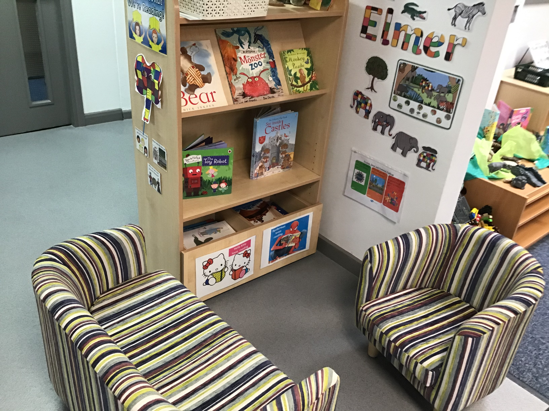
Bramhope Primary School
Home Reading

Slide 2
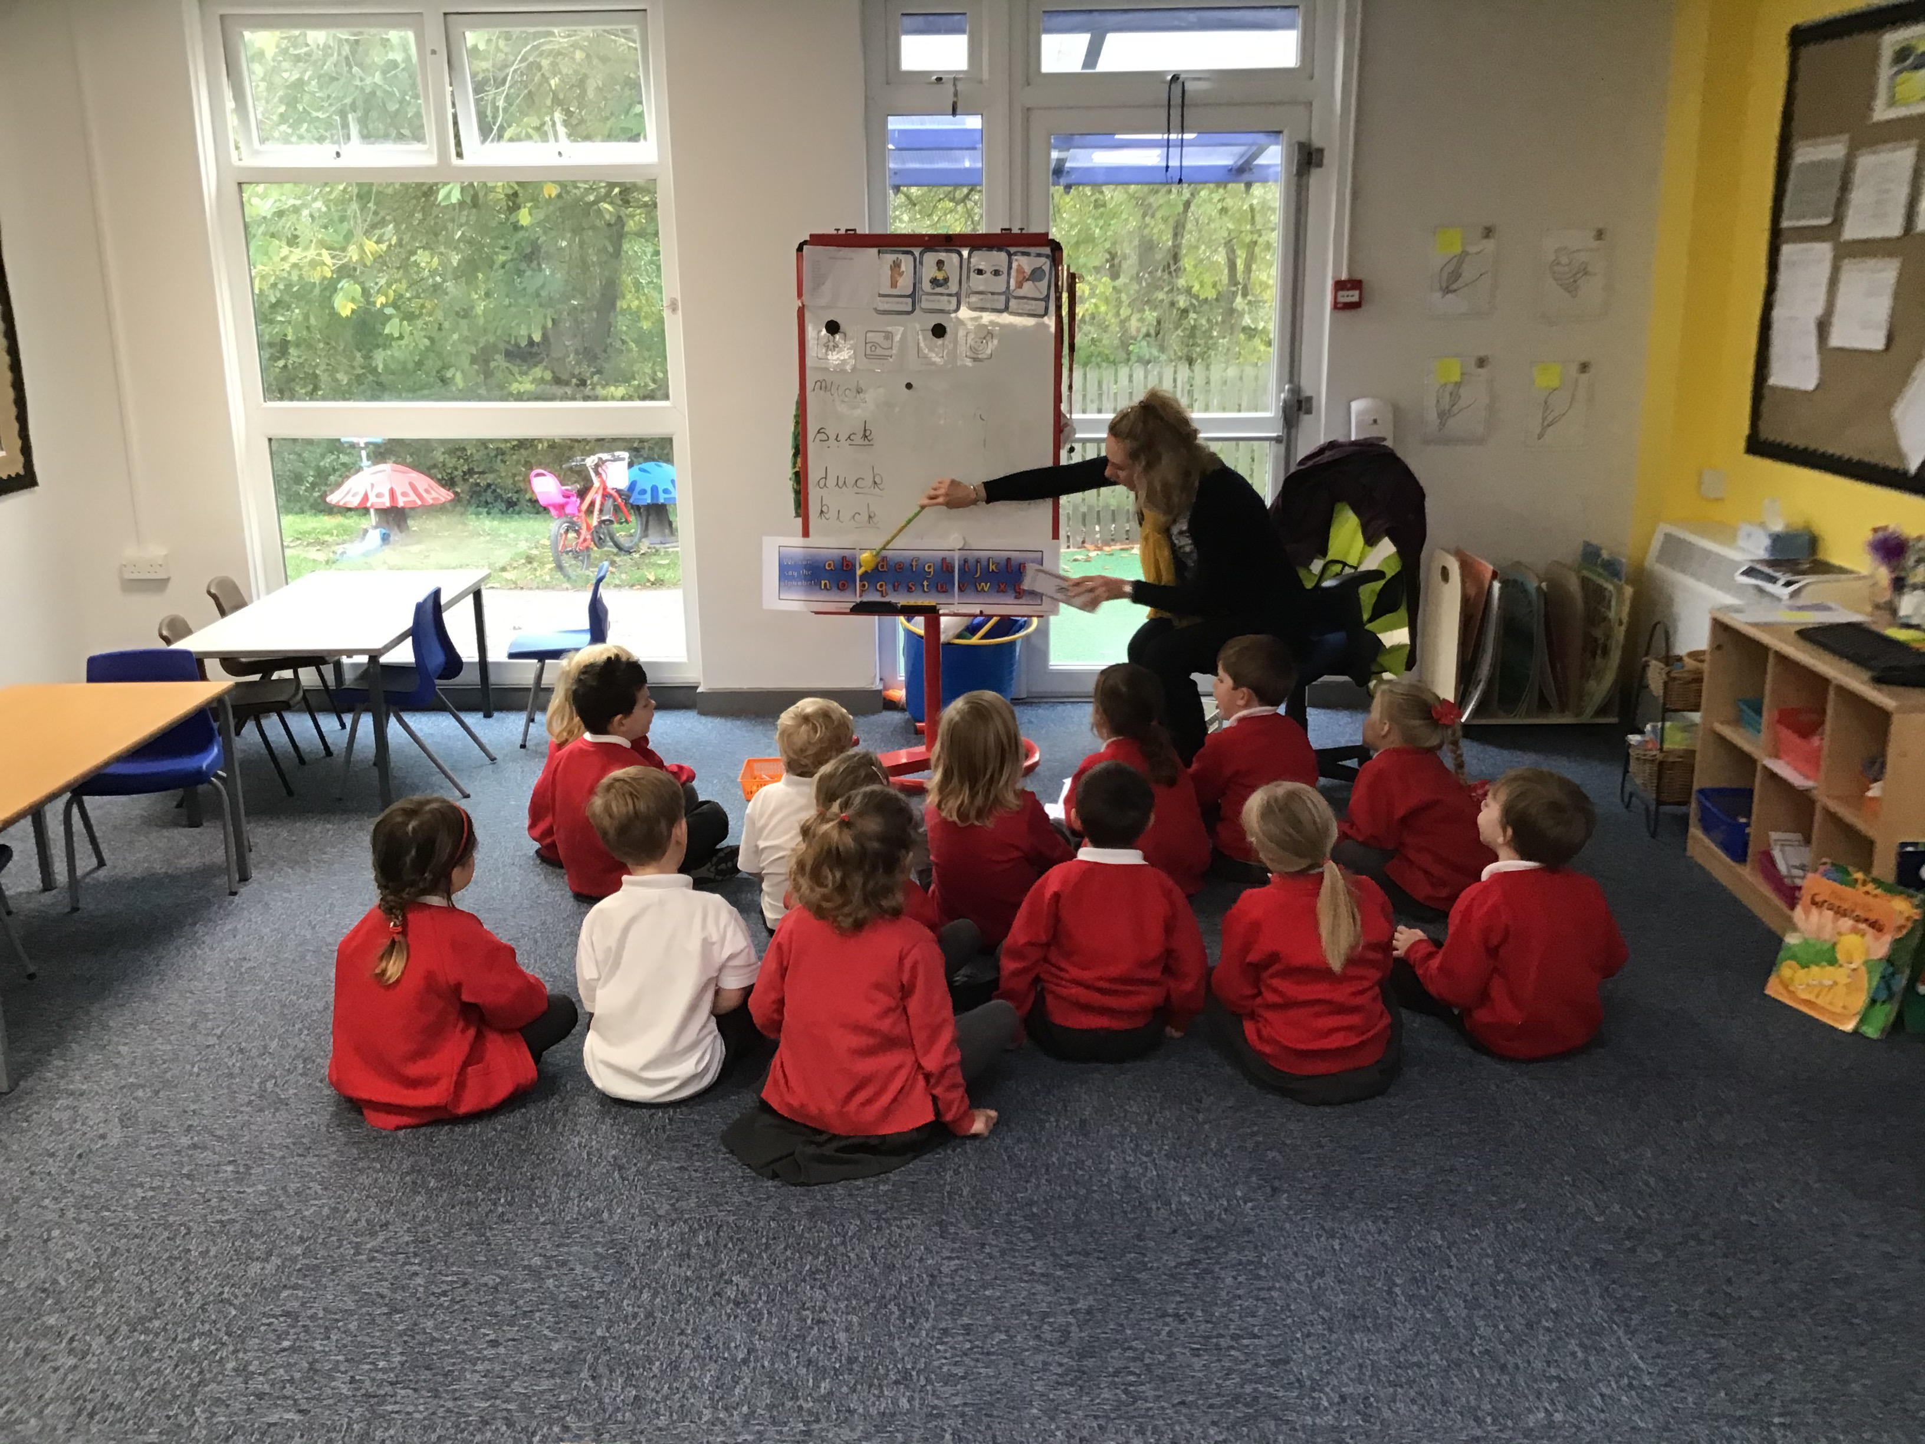
At Bramhope Primary School we teach children to read through daily focused teaching of phonics. Our teaching of phonics follows the Department of Education’s programme ‘Letters and Sounds’. Reading is also taught through a number of other activities including 1:1 and group reading sessions. There are also plenty of opportunities to share and enjoy books and stories.

Slide 3
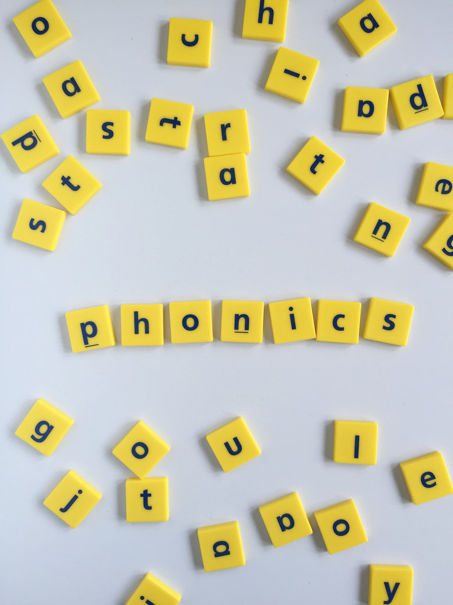
To support this, we have a home reading scheme which corresponds to our teaching of phonics. The books in our school reading scheme are organised into phonic phases and sets from phase 1 up to phase 5 set 27. These correspond with ‘Letters and Sounds’ guidance.

Slide 4
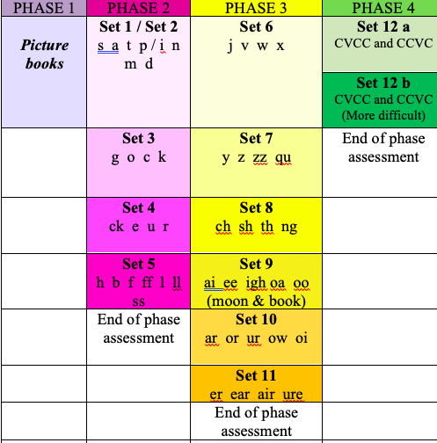
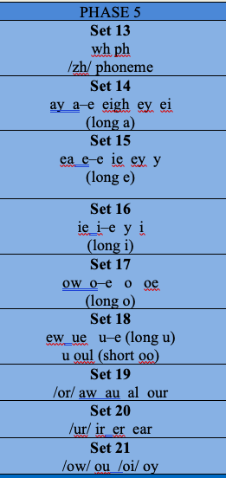
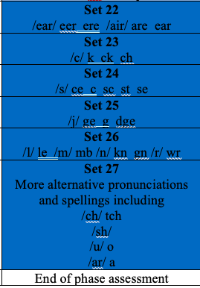
Set 27 Alternative pronunciation of graphemes also included o hot, cold ea bread ou shoulder, could,u but, put (south) a hat, what

Slide 5
Which set book will my child get? How do the sets work?
Your child will be given a book which closely matches their current level of learning. The book will contain sounds/ phonemes that your child has learnt. The books will provide them with an opportunity to practise blending these sounds together to read words (c-a-t cat) and they will help your child to develop fluency and comprehension skills. From phase 1 to phase 4 the sets are progressive. For example, set 3 books will contain all the set 3 phonemes/ sounds (g o c k) and all the sounds from set 1 and 2 as well. Teaching staff will use their professional judgement to decide once a child has mastered a particular set and is ready to move on to a more challenging set of books. A confident reader would not have to read every book in every set. However, a less confident reader may need to work through the sets systematically to give them more opportunity to develop fluency.

Slide 6
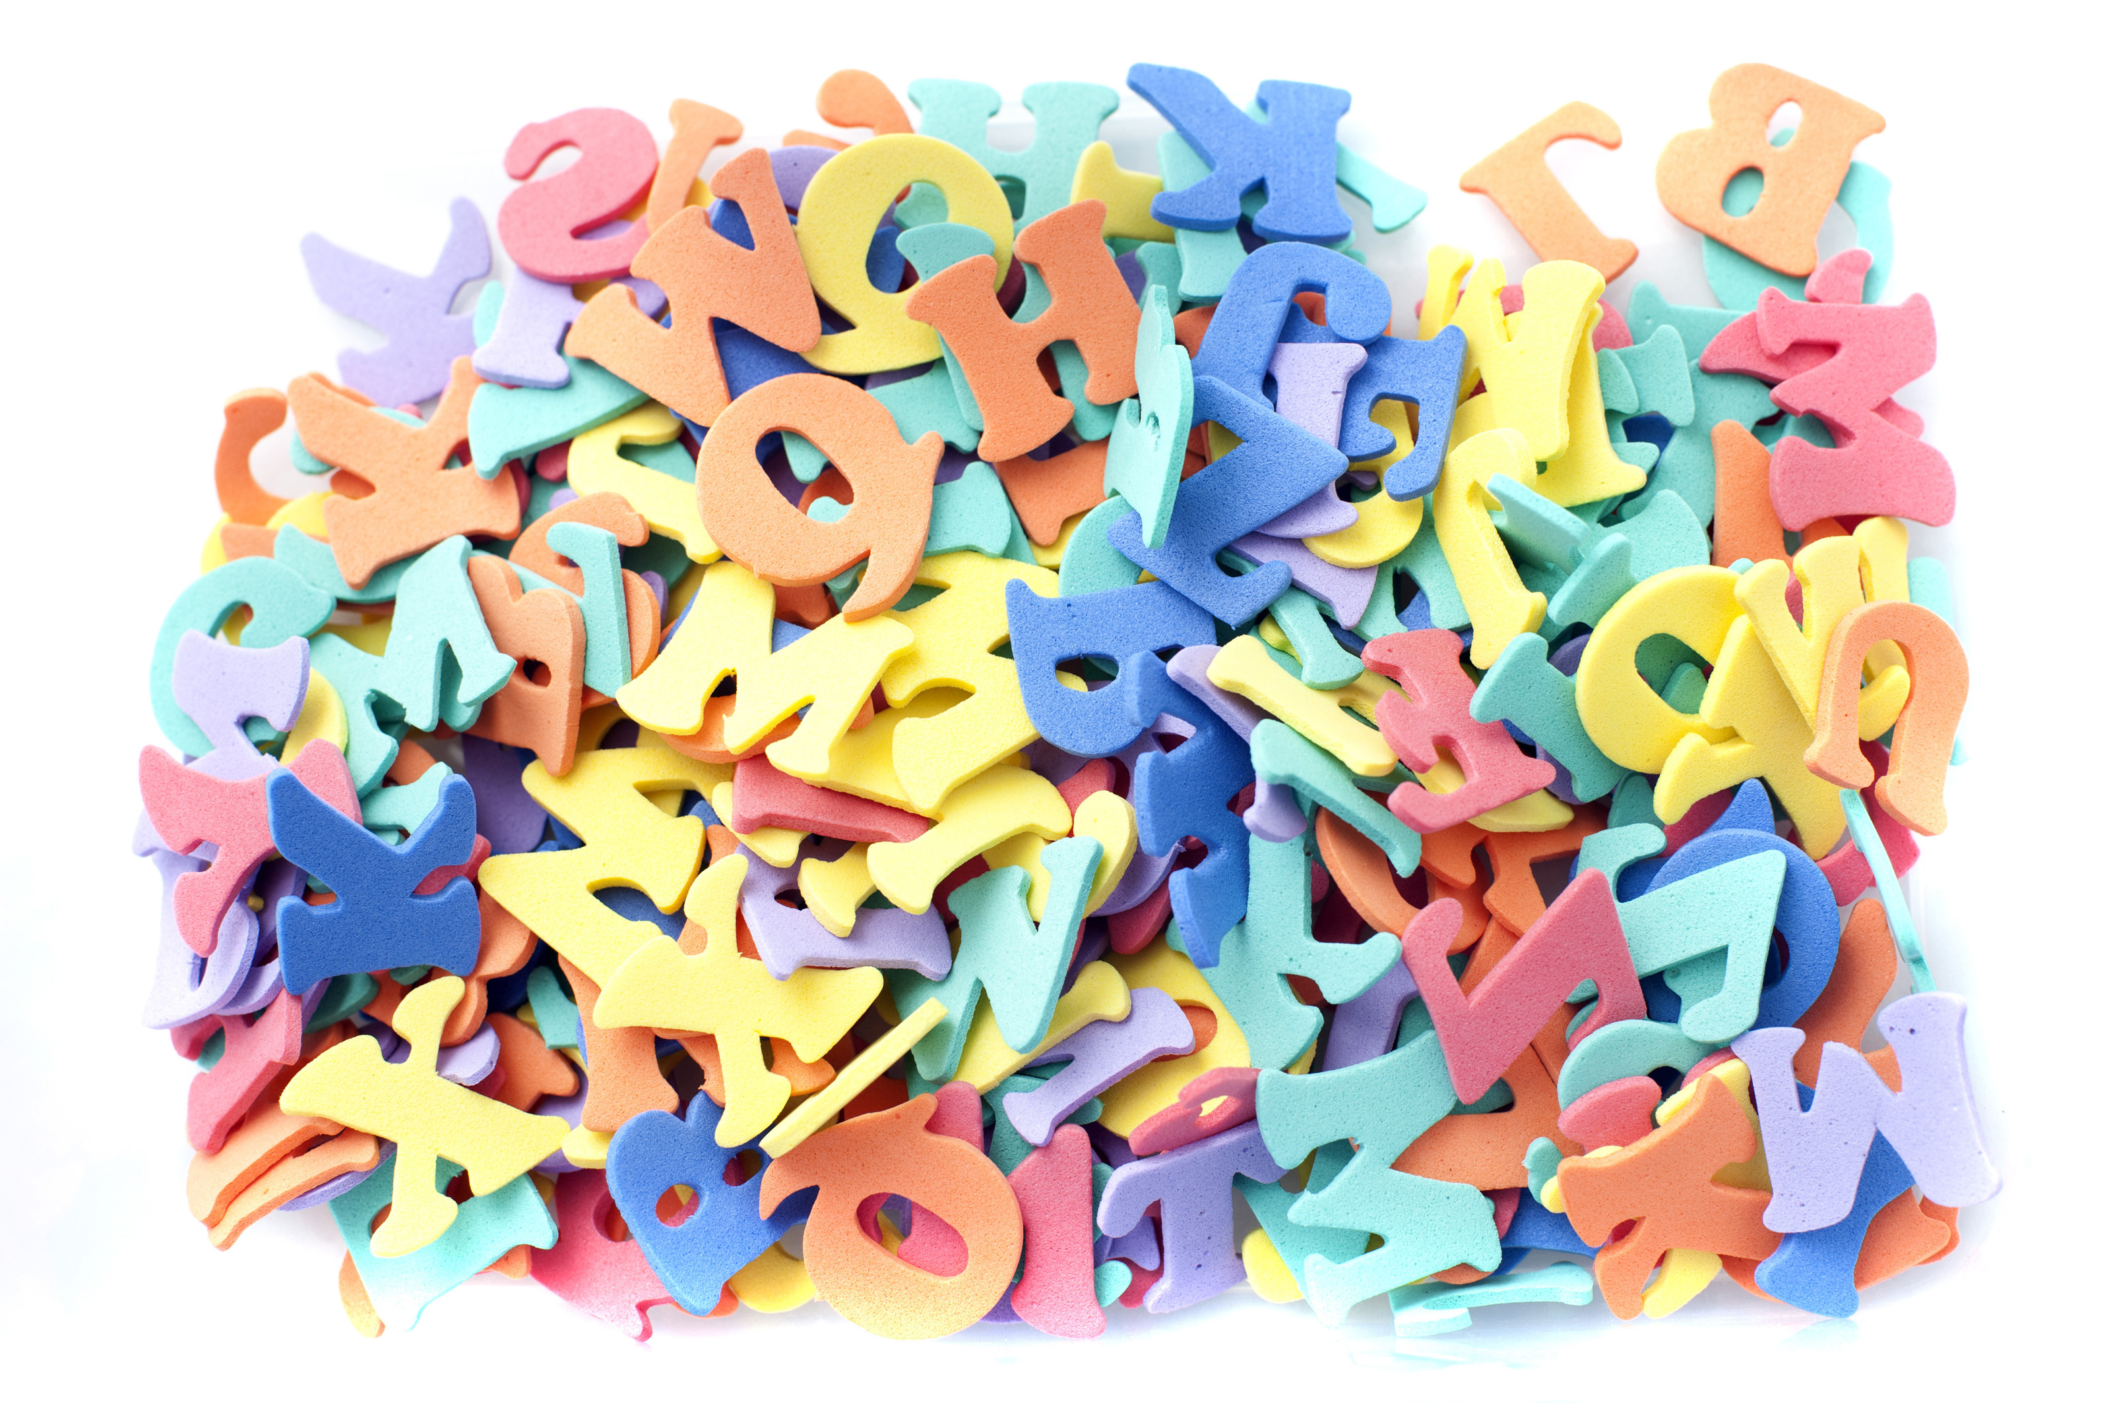
Children who are working on set 12 a and b are working at phase 4. In this phase no new sounds are taught. Children spend this phase consolidating their knowledge of earlier sounds and practise blending together sounds to read longer words including, for example, CVCC words (consonant , vowel, consonant, consonant e.g. belt).

Slide 7
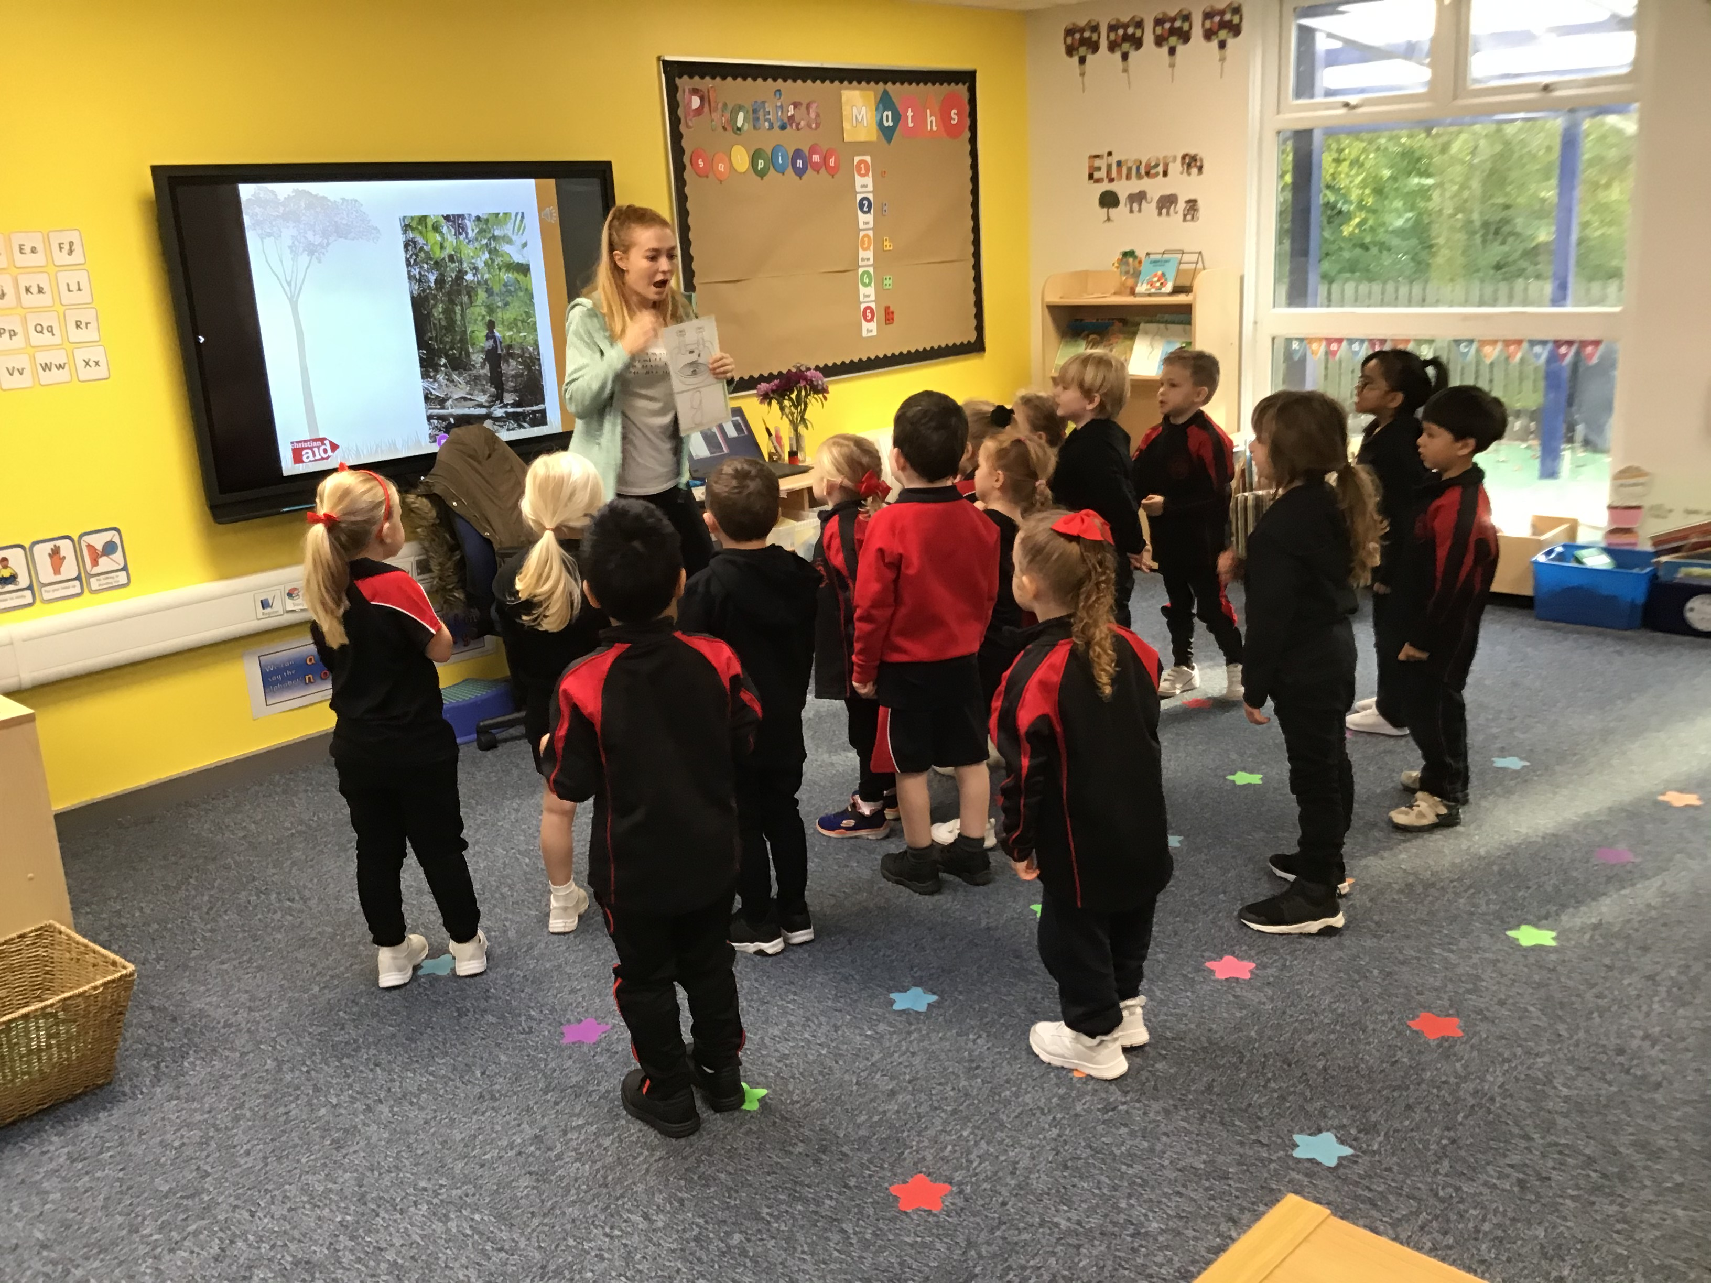
When a child reaches Phase 5, they will initially be taught new letters/ graphemes for reading and alternative pronunciations of graphemes in sets 13 – 21. Once these are embedded, the child will then be able to access sets 13– 21. At this point the scheme is not progressive and the sets can be used in any order (the reader must, however, know the phonemes/sounds and graphemes/letters in the set). They will then move onto sets 22 – 27 which contain further alternative spellings and pronunciations of letters/ graphemes and sounds/phonemes. Again these can be read in any order.

Slide 8
Your support in your child’s learning is invaluable. Please read with your child daily and add comments to your child’s reading journal to updates us with their progress.
Books are given out on Mondays. Please return them on Thursdays. Books are then quarantined for 72 hours before being given to another child.

Slide 9
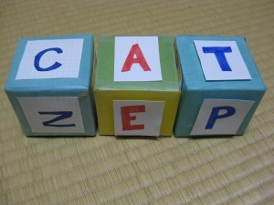
How do I help my child to read at home?
When should I read with my child?
Try to read with your child daily at a time when your child is relaxed and not too tired. Find a time that works for your family and your routines. This could be the morning before school or just before bed.
My child doesn’t like reading. What can I do?
Try these strategies to help:
Ask your child to read to a teddy or help a doll to read.
Ask the child to be the teacher and ‘teach’ you to read.
Make the activity special – read in a cosy area of the house and perhaps give your child a warm drink to enjoy afterwards.

Slide 10
Watch our video on home reading
Click on the below link to see a video of Mrs Lillitos (Bramhope’s Primary Mastery Tead Teacher – English) providing ideas.
5 Tips for reading with your child

