Slide 1
English Y5 and Y6
13.7.20

Slide 2
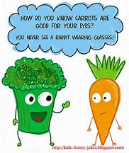
L.C. Can I write my own jokes?

Slide 3
I say, I say, I say.................
How do all the oceans say hello to each other?
What did one wall say to the other wall?
What do you call a bear with no teeth?
What do you get when you cross a snowman and a vampire?
What do elves learn in school?
Why are seagulls called seagulls?

Slide 4
I say, I say, I say.................
How do all the oceans say hello to each other? They wave!
What did one wall say to the other wall? I’ll meet you at the corner!
What do you call a bear with no teeth? A gummy bear!
What do you get when you cross a snowman and a vampire? Frostbite!
What do elves learn in school? The elf-abet.
Why are seagulls called seagulls? Because if they flew over the bay, they’d be bagels!

Slide 5
Why did the girl smear peanut butter on the road?
What do you call a fake noodle?
Why couldn’t the pony sing himself a lullaby?
What’s a pirate’s favourite letter?
What musical instrument is found in the bathroom?

Slide 6
Why did the girl smear peanut butter on the road? To go with the traffic jam!
What do you call a fake noodle? An impasta!
Why couldn’t the pony sing himself a lullaby? He was a little hoarse.
What’s a pirate’s favourite letter? Rrrrrrr!
What musical instrument is found in the bathroom? A tuba toothpaste.

Slide 7
I say, I say, I say.................
Why are fish so smart?
What did 0 say to 8?
Why do bananas have to put on sunscreen before they go to the beach?
What do you call a cow on a trampoline?
Where do cows go for entertainment?

Slide 8
I say, I say, I say.................
Why are fish so smart? Because they live in schools!
What did 0 say to 8? Nice belt!
Why do bananas have to put on sunscreen before they go to the beach? Because they might peel!
What do you call a cow on a trampoline? A milk shake!
Where do cows go for entertainment? To the moo-vies!

Slide 9
I say, I say, I say.................
What do you call a pig that knows karate?
Why are ghosts bad liars?
Why do bees have sticky hair?
What do you call an alligator in a vest?
Why did the man run around his bed?
What do you call a dinosaur that is sleeping?

Slide 10
I say, I say, I say.................
What do you call a pig that knows karate? A pork chop!
Why are ghosts bad liars? Because you can see right through them!
Why do bees have sticky hair? Because they use honey combs!
What do you call an alligator in a vest? An investigator!
Why did the man run around his bed? Because he was trying to catch up on his sleep!
What do you call a dinosaur that is sleeping? A dino-snore!

Slide 11
I say, I say, I say.................
What do you call a pig that knows karate? A pork chop!
Why are ghosts bad liars? Because you can see right through them!
Why do bees have sticky hair? Because they use honey combs!
What do you call an alligator in a vest? An investigator!
Why did the man run around his bed? Because he was trying to catch up on his sleep!
What do you call a dinosaur that is sleeping? A dino-snore!

Slide 12
I say, I say, I say.................
How can you tell a vampire has a cold
What’s worse than finding a worm in your apple?
What do you call a boomerang that won’t come back?
Did you hear about the new restaurant on the moon?
How do you make an octopus laugh?

Slide 13
I say, I say, I say.................
How can you tell a vampire has a cold? They start coffin.
What’s worse than finding a worm in your apple? Finding half a worm.
What do you call a boomerang that won’t come back? A stick.
Did you hear about the new restaurant on the moon? The food was good, but there really wasn’t much atmosphere.
How do you make an octopus laugh? With ten-tickles!

Slide 14
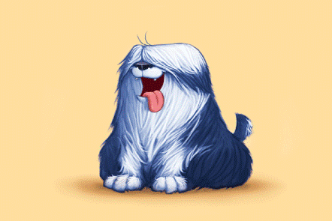
Shaggy Dog Stories
“Come on, Anna,” said her mum. “Hurry up and finish your
breakfast or you’ll be late for school.”
“I don’t want to go to school,” said Anna.
“But you must,” said her mum.
“The teachers all hate me, and I hate them,” moaned Anna.
“Even so…” said her mum.
“The children, too,” said Anna. “None of them like me, and I
don’t like them, either.”
“You still have to go,” said her mum.
“But why must I?” she wailed.
“Well,” replied her mum, “for one thing, you’re fifty-five years
old, and for another, you’re the headteacher…”

Slide 15
Shaggy Dog Stories
A man walks into a library, approaches the
librarian and says, “I’ll have a cheeseburger and
fries, please.”
The librarian says, “Sir, you know you’re in a
library, right?”
“Sorry,” he whispers. “I’ll have a cheeseburger
and fries, please.”

Slide 16
Shaggy Dog Stories
A man was driving down the road when a police-officer
stopped him. The officer looked in the back of the man’s van
and said, “Why are these penguins in your van?”
The man replied, “These are my penguins. They belong to
me.”
“You need to take them to the zoo,” the police-officer said.
The next day, the officer saw the same guy driving down the road and
pulled him over again. The penguins were still in the back, but they
were wearing sunglasses this time. “I thought I told you to take these
penguins to the zoo!” the officer said.
“I did,” the man replied. “And today I’m taking them to the beach."

Slide 17
Shaggy Dog Stories
One day a woman with an elephant walks into a cinema.
“I’m afraid I can’t let your elephant in here, madam,” the
manager says.
“Oh, I assure you, he’s very well behaved,” the woman
says.
“All right then,” the manager says. “If you’re sure. …”
After the movie, the manager says to the woman, “I’m
very surprised! Your elephant was well behaved, and he
even seemed to enjoy the movie!”
“Yes, I was surprised, too,” says the woman. “He hated
the book.”

Slide 18
How to Tell Shaggy Dog Stories
The important things about a shaggy dog story is
that you embellish as you tell it.
What does this mean…?
To embellish is to elaborate, to add detail, to
make it more descriptive and less plainly told.
Here are two versions of a Shaggy Dog story:
Rabbit’s and Fox’s.
Read them carefully. Then say which you like best.

Slide 19
Rabbit’s version
A really tall man turned into a small back street one day. He went up to
the door of the first house on the road. He leant forward and used his
head to ring the house’s doorbell. When the owner opened the door,
the tall man politely bowed. Without saying anything, he turned and
walked quickly on to the next house. Again, he used his face to press
the buzzer. Once again, when the owner answered the door, he bowed
most courteously, turned and went on. This happened all the way
down the street, from No 1 to No 33, with the tall man pressing his
head on the doorbell of each and every house, then bowing politely
and moving on. People on the street were rather startled. Some were
annoyed, but they all watched him in great puzzlement. “Who on earth is that
man?” asked one old lady. “I’m not quite sure,” replied her friendly neighbour,
“but his face rings a bell.”

Slide 20
Fox’s version
One day, a man went down a street. He went up to the first
house front door. He leant forward and used his head to ring
the house’s doorbell. When the owner opened the door, the
man bowed and then walked on to the next house. Again, he
used his face to press the buzzer and bowed when the owner
answered the door. This happened all the way down the
street, at each house, with the man pressing his head on the
doorbell at every house in turn.
“Who is that man?” asked a house owner. “I’m not quite
sure,” replied his neighbour, “but his face rings a bell.”

Slide 21
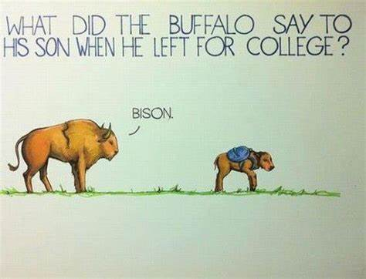
It makes a much better joke if you add
descriptions and information as you go.
And you delay the punch line – which makes it
all the funnier!

Slide 22
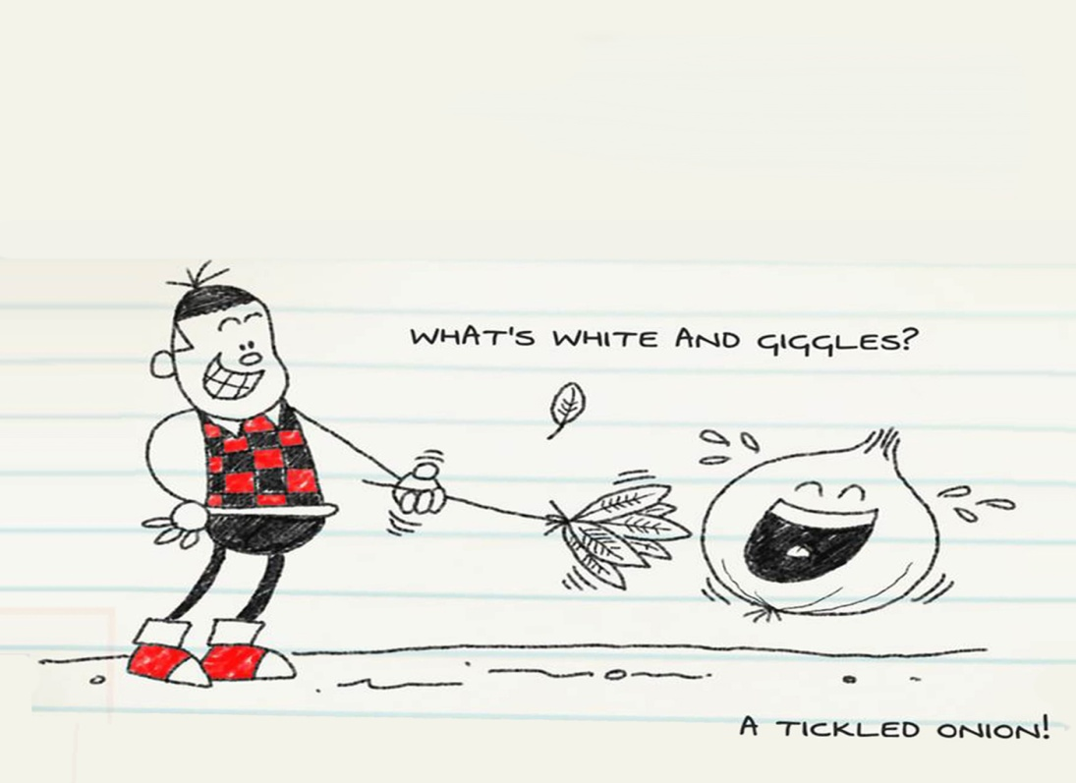
Watch this video about writing jokes.
https://www.bbc.co.uk/programmes/p04v9hkx

Slide 23
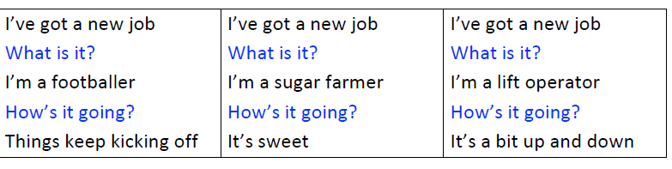
Read “I’ve got a new job.” Choose the best punch lines for the jokes.

Slide 24
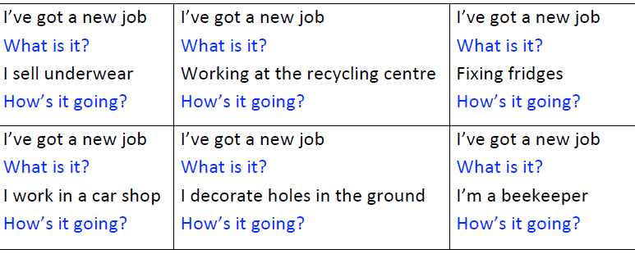
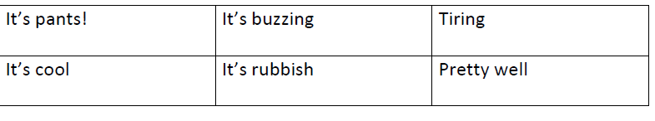
Possible Punchlines

Slide 25
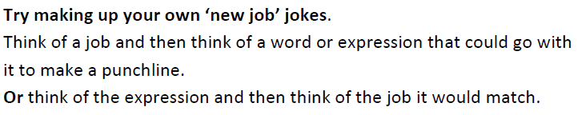
Try to write your ‘I’ve got a new job’ jokes.

Slide 26
Writing jokes
Watch these top five tips about writing jokes:
https://www.bbc.co.uk/programmes/p04v9hmz
Try following these tips and writing some of your
own jokes.

Slide 27
Make a joke book
Collect your favourite jokes from One Liners and
Shaggy Dog Stories and the jokes that you have
written yourself.
Add any other favourite jokes that you have.
Make a book to write your jokes in.
Add comic illustrations too.

Slide 28
L.C. Can I write an escape plan?

Slide 29
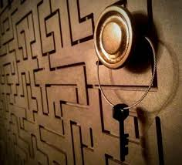
Escape Puzzles
Read Escape Puzzles. Can you work
out solutions to any of them?
Have a go at a couple of them.
Check the solutions. Which do you think is
cleverest?
Learn your favourite off-by-heart and try it out
on other people.

Slide 30
Escape Puzzles
Two convicts are locked in a cell. There is an
unbarred window high up in the cell. No matter if
they stand on the bed or one on top of the other,
they can’t reach the window to escape. They then
decide to tunnel out. However, they give up with
the tunnelling because it will take too long. Finally,
one of the convicts figures out how to escape from
the cell. What is their plan?

Slide 31
Escape Puzzles
Their plan is to dig the tunnel and pile up the dirt to climb
up to the window to escape.
A woman is trapped in a room. In the room there is a
table, chair, two doors, and a small hole in the ceiling
thirty centimetres in diameter. Behind one of the doors is an
extremely hungry lion that hasn't eaten in a couple of days.
Behind the other door is a glass tunnel that magnifies the sun
creating temperatures so high that even opening the door
could kill you. How does she escape?

Slide 32
Escape Puzzles
She waits until it is night (she can tell through the hole in the ceiling) then leaves through the glass tunnel.
A man is trapped in a room by his enemies. He is given the chance to leave through one of three rooms. The first is full of raging fires, the second is full of assassins with loaded guns, and the third is full of lions that haven't eaten in 3 years. Which room is safest for him?

Slide 33
Escape Puzzles
The third room. Lions that haven't eaten in three years are dead.
There are two doors and there is one guard for each door. One door leads to life and the other leads to death. You only have one question to ask and you can

Slide 34
Escape Puzzles
You would ask: "If I were to ask the other guard which door leads to life, what would he say?" The guard that tells the truth knows that the other guard would lie. So he tells the truth and points to the door that leads to death. The guard that lies knows that the other guard would tell the truth. So he lies and points to the door that leads to death. Both guards point to the death door.
A man is inside a prison cell. The cell is completely empty except for the man and a table. There are no doors or windows to escape from. There is also a desert surrounding the prison. At the edge of the desert is a town. The man escapes and traverses the desert to reach the town without walking over the desert. How?

Slide 35
Escape Puzzles
The man hits his hand on the table until it is sore. He then uses the saw to chop the table into two halves. He puts the two halves together to make a whole. He jumps through the hole and lands in the desert. He shouts and shouts until his voice is hoarse. He jumps onto the horse and rides to the town. Before he gets to the town, he comes across a river. He then remembers that the banks close at 5pm. So he waits until 5pm and crosses the river into town.

Slide 36
Escapes
Watch Anthony Horowitz talking about the top five
escapes for Alex Rider (the character he writes
about).
https://www.youtube.com/watch?v=ZiGlRtbXKiI
Read the Alex Rider extract. Underline all the
challenges that Alex faces as he tries to escape the
prison.

Slide 37
Can you write how Alex escapes?
1. Alex is hidden in a broken-down car. It has been lifted into a car-crusher.
2. Alex is imprisoned a school in the mountains. There are no skis or snowboards. He cannot leave on foot.
3. Alex is fighting in zero-gravity.
4. Alex is in a sabotaged car that has sunk fifty metres into a frozen lake.
5. Alex is locked in a maximum-security prison in Gibraltar.

Slide 38

L.C. Can I complete a puzzle?

Slide 39
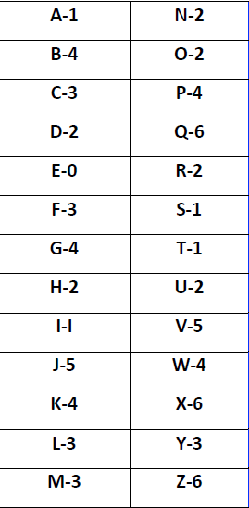
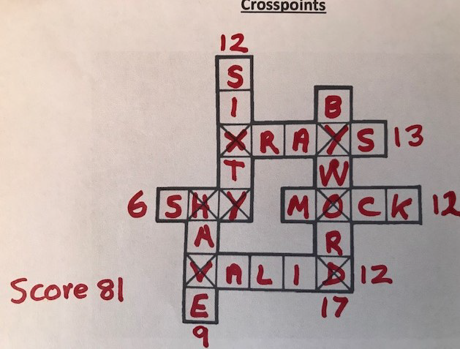
Complete a Crosspoints puzzle
Fill in this grid with words of your choice. You gain points for
certain letters. Different letters get different scores. A letter
which falls on a ‘cross’ square is counted twice. How high a score
can you get?

Slide 40

Complete a Crosspoints puzzle.

Slide 41
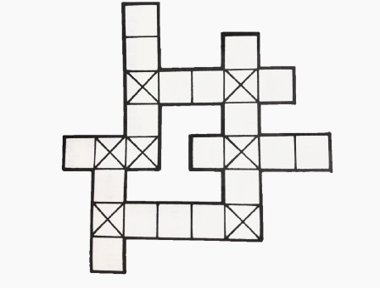

Complete a Crosspoints puzzle
Use the other Crosspoint Grids yourself to try to
beat your score OR challenge someone else to
play the game and see how they do.

Slide 42


Complete a Crosspoints puzzle.

Slide 43
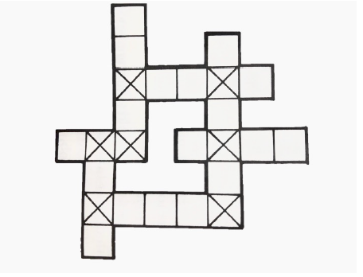

Complete a Crosspoints puzzle

Slide 44
Can you make your own Crosspoints challenge?

