Slide 1
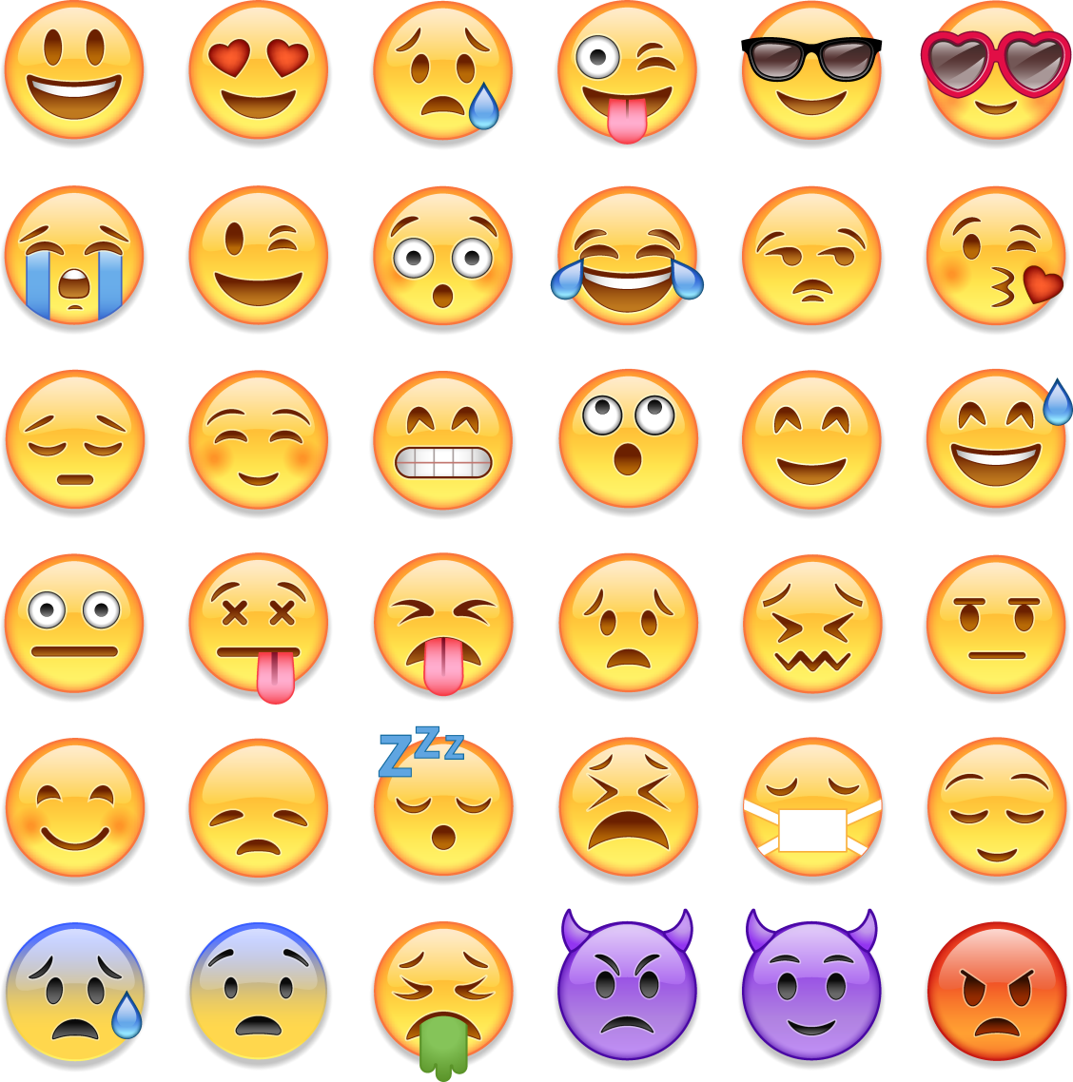
How does
money affect
my feelings?
Presentation

Slide 2


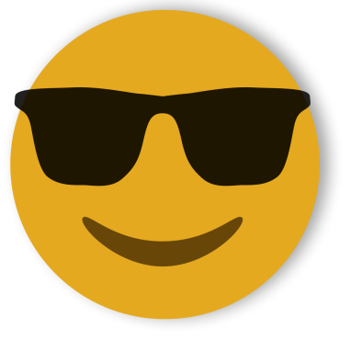
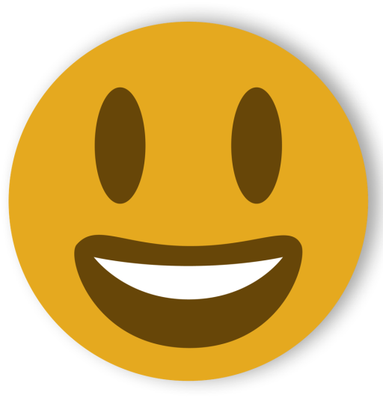


How can our choices about money affect the way we feel?

Slide 3


What is debt?
People are in debt when they borrow money from a person or organisation. They stay in debt until they pay back what they owe
People get into debt in lots of different ways, from borrowing money from a friend or family member, to using credit cards (which let you spend money and pay it back later), to taking out a loan or mortgage (a loan to buy a property) from a bank
Debt can be well managed, with the person in debt making sure they are able to pay it back, for example, by arranging to pay a small amount of the debt off each month until
it is all paid back
Debt becomes a
problem when it
becomes
‘unmanageable’
and the person
cannot afford to pay
back the money they owe

Slide 4
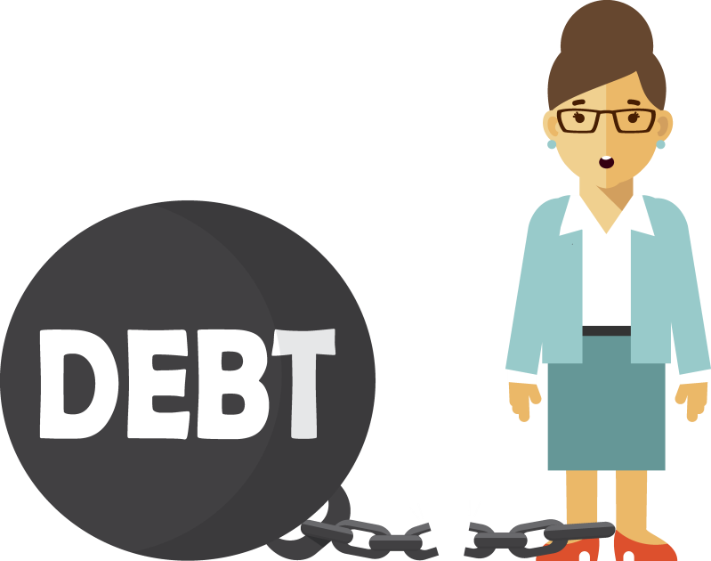
How can debt affect people?
Unmanageable debt usually has a negative effect on a person’s life, and can also affect their family and
loved ones
The creditors (people or companies the person owes money to) can put pressure on the person to pay back the debt, for example, by sending letters, phoning or by sending people from debt collection companies to visit the person’s home and demand the money
If the person can’t pay, the things they own can be taken away and sold to pay off the debt, and they may even lose their home
They may be declared bankrupt,
which would make
it very difficult
for them to
borrow money
for the following
six years

Slide 5
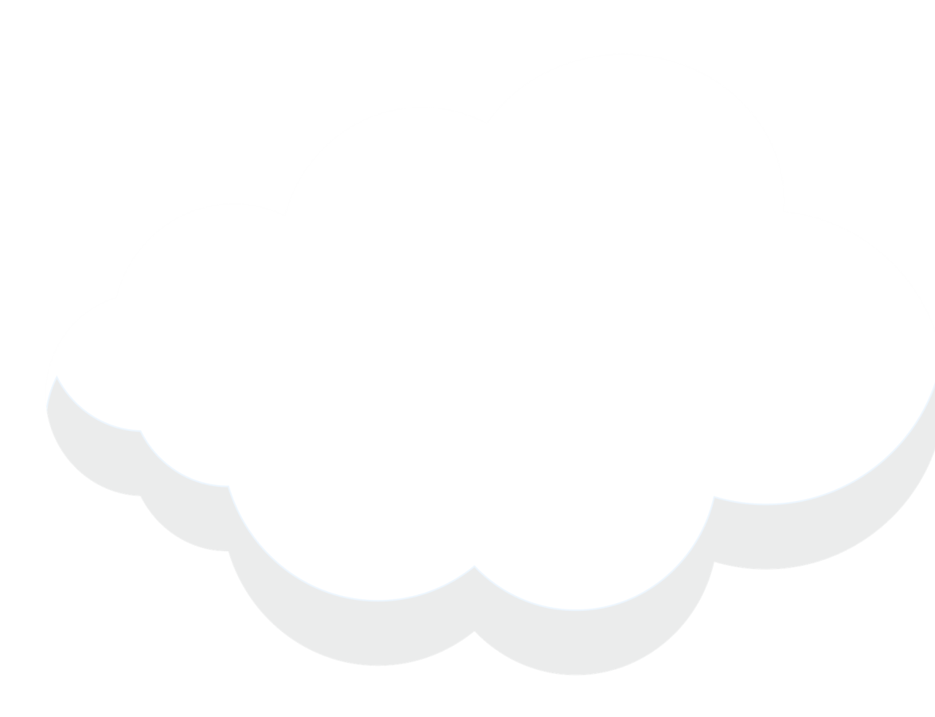



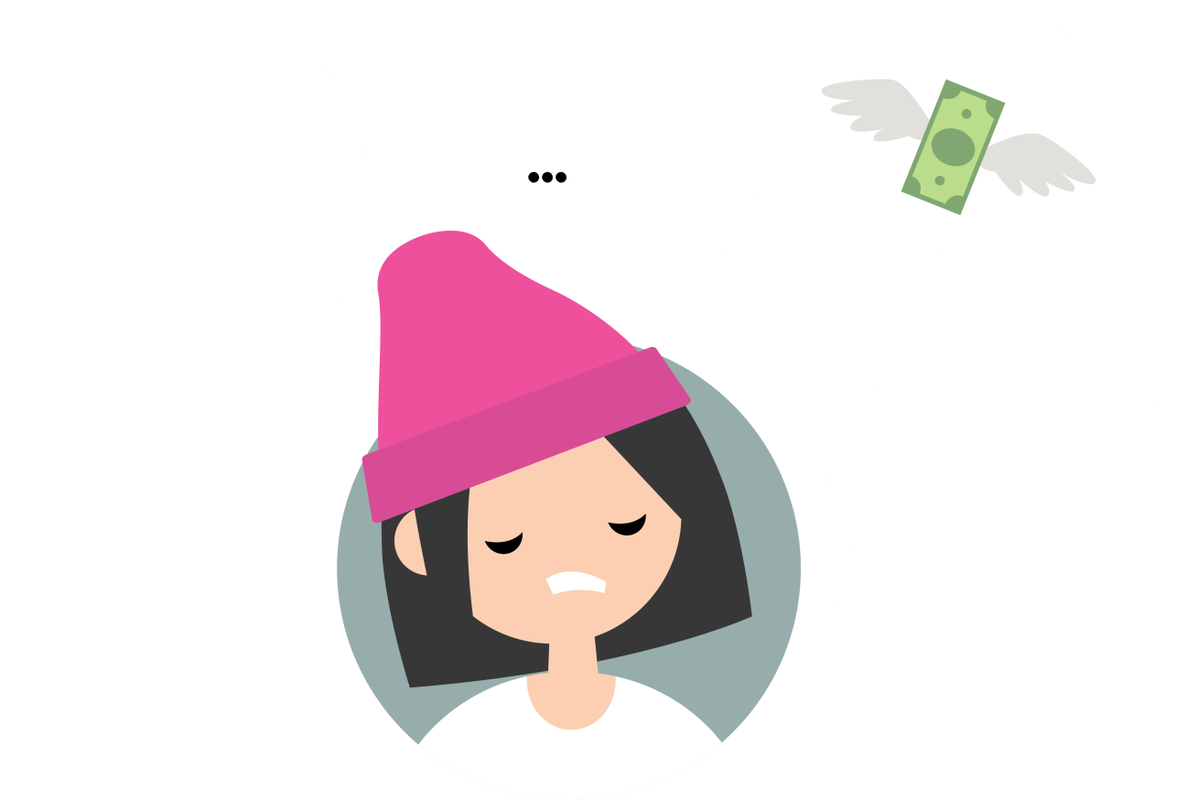

Debt can affect people’s emotional wellbeing
tiredness
unable to be positive
Poor emotional wellbeing might simply mean feeling sad or negative, but it can also affect people in lots of other ways…
getting into arguments
losing sleep
feeling unable to cope with life
loss of
appetite
expecting bad things to happen
avoiding friends
difficulty recovering from illness
unable to relax
hiding feelings
depression
loss of confidence
poor memory
difficulty enjoying
yourself
stress

Slide 6
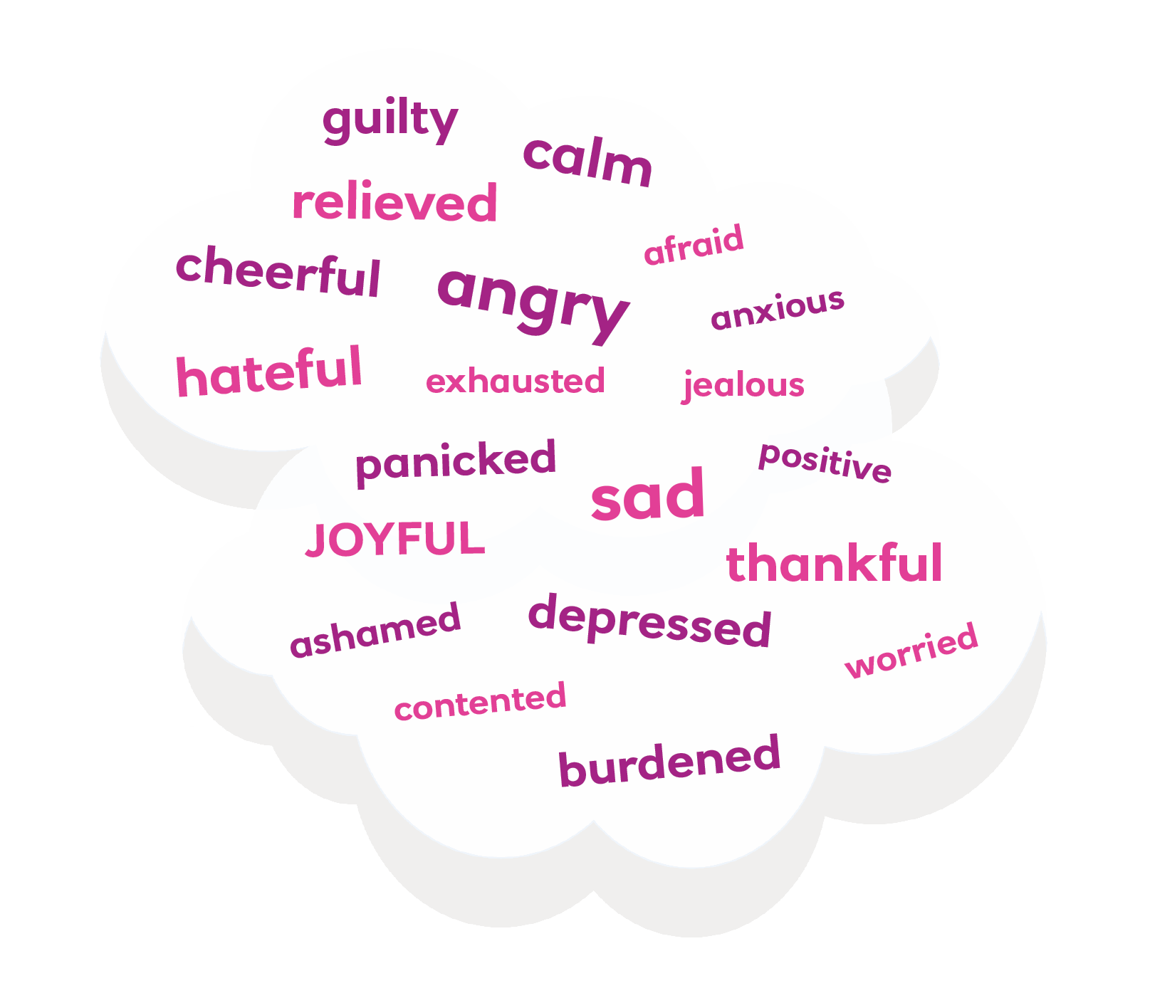
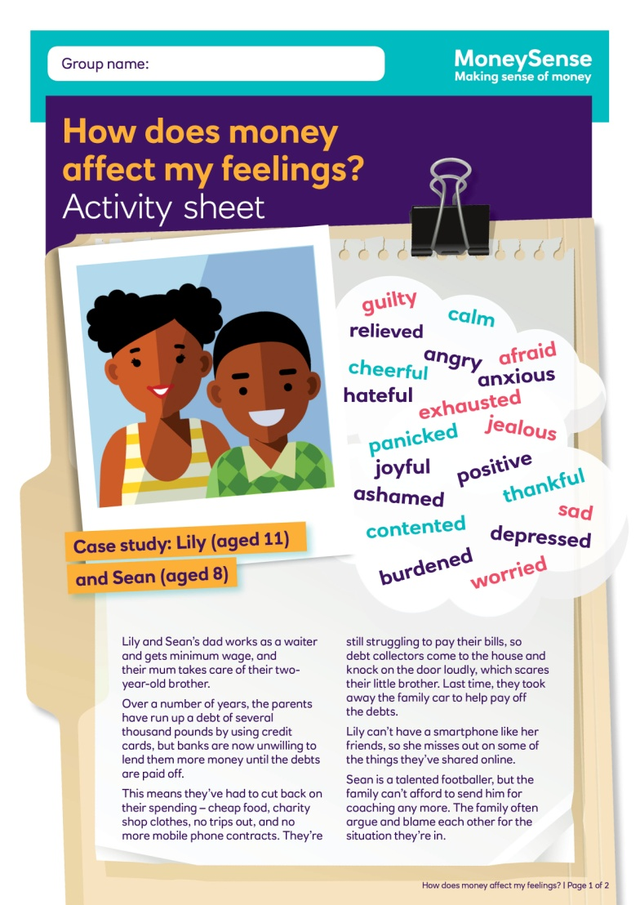
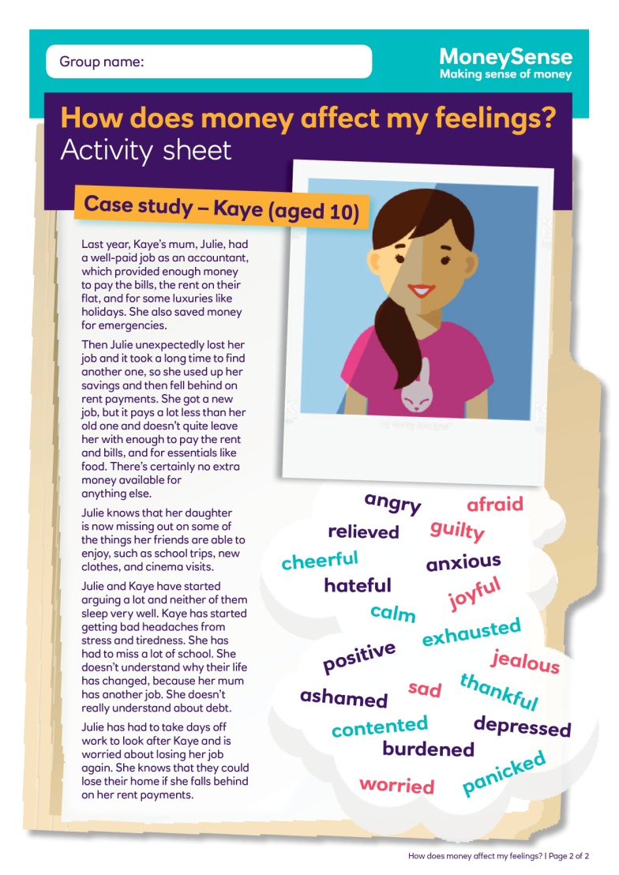
Case studies
Read the two case studies, which show examples of families experiencing debt
Consider how the different family members feel.
You can use the emotion words to help you talk about the characters’ feelings

Slide 7
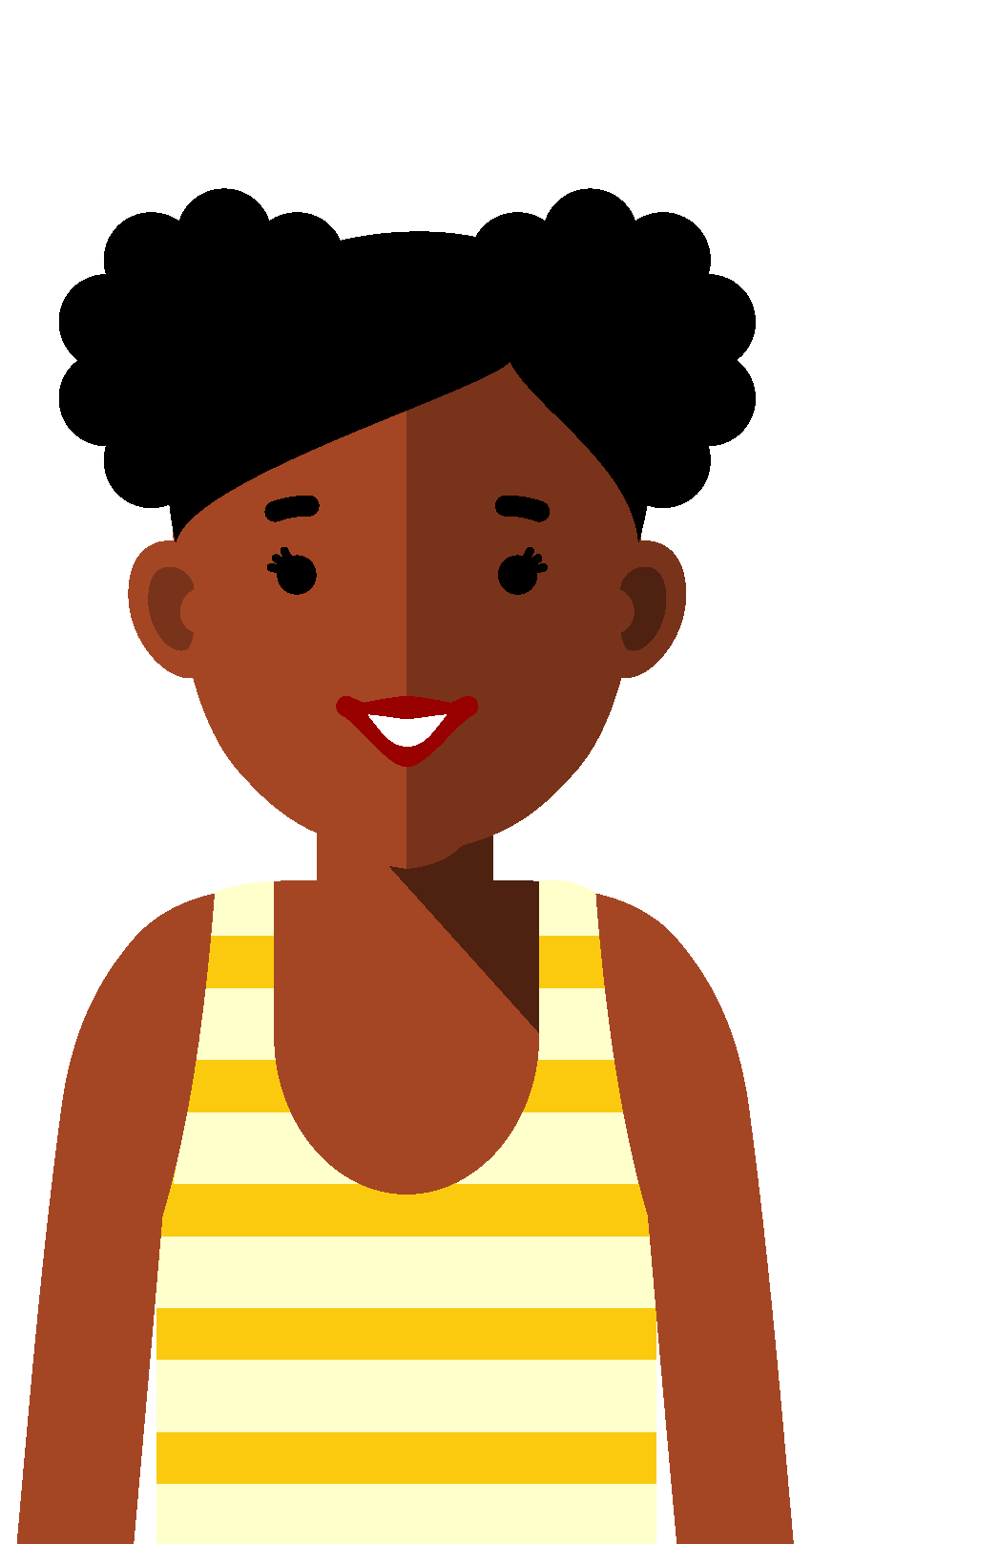
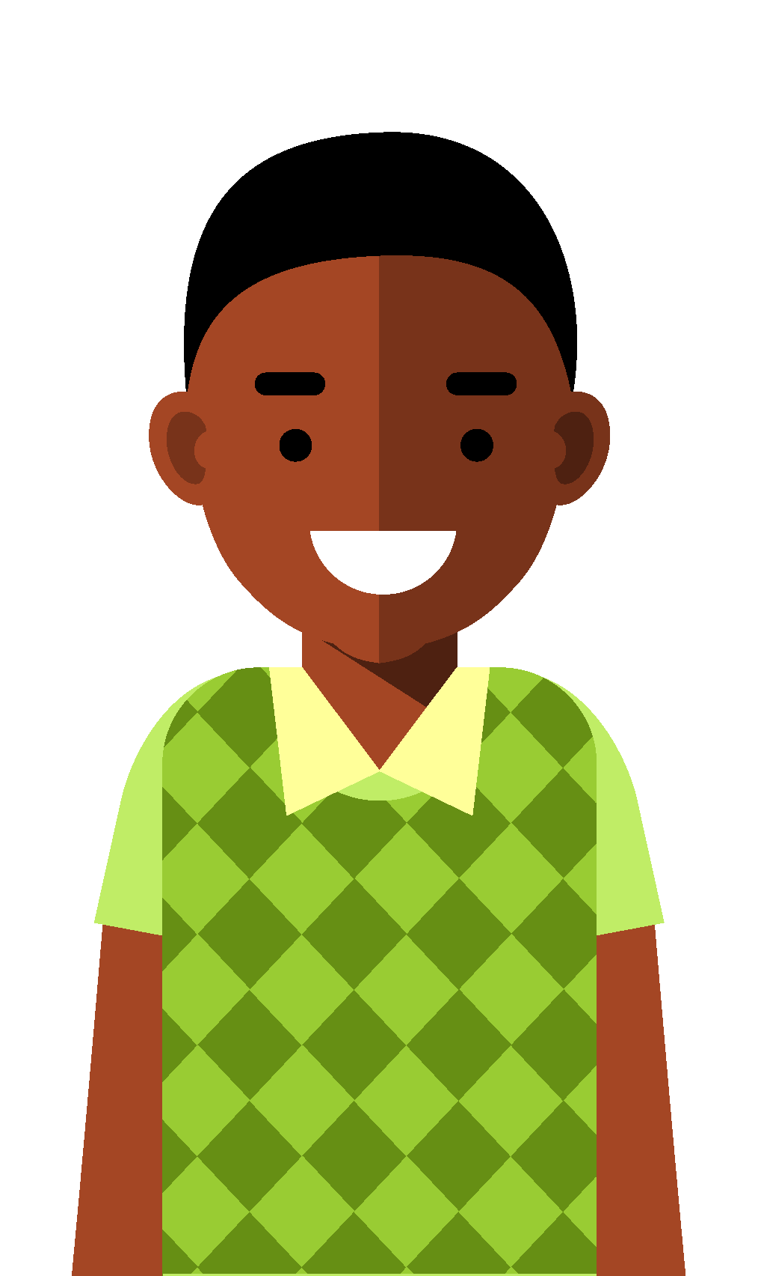
Case study: Lily and Sean. What happened?
Lily and Sean’s teachers noticed that their behaviour had changed over the past few months. They were tired and couldn’t concentrate in class.
Lily’s work in class became
poor and she often argued
with her friends.
Sean had lost interest in all
his lessons and had been involved in some fights in
the playground.
The headteacher invited their parents in for a chat and, between them, they organised counselling sessions for both the children.
These gave the children a chance to talk about how they were feeling and about the change in their home life.
It felt good to talk about
it with someone outside
the family.
The counsellor gave both children some strategies for keeping calm and trying to remain positive.
How does money affect my feelings? | 7

Slide 8
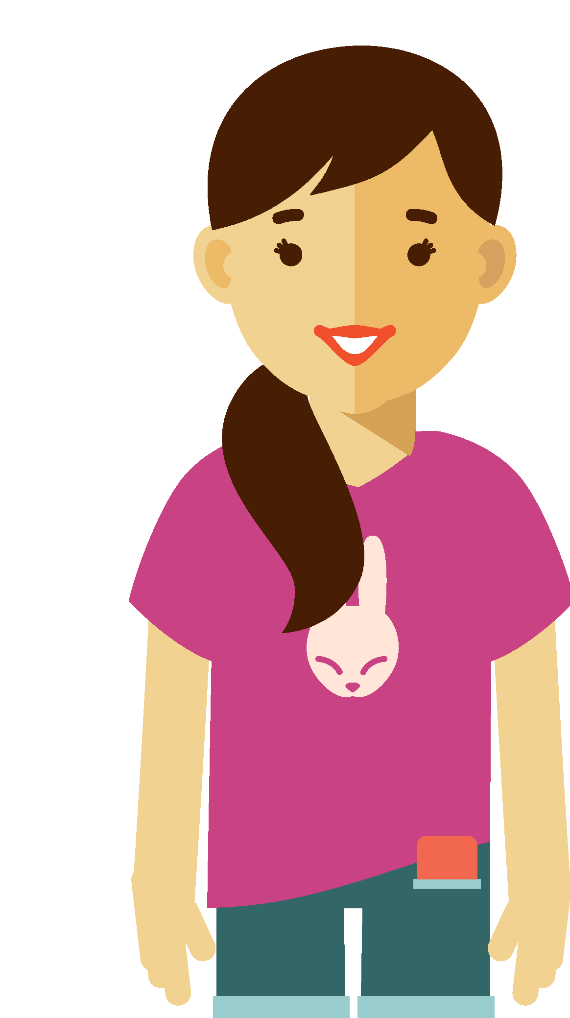
Case study: Kaye.
What happened?
Kaye was feeling really down one evening. She’d heard about the charity Childline in a health class at school, and decided to call their helpline.
The person at the end of the phone listened and suggested that Kaye ask her mum to arrange a doctor’s appointment about her headaches.
The doctor also spoke
with Kaye about how she was feeling, and gave her some advice on things she could do to feel happier and healthier.
Kaye and her mum started to talk with each other more, and share their feelings. This helped them become closer and deal with their situation as a team.
How does money affect my feelings? | 8

Slide 9
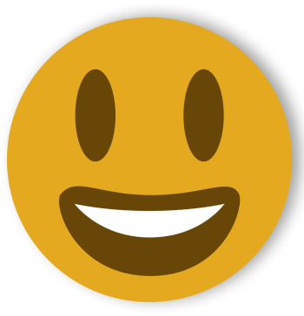
Getting support
Young people who are having difficulty feeling positive do not need to suffer alone.
There are a lot of different people and organisations that can provide advice
and support.
Talking about how you feel is usually the first step to getting help and finding ways to cope.

Slide 10

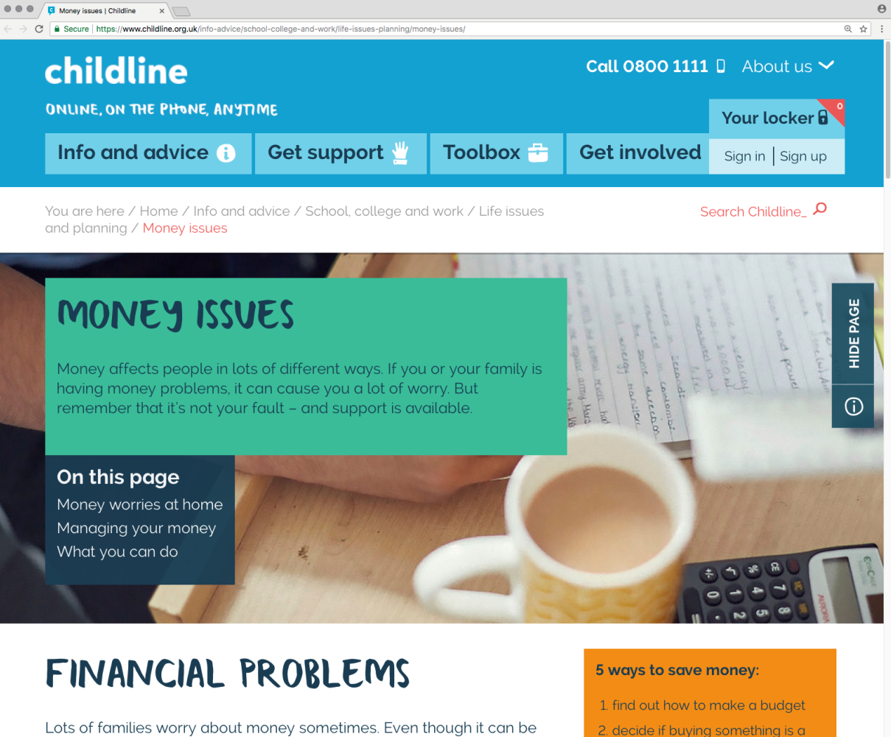

Childline
Childline is a charity that supports children and young people, whatever they are worried about. It helps them find ways to cope.
It has a helpline, which is always open, as well as an online chat service, or you can contact a counsellor by email. The people who respond have been trained to offer advice and support.
Children and young people can contact Childline at any time and talk about whatever is bothering them.
www.childline.org.uk
Telephone: 0800 1111

