Slide 1


Slide 2

Johannes Brahms
Hungarian Dance No. 5 in G minor
LC: Can you recognise pulse and rhythm?

Slide 3
Pulse and Rhythm
A pulse is the heartbeat of the rhythm/music that you hear - and feel - when listening to music and this is what people usually tap along to when listening.
By definition, rhythm is the pattern of regular or irregular pulses caused in music by the occurrence of strong and weak melodic and harmonic beats. Simply put, rhythm is that music component that makes us move, or even just tap the foot, when we listen to a song.

Slide 4

Trailblazer
Johannes Brahms was fascinated with the sound of the Hungarian Gypsy travelling bands. He took these sounds and super-sized them for the orchestra!

Slide 5
Lesson outcomes
After this lesson, pupils will be able to:
listen and reflect on a piece of orchestral music
learn musical language appropriate to the task

Slide 6
Glossary of music terms
Term | Definition
Bar | A very short, countable section of music
Melody | another word for ‘tune’, like a musical sentence
Off-beat | the ‘weak’ beats between the strong, ‘on-beats’ of the pulse
Orchestrate | choose which instruments perform which parts of the music
Ostinato | a repeating (often rhythmic) pattern
Pitched percussion | percussion instruments that can play different pitches – xylophones, glockenspiels, chime bars, etc.
Unpitched percussion | percussion instruments that can only make a limited number of sounds – drums, shakers woodblocks, tambourine etc.

Slide 7
Lesson 1
Watching and listening and dancing!

Slide 8
Background – the composer
Johannes BRAHMS
(1833–1897)
German composer
One of the ‘three B’s’ of German music – Beethoven, Bach, Brahms
Wrote four symphonies and much for smaller chamber groups
Known as a perfectionist, a traditionalist and an innovator

Slide 9
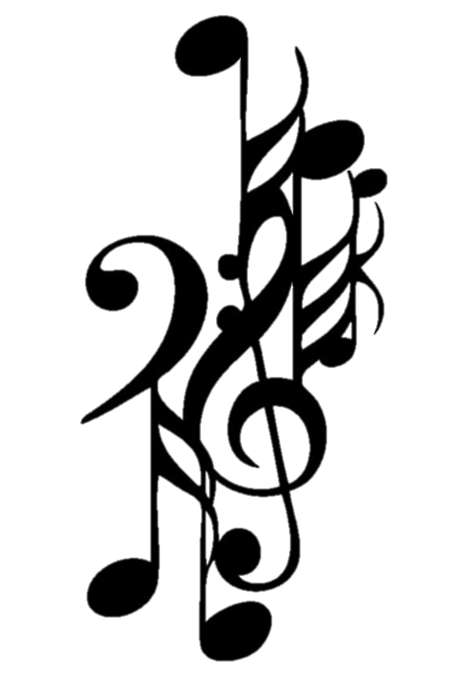
Background – the music
Hungarian Dance No. 5 in G minor
The most famous dance from a set of 21 originally written for piano (four hands) in 1869
Brahms became fascinated by Hungarian folk music after meeting and working with violinist Ede Reményi who introduced him to ‘gypsy-style’ playing
Brahms thought he was using a traditional Hungarian folk tune but he actually, unknowingly, stole this tune from a composer called Béla Kéler
The Hungarian Dances are his most popular and lucrative pieces

Slide 10
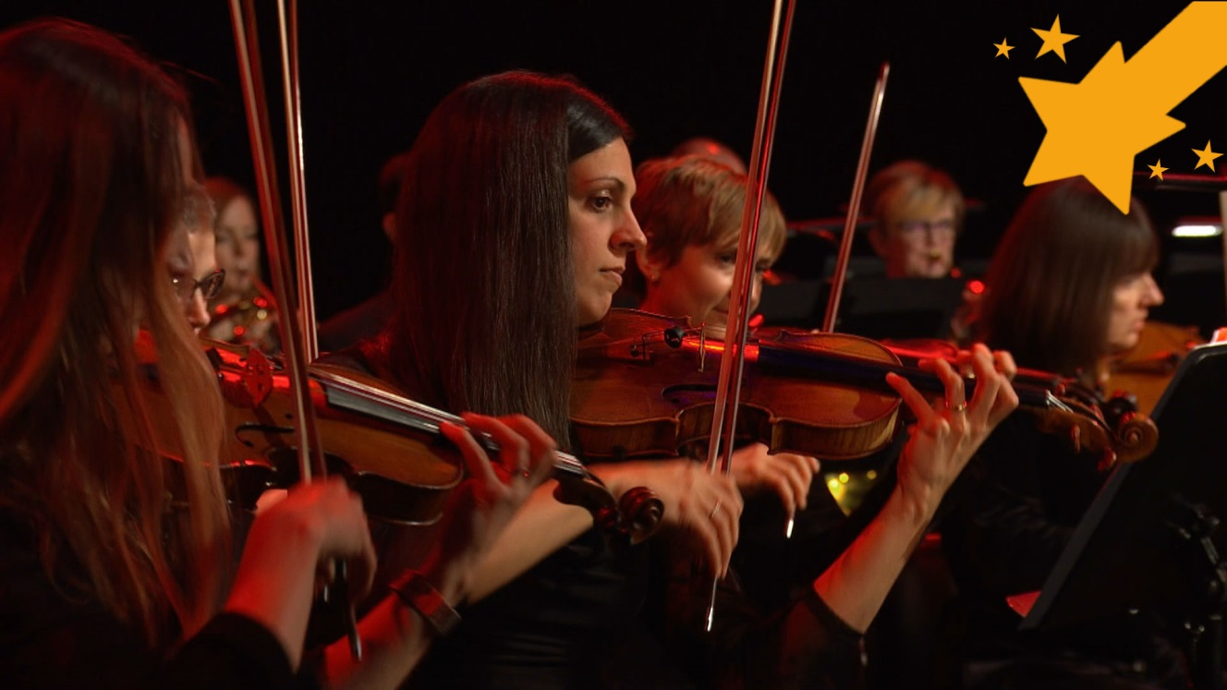

Watch the orchestral performance

Slide 11
Activity 1
Follow the next 5 slides.
Listen to the melody and think of some movements to fit to the beat.
Add a ‘chest tap’ to your pattern – this is called the ‘off-beat’.
Think of a simple tune that will fit your pulse.
Body percussion.

Slide 12

Listen to the melody and count to eight as you listen

Slide 13

Think of some movements to fit with the beat

Slide 14
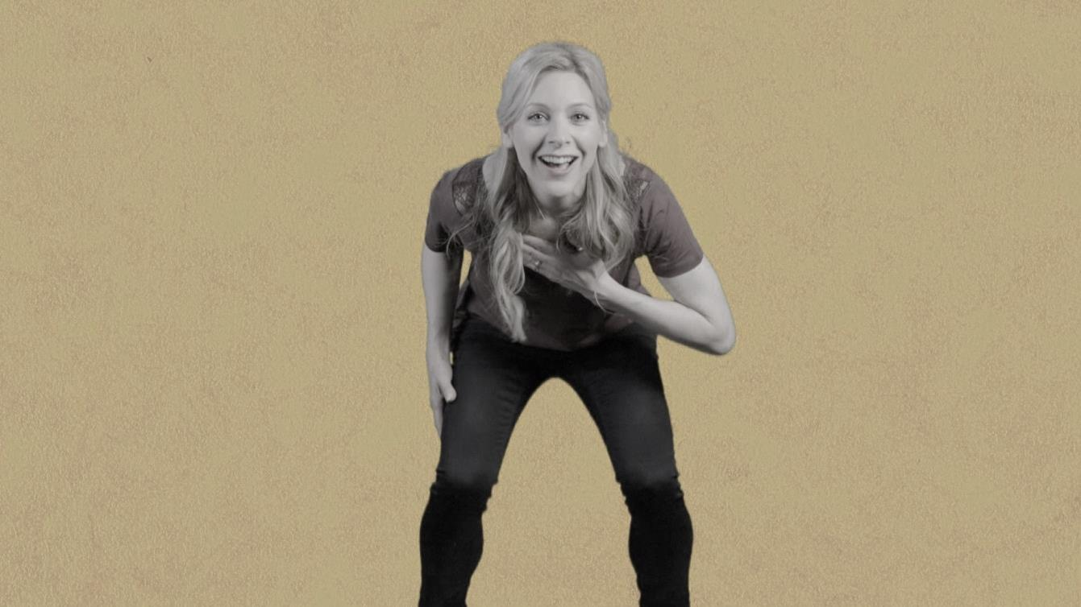
Add a ‘chest tap’ to your pattern – this is called the ‘off-beat’

Slide 15
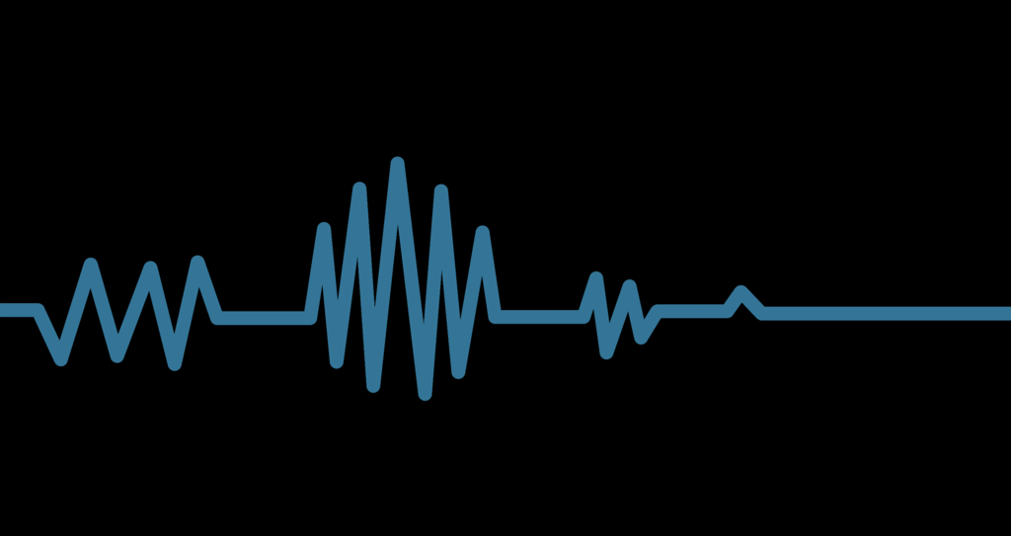
Think of a simple tune that will fit your pulse

Slide 16

Body percussion

Slide 17
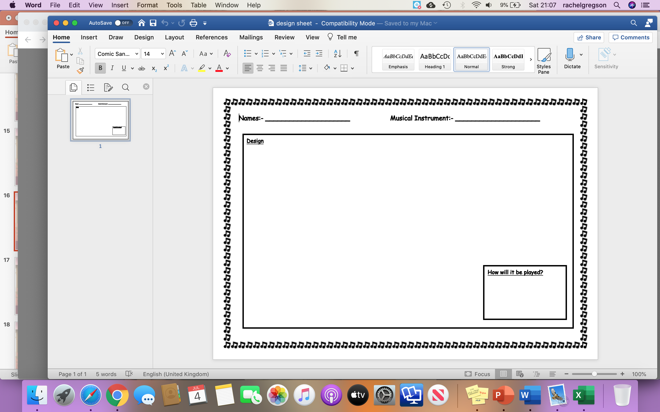
Activity 2: Design your own musical instrument

Slide 18
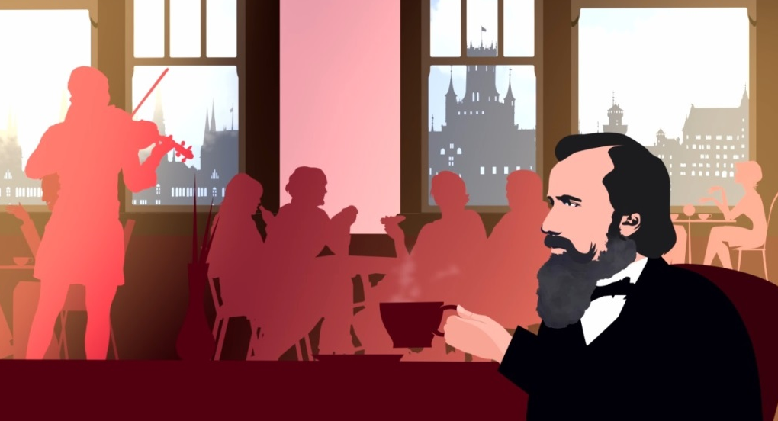
Recap
Um-pah
Off-beats and melody
Long and short sounds

Slide 19
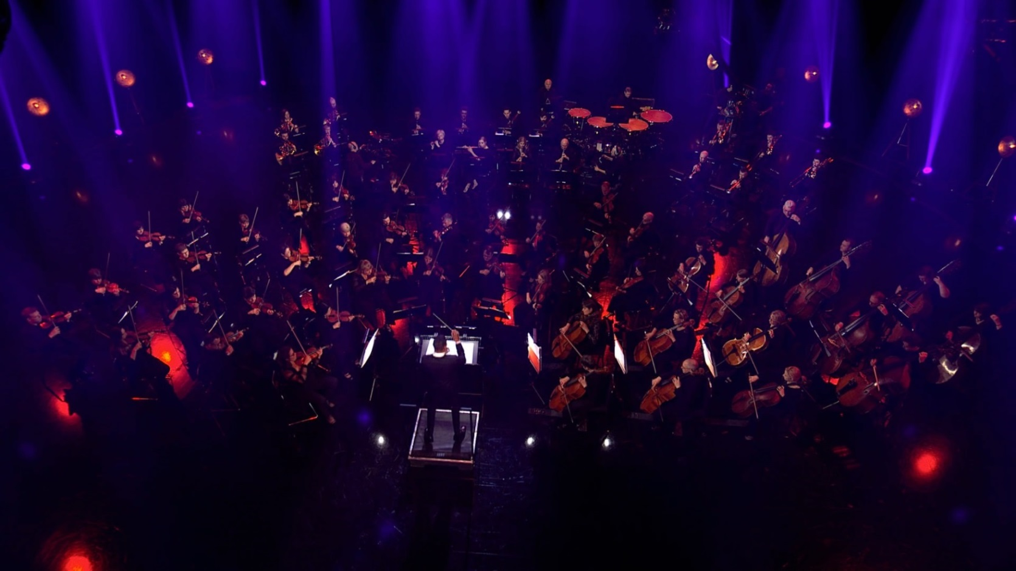
Practise and perform!

Slide 20
Taking it further – cross-curricular activities
MUSIC: BBC Ten Pieces features other dance pieces you might like to explore: Florence Price’s ‘Symphony No. 3’ is based on the ‘juba dance’, Tchaikovsky’s ‘Nutcracker Suite; is made up of dances from his ballet including a lively Russian dance (Trepak) and Anna Meredith’s ‘Connect It!’ features physical gestures and body percussion instead of instruments.
RESEARCH: Brahms was actually one of the finest symphony composers of all time – a symphony is a large piece for orchestra. Find out about his symphonies or research how he felt about his simple ‘Hungarian Dances’ becoming the pieces for which he was most known, rather than his ‘serious’ works.

