Slide 1

Summer Poem

Slide 2

This week, we return to poetry
The focus of our poetry is
summer and summertime.
You may find that parts of the
English, Science and Geography
intertwine and support each other this week.

Slide 3
Lesson 1

Slide 4

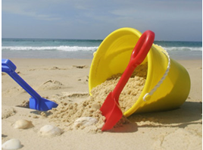
All things summer
Lesson 1
Using the ‘thought shower sheet’ (attached), make a note of as many different things you can think of associated with Summer.
You may find it helpful to do the Science or Geography lesson first this week to help you with this.
There is also a ‘Photo Pack’ PowerPoint attached with lots of ideas too.
Try challenge yourself first to come up with as many ideas as you can on your own before you use these sources of support.

Slide 5
Lesson 2

Slide 6
Lesson 2
You might find it helpful to quickly
read through all of today’s slides
before starting any work,
just to be clear on your chosen approach.

Slide 7
Planning & Vocabulary
Lesson 2
Choose some of your favourite ideas from the thought shower sheet. Try to choose a variety of summer items so that they are not all summer clothes or all summer foods (unless, of course, you wish for your Summer poem to have a theme e.g 'Summer Eating' or 'Summer Fun').
Add each chosen summer word to the first column of the planning sheet.
Summer word | adjectives | verbs | Adverbs (-ly) | Other interesting vocabulary ideas
sun
picnic
ice-cream

Slide 8
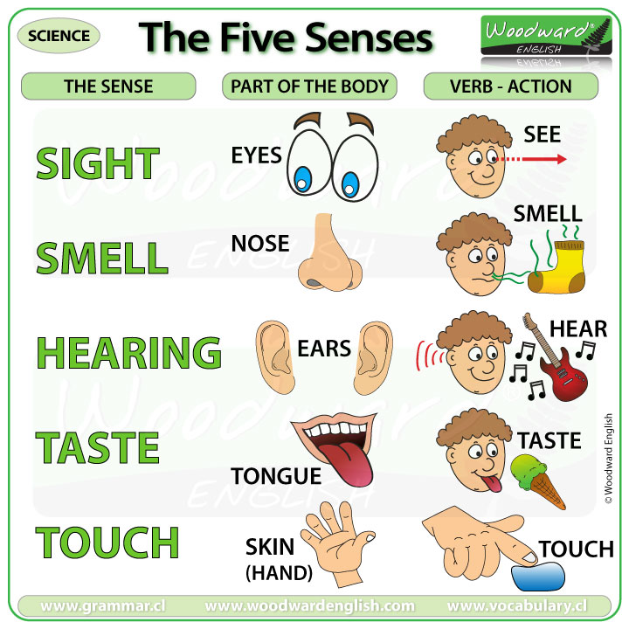
Now, add some adjectives to the second column. You can add as many as you like at this stage and then you have a range to choose from when you write your poem.
Think carefully about your summer word and use all your senses to try to describe it.
Lesson 2

Slide 9
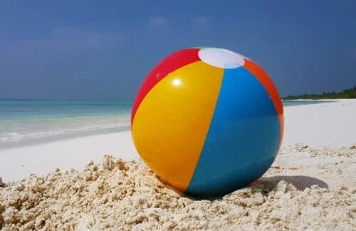

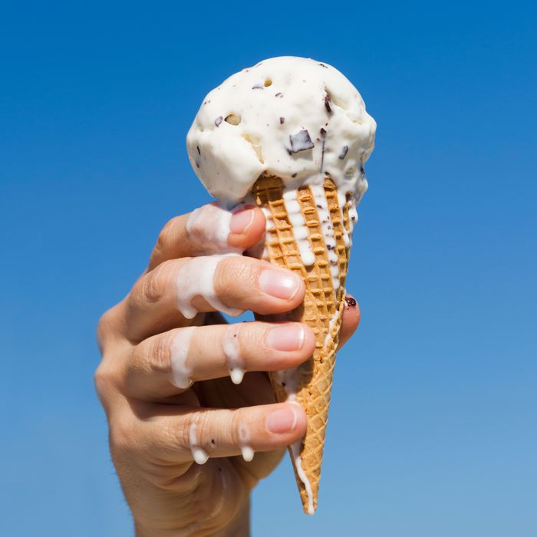
Now, continue along the planning sheet adding in some verbs.
For the verbs – either think of action words to match the summer word or action words you may use with the summer word. For example if your word is ‘sun’ then the verb could be ‘shine’ similarly for an item like ‘beach ball’ the verb could be ‘bounce’ or ‘roll’. However, also in the word ‘beach ball’ you could think about the action of a person with the ‘beach ball’ like ‘throw’ and ‘catch’.
Another example could be ‘ice cream’ – you could have ‘melt’ and ‘drip’ because this is what the ice cream is doing but you could also add ‘gobble’ and ‘lick’ as this is what you might do to an ice cream.
Lesson 2

Slide 10
As you move along your planning sheet, add in adverbs that will match some of the verbs you chose e.g. licked ‘greedily’, shines ‘brightly’, throw and catch ‘excitedly.
Lesson 2
Summer Poem planning sheet
Summer word | adjectives | verbs | Adverbs (-ly) | Other interesting vocabulary ideas
sun | bright, golden, yellow, orange, sparkling, round, spherical, blazing, hot, scorching | beam, glows, sparkles, shines, glistens | brightly, warmly, happily, cheerfully, slowly, glistens | flash hot like lava orange glow like topaz
The end column allows you to add any other ideas to make your writing more exciting such as similes, alliteration and onomatopoeia.

Slide 11
Lesson 2
A few points to consider first:
You can add lots of ideas to each column to accompany each ‘summer word’ and then choose your favourite ideas when you write your poem OR you may choose to think about lots of descriptive vocabulary but just write down your chosen words.
You might choose to work down each column, one at a time, thus focussing on one type of vocabulary e.g. Do all the verbs first, then all the adverbs OR you may wish to work across the rows, focussing on each of the summer words one at a time and adding in all the vocabulary that relates to that word.
Each summer word will be the focus of each of your lines in the poem. So it will depend on how may ‘summer words’ you plan for as to how long your poem is. Don’t forget, if you over plan you don’t have to use all your ideas and if you under plan, you can always add more ideas to your plan and lines to your poem later.
You might find it helpful to read some of the example poem lines later in this PowerPoint to help you to see and understand our end aim.

Slide 12
Lesson 3

Slide 13
Time to write your poem
Lesson 3
In this lesson, you are going to write some lines of your poem.
You might finish your poem today, or you may need lots of thinking time and chance to go back to your planning sheets so it may take a little longer.
By now you have probably thought about 4-6 ‘summer’ words you plan to use in your poem. However, you can write more if you wish. Remember, each chosen summer word will be used to write each line of your poem.
You will probably find your poem easier to write if you choose a pattern to follow. However, you can choose to vary this a little as you may have lots of ideas and vocabulary for some of the words and less for others.

Slide 14
Lesson 3
Choosing you word pattern
You will probably find it easier to write your pattern with a set pattern. Here’s some you could try:
adjective noun verb adverb.
Hot sun glistening brightly.
Colourful beach ball bouncing joyfully.
Cold ice-cream melting quickly.
adjective, adjective noun verb adverb.
Hot, golden sun glistening brightly.
Bright, colourful beach ball bouncing joyfully.
Cold, strawberry ice-cream melting quickly.

Slide 15
Lesson 3
Choosing you word pattern
adjective, adjective noun adverb verb and verb.
Hot, golden sun brightly glistening and sparkling.
Bright, colourful beach ball joyfully rolling and bouncing.
Cold, strawberry ice-cream quickly melting and trickling.
onomatopoeia adjective, adjective noun adverb verb and verb.
Flash - Hot, golden sun brightly glistening and sparkling.
Boing - Bright, colourful ball joyfully rolling and bouncing.
Drip - Cold, strawberry ice-cream quickly melting and trickling.
adjective, adjective noun verb adverb simile
The hot, golden sun glistens brightly like a jewel in the sky.
A bright, colourful beach ball bounces joyfully like a coiled spring.
A cold, strawberry ice-cream melts quickly like a flowing stream.

Slide 16
Lesson 3
Choosing you word pattern
There are so many varieties that you can choose to use a selection but it is better to at least stick to some pattern in each line to ensure that your poem includes a variety of interesting vocabulary and follows the line structure.
Want to do verses? Maybe you could do 2 or 3 lines about summer food, then 2 or 3 lines about summer garden activities and then 2 or 3 lines about on the beach.
Be creative with your writing!

Slide 17
Lesson 4

Slide 18
Lesson 4
Proof-read, edit and check!
Did you manage to finish your poem in the last lesson or do you need a little more time?
Did you get part way through and wish you had chosen a different pattern? Maybe you started to see groups of ‘lines’ that would go nicely together to create verses?
Did you stick to your chosen pattern or choose to change for a reason?

Slide 19
Lesson 4
Proof-read, edit and check!
Read and ‘track’ through your poem carefully. Check for spellings and any little mistakes like missed out words.
Have you repeated any words a lot? If so, can you maybe think of an alternative? Or have you spotted a word and now think you could have used an even better word – maybe a more specific and more powerful noun or verb?
Do you remember when we use a different coloured pencil crayon to underline each word type? You could try this with your poem. It will help you to check if you followed your pattern and will highlight any vocabulary repetitions

Slide 20
Lesson 5

Slide 21
Lesson 5
Present and perform
It would be absolutely wonderful to receive some of your poems at our email addresses.
12HP@bramhopeprimaryschool.co.uk
12F@bramhopeprimaryschool.co.uk
12G@bramhopeprimaryschool.co.uk
Use lesson 5 to present your final poem in your choice.
Maybe you would like to write your poem up in the neatest writing you can – possibly with some illustrations to decorate it. You can choose to use the optional writing frame uploaded or design your own.
Maybe you’d like to use your computing skills to type your poem or even display it in a PowerPoint presentation.
Or would you like to develop your speaking skills and film a little video of yourself reading or reciting your poem. You may even wish to perform and add some accompanying actions.

Slide 22
We really hope that you are able to enjoy some of the things you have chosen to include in your poem throughout the
Summer Holidays – ENJOY!!!
The End

