Slide 1
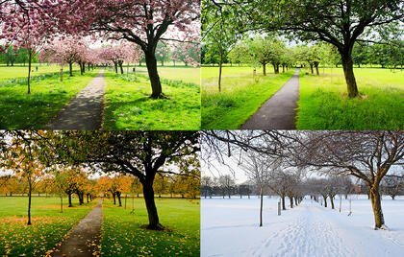
Seasonal Change
https://www.youtube.com/watch?v=pjRDuoWJwE0

Slide 2
In this lesson, we will:
Recap the seasons of the year.
Look at changes as spring turns into summer, including what happens to our natural surroundings (e.g. trees & plants) and changes to length of the days.
Think about the clothes we wear and the activities we do.
We will also be recapping ‘Sun Safety’.

Slide 3
The Four Seasons
Autumn
Winter
September
December
October
January
November
February
Spring
Summer
March
June
April
July
May
August
https://www.bbc.co.uk/teach/class-clips-video/the-four-seasons/z4vjmfr
Science KS1 / KS2: British plants, animals and landscapes through the four seasons

Slide 4
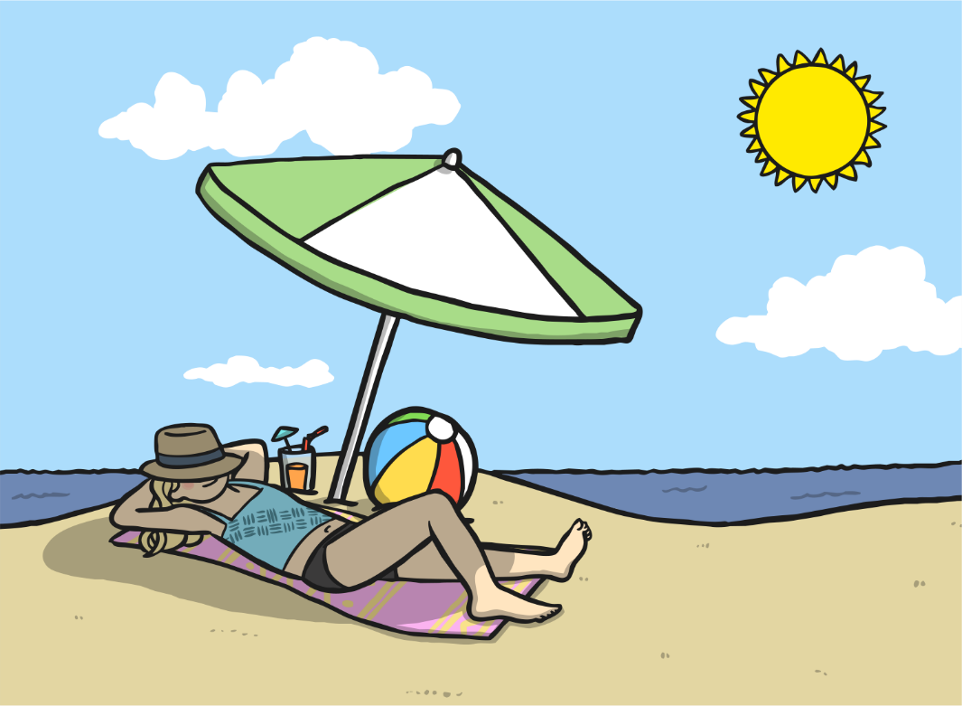
Summer Changes
What changes have you noticed between spring and summer?
What have you been wearing?
What has happened to the trees?
What has happened to the length of the days?
Compare this with spring. What are the main differences?

Slide 5

Summer
As the seasons change from spring to summer, the temperature begins to rise, which means it gets even hotter.
In the summer trees are full of leaves and grow lots.
Shadows are easy to see in summer and happen when an objects blocks out some of the Sun’s light.
As spring turns to summer the days get longer and the nights get shorter. Summer has the longest days and shortest nights of all the seasons.

Slide 6

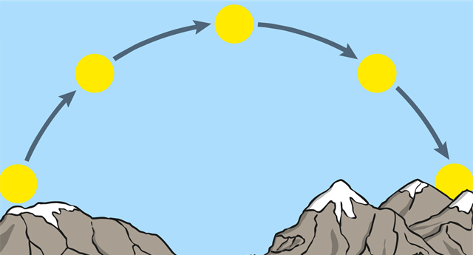
Day Length
Look at the number of hours of daylight we have during the summer.
Can you notice anything about the numbers compared to the spring numbers?
Month | Sept | Oct | Nov | Dec | Jan | Feb | Mar | April | May | June | July | Aug
Hours of sunlight | 13 | 11 | 9 | 8 | 8 | 10 | 12 | 14 | 15 | 16 | 16 | 14

Slide 7
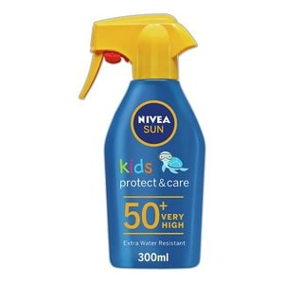
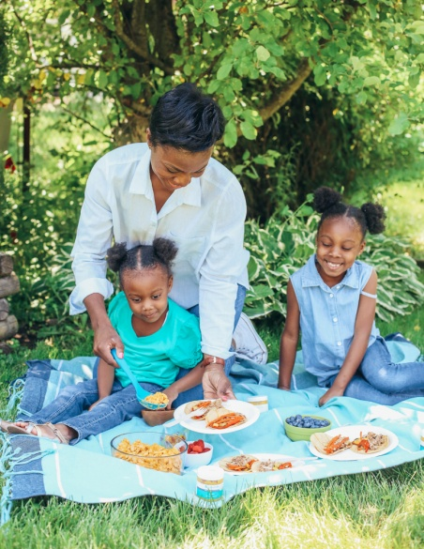
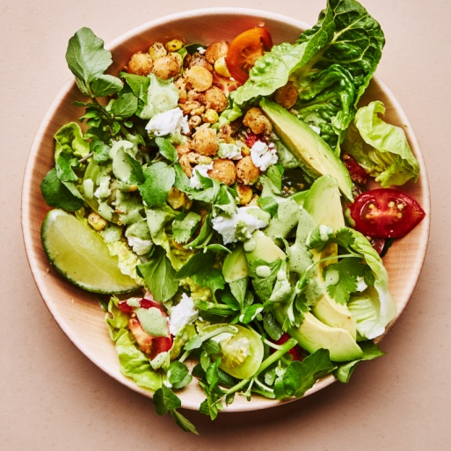
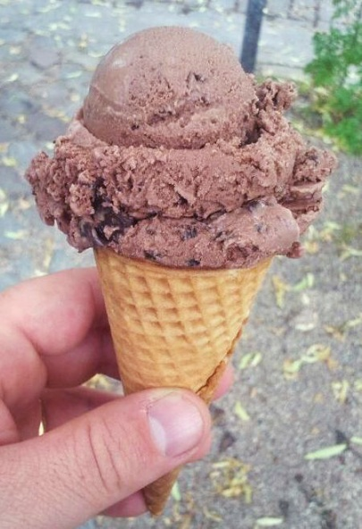
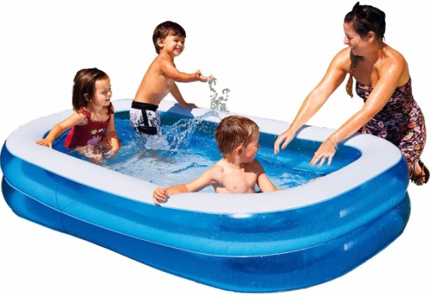
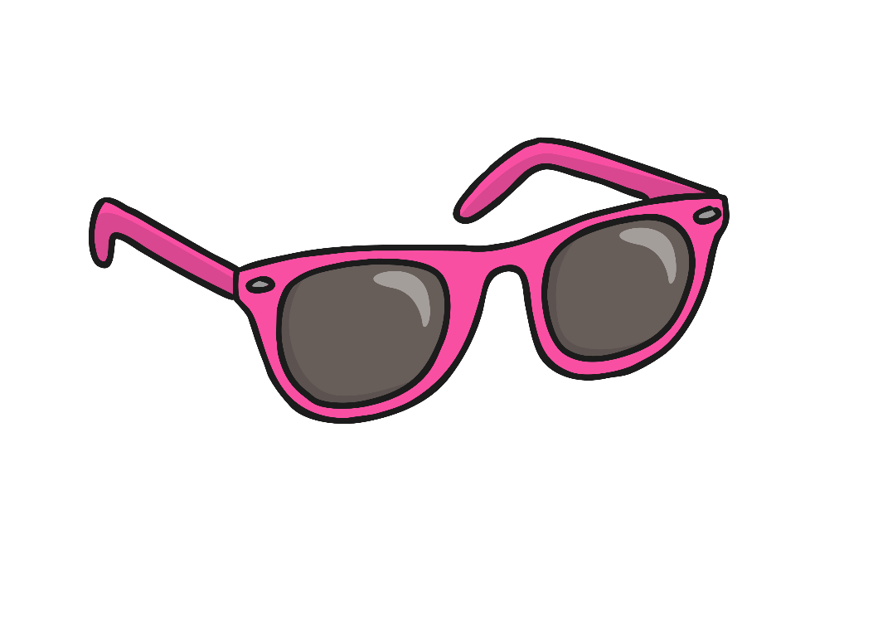
Summer Photos
Look at the Summer Photos in the ENGLISH Poetry/SCIENCE photo pack PowerPoint
and think about these questions:
Does it ever rain in the summer?
What type of weather do we sometimes have in the summer after it has been very hot and sticky?
What can you do more of in the summer, compared with other seasons?
What clothes might you wear? What precautions might you take?

Slide 8

Summer Weather
What has the weather been like this week & last week?
What has the temperature been like?
What clothes have you been wearing?

Slide 9
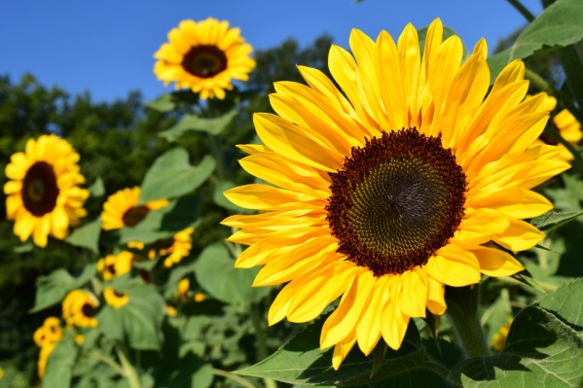
How Summer affects plants and animals
https://www.bbc.co.uk/teach/class-clips-video/science-ks1-ks2-how-summer-weather-affects-behaviour-of-british-animals-plants/zkdkjhv
Below are the links to the other seasons if you wish to recap
Spring:
https://www.bbc.co.uk/teach/class-clips-video/science-ks1-ks2-seasonal-changes-behaviour-animals-growth-cycle-plants/zfynvk7
Autumn:
https://www.bbc.co.uk/teach/class-clips-video/science-ks1-ks2-animals-preparing-winter-storing-food-migrating-hibernating/z6h6nrd
Winter:
https://www.bbc.co.uk/teach/class-clips-video/science-ks1-ks2-winter-weather-behaviour-british-animals-plants/zbcg92p

Slide 10

Activity: Changes around Us
Make some recordings of some of the changes around you that are due to seasonal change – because it is summer!
You may wish to do sketches, make notes or take photographs.
You may choose to compile a little video, create a
PowerPoint or just retain your knowledge in your mind and in your notes.
You might wish to do a little online research into summer or create a poster or leaflet of activities to do and clothes to wear due to the seasonal changes in summer.
Remember to try and link the choice of activity and clothing or the change to the changes in weather, length of the day and other seasonal changes.
Remember: Keeping safe in the sun is essential.
Take a look at the next section of this PowerPoint

Slide 11

Sun Safety
I can explain how to stay safe in the sun:
I can tell you why it is important to stay safe in the sun.
I can tell you different ways to stay safe in the sun.
I can tell you why it is not ever safe to look directly at the sun.

Slide 12

Summer Sun
Think about/Talk to a partner about playing outside in the summer.
Use these questions to help you:
What do you do outside in the summer?
What do you wear outside in the summer?
Do you do anything before you go to play outside?
What should you do if you get too hot outside?

Slide 13
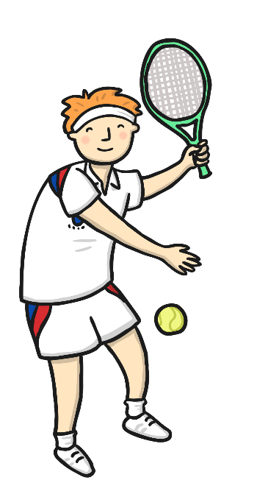
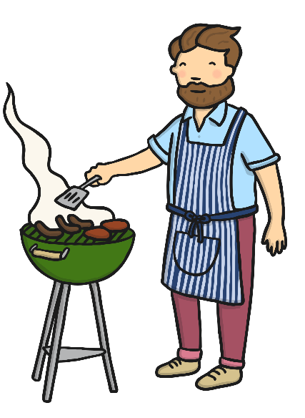
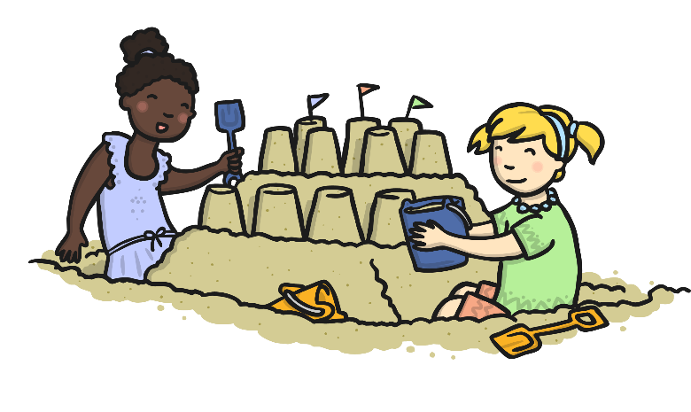
Staying Safe in the Sun
Sunshine is great because warmer weather means
we can enjoy doing lots of different things outside in the summer!
The sun gives out rays of light and warmth. Some rays we can see but some rays are invisible.
These invisible rays can cause sunburn and damage humans’ skin and eyes, so it’s really important to make sure we protect ourselves.
What do you think we could do that would help keep us safe in the sun?

Slide 14

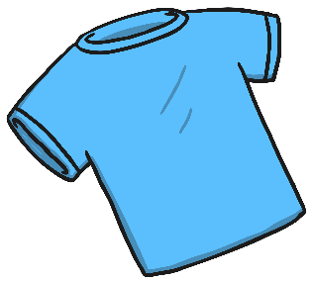
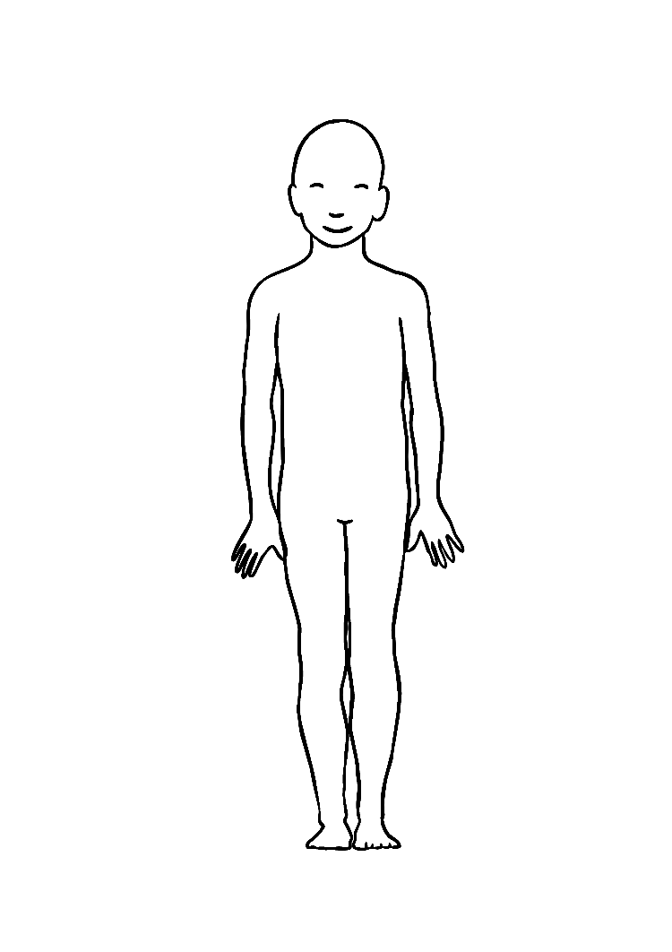
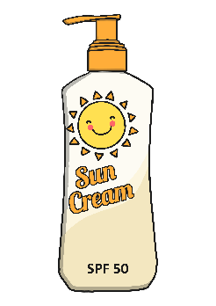
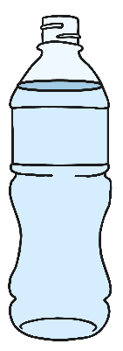
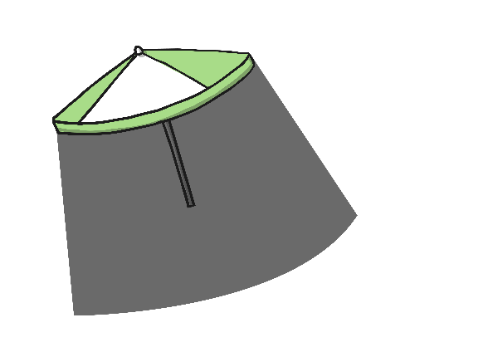
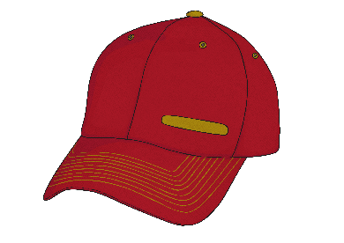
Be Prepared!

Slide 15
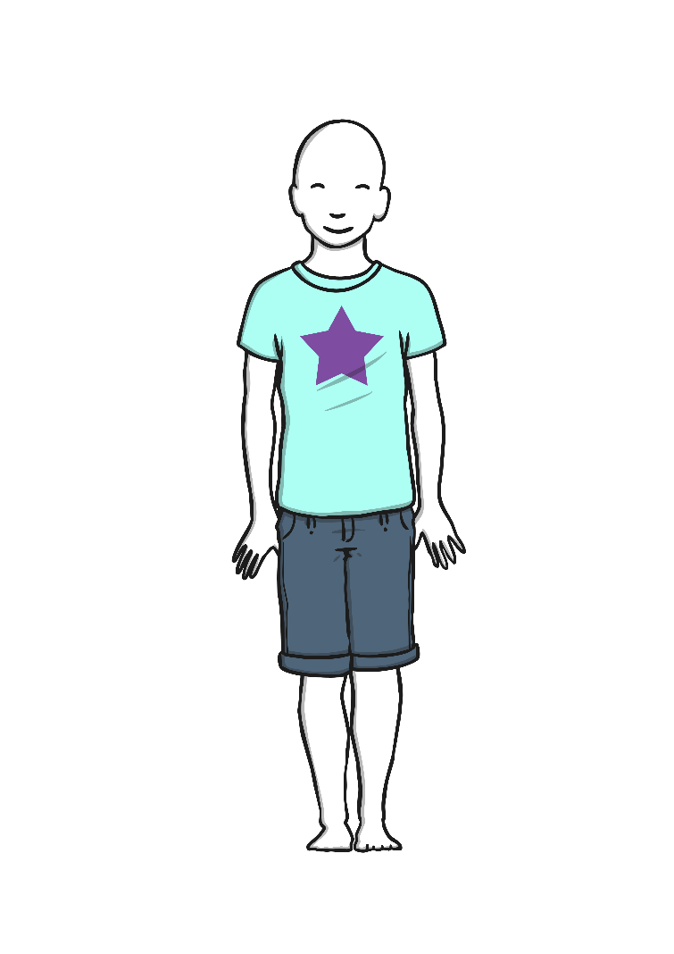

Be Prepared!
Clothes
Wear clothes which will protect large areas of your body.

Slide 16
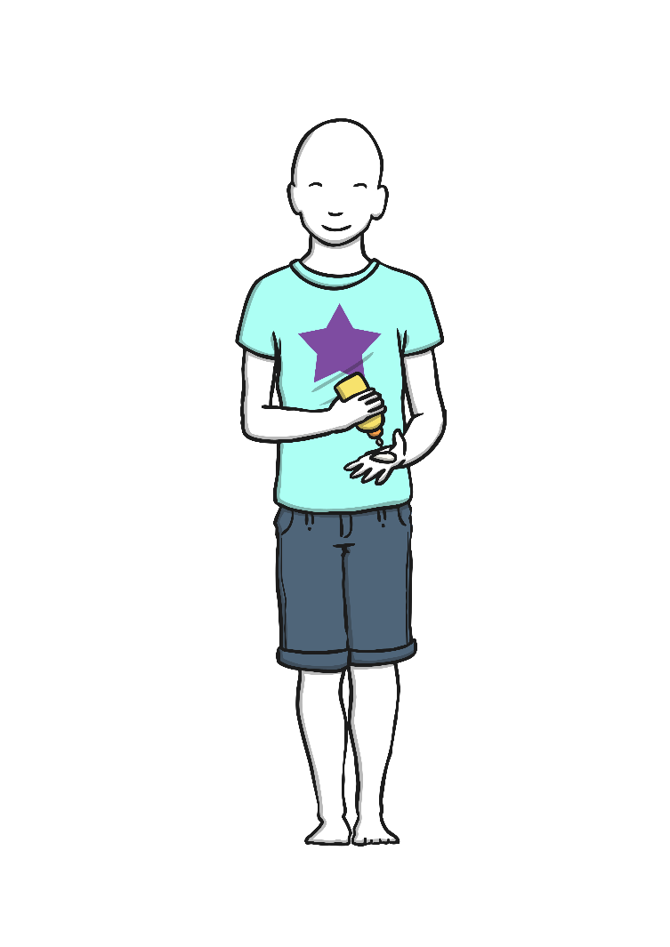

Be Prepared!
Sun Cream
Put sun cream on exposed skin before going outside to protect against sunburn. Remember to reapply it when needed.

Slide 17
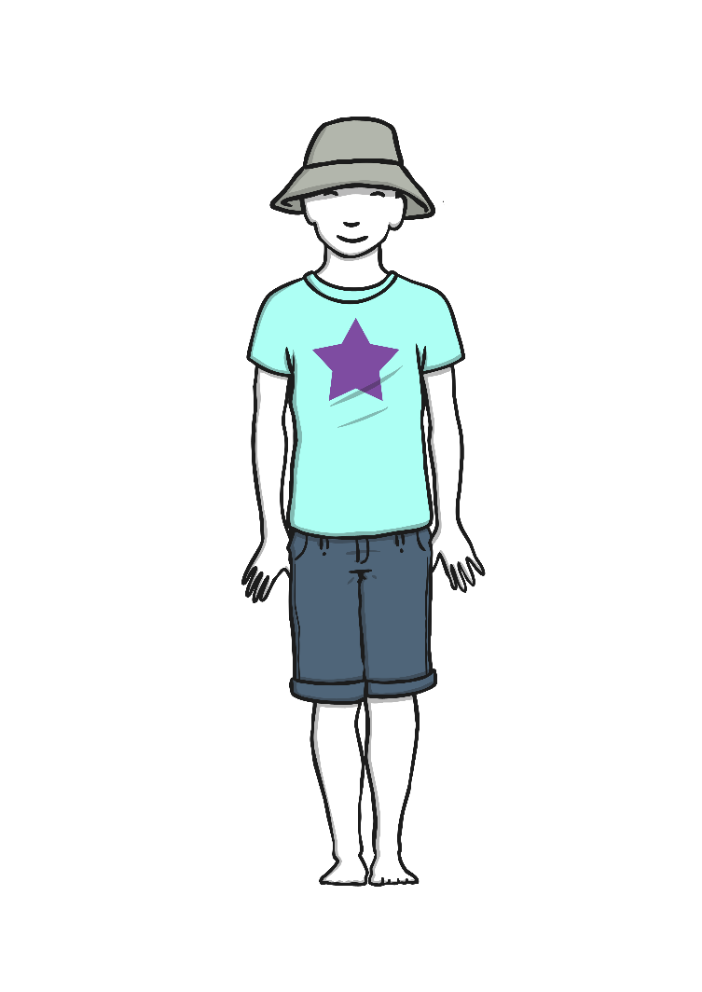

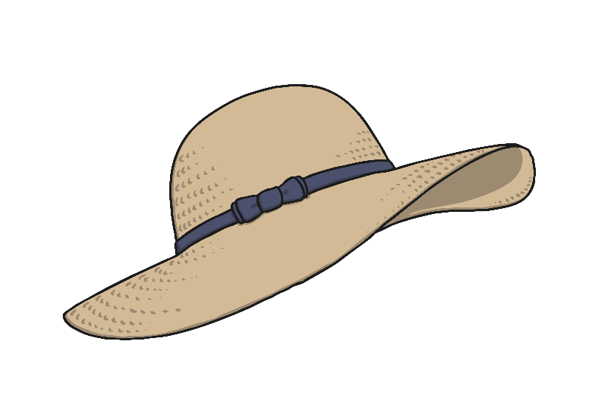
Be Prepared!
Sun Hat
Wear a sun hat with a wide brim to protect your face and neck.

Slide 18
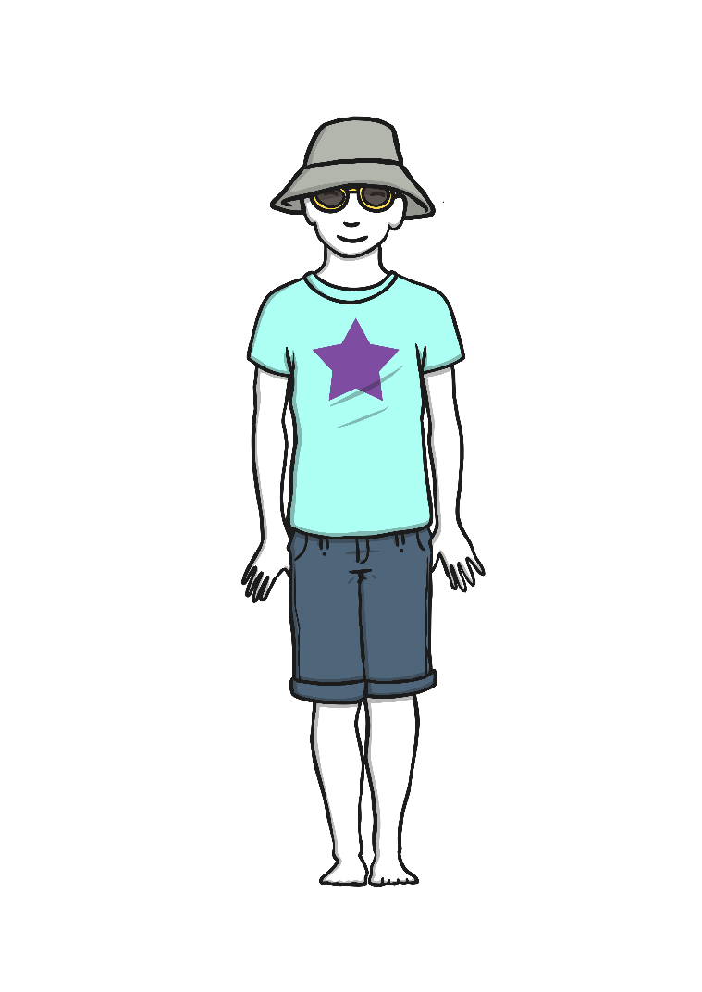

Be Prepared!
Sunglasses
Wear sunglasses to protect your eyes from the strong and invisible rays the sun gives out.

Slide 19
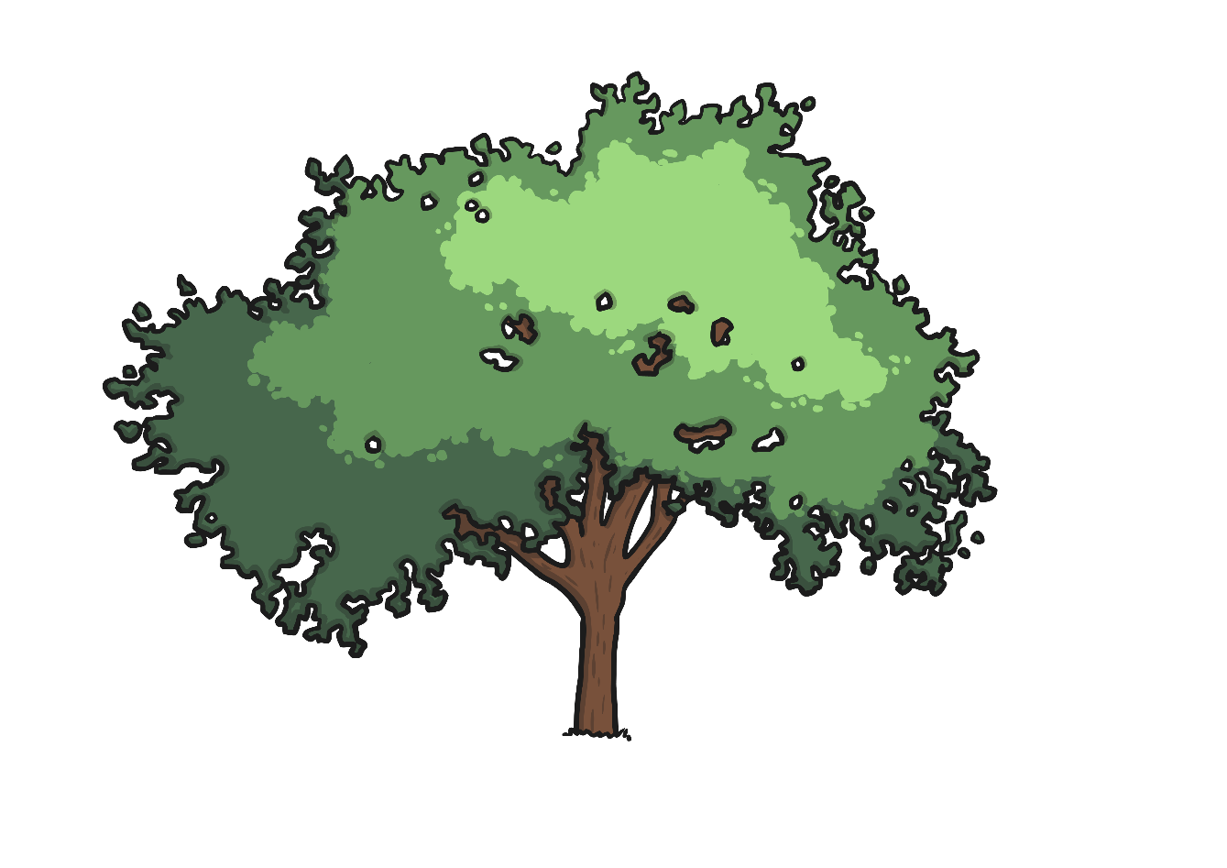
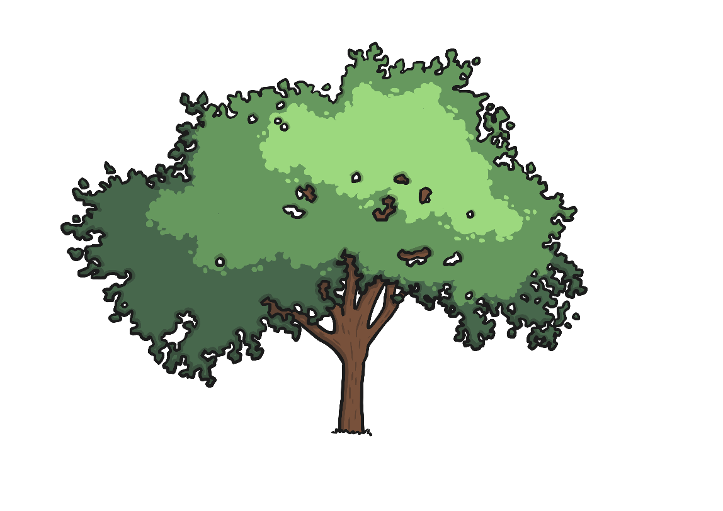

Be Prepared!
Shade
Play in the shade, especially between 11 o’clock in the morning and 3 o’clock in the afternoon, as this is the hottest part of the day.

Slide 20
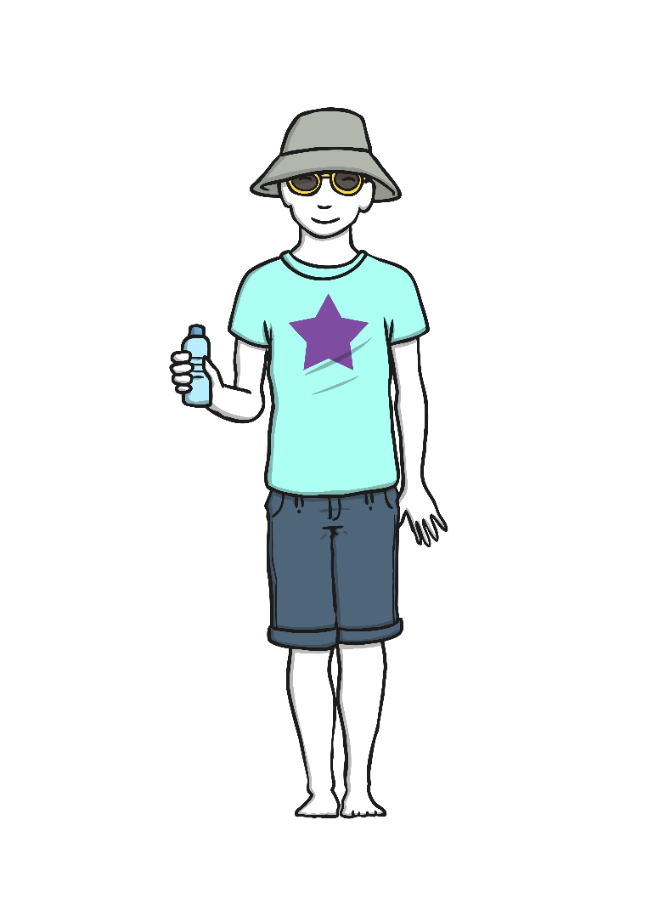
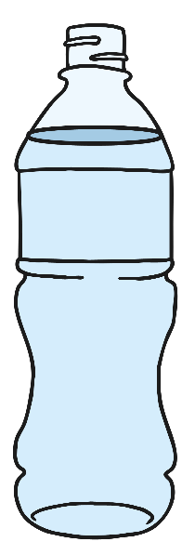
Be Prepared!
Water
Drink lots of water to keep hydrated and replace all the fluids which your body loses through sweating.

Slide 21

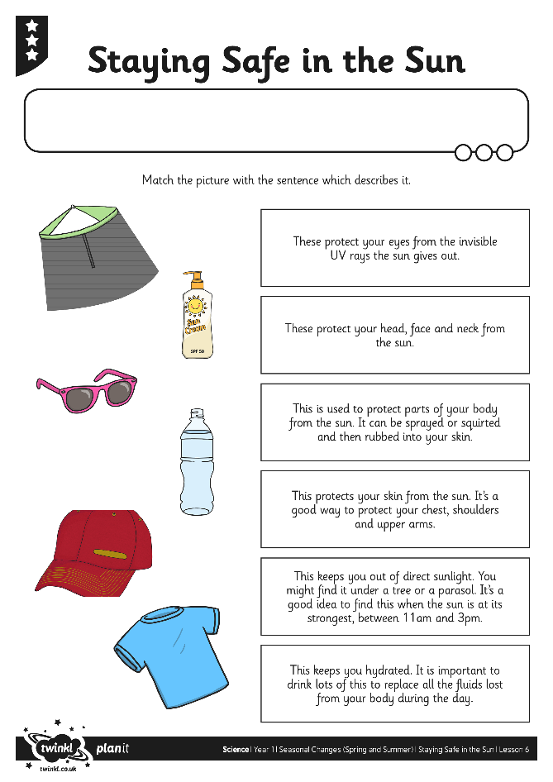
Safety in the Sun
Activity: Can you create a way of promoting sun safety to others?
Match the pictures and captions to help you the planning stage.
Draw on your talents and skills to decide how you would like to present your information.
Ideas include:
Create an information leaflet
Video an advert or awareness broadcast
Produce a PowerPoint

Slide 22

Vivaldi’s Four Seasons
https://www.youtube.com/watch?v=GRxofEmo3HA

