Slide 1
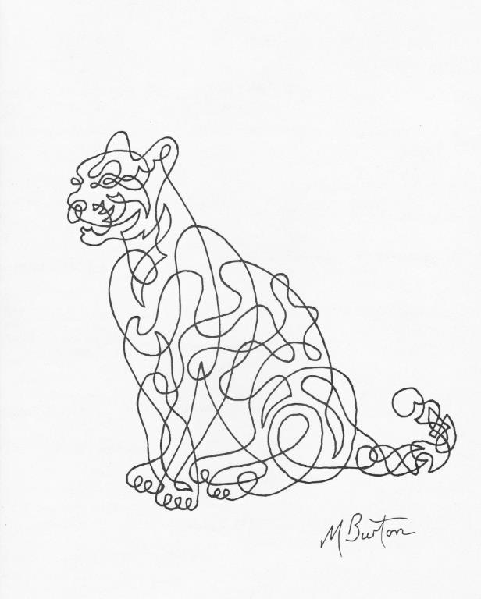
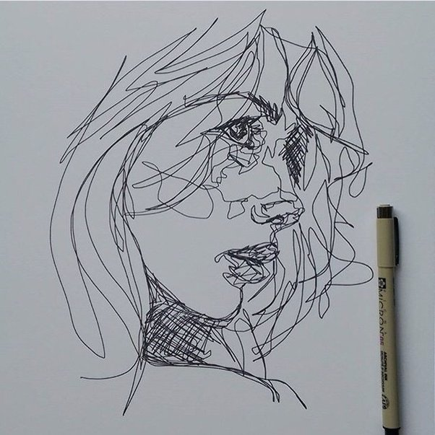
Continuous Line Drawing

Slide 2
Practice
Continuous Line Drawing is a fun way of drawing. It helps you to relax (a bit like meditation) and also helps you get better at drawing by slowing you down and making you focus on what you SEE and not what you THINK you see. Have a go at the video below for practice.
Mindfulness Line Drawing

Slide 3
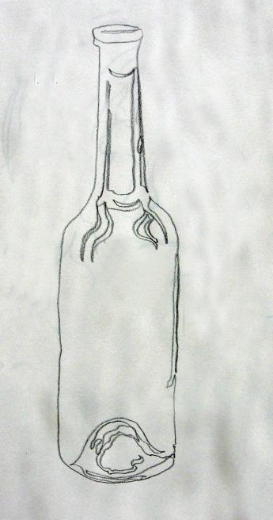
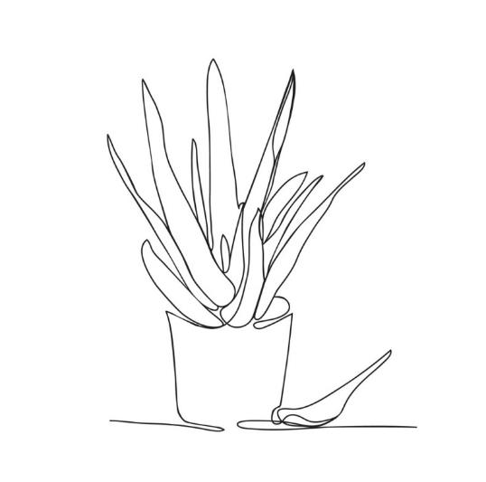
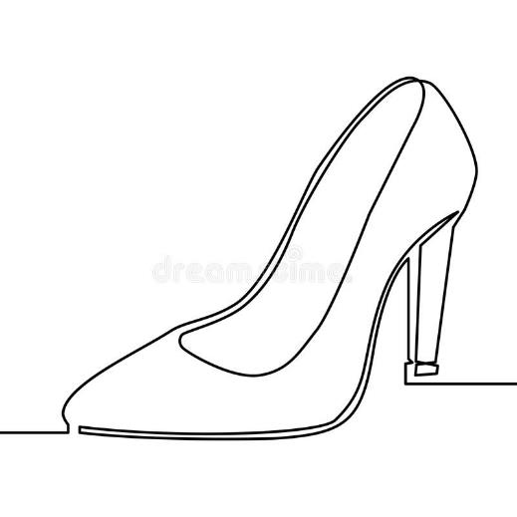
Now you’ve had a practice you could have a go at actually drawing something. Small objects like keys, cutlery, tools, feathers and coins are all good subject matters. You want to do the whole drawing without taking your pencil off the paper. Let your eyes trace along the edges and details and let your pencil flow slowly along with it. Don’t worry about making mistakes! Have a look at the pictures below for ideas…

Slide 4
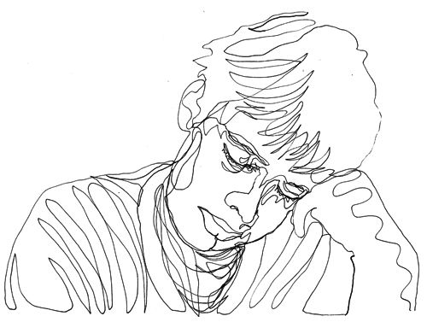
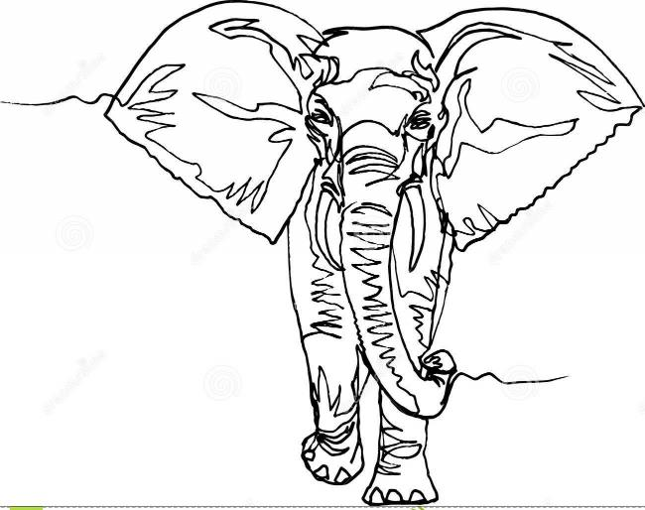
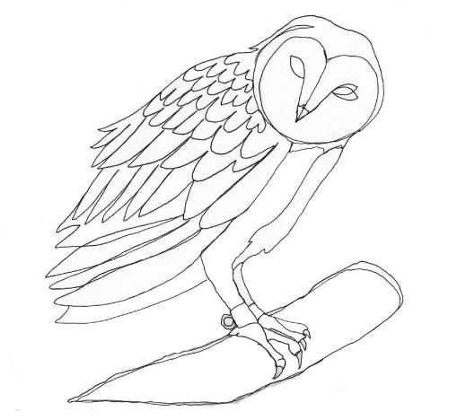
Now, if you feel like you want to challenge yourself, have a look at the examples below. Try something like a face or an animal, but remember not to take your pencil/pen off the paper!

Slide 5
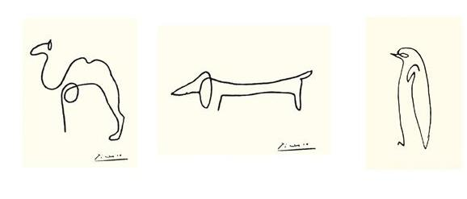
These beautifully simple ones are by Picasso!

Slide 6
Explore, experiment and, most importantly, have fun!
Mrs Heald ☺ harriet.heald@bramhopeprimaryschool.co.uk

