Slide 1
FEELINGS

Slide 2




Feelings – happy, sad, unsure, worried, excited.

Slide 3
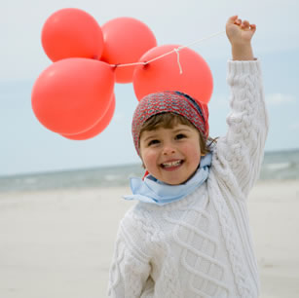
Feelings
How does this girl feel?
Why do you think she feels like that?
What makes you feel happy?

Slide 4
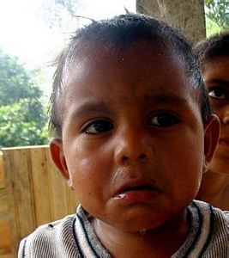
Feelings
How does this boy feel?
Why do you think he feels like that?
What makes you feel sad?

Slide 5
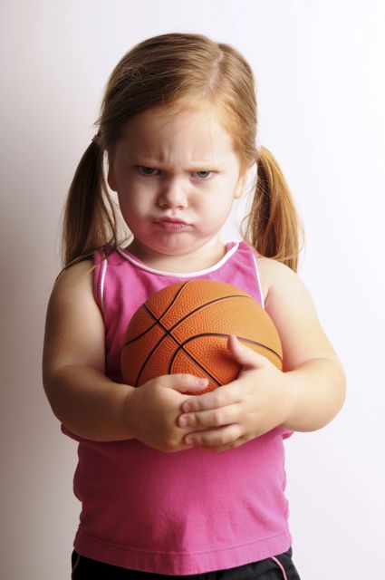
Feelings
How does this girl feel?
Why do you think she feels like that?
What makes you feel cross?

Slide 6
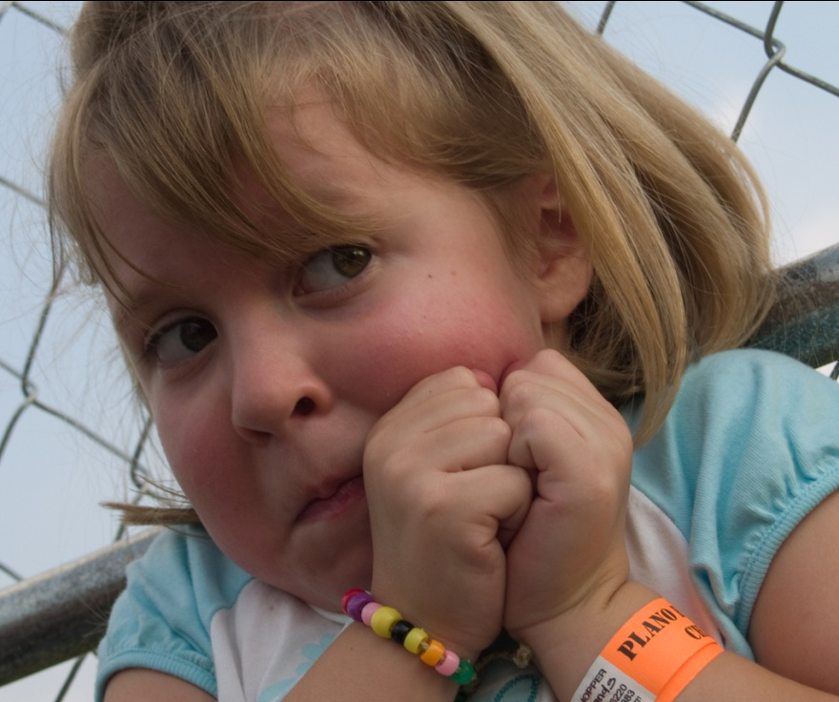
Feelings
How does this girl feel?
Why do you think she feels like that?
What makes you feel frightened?

Slide 7
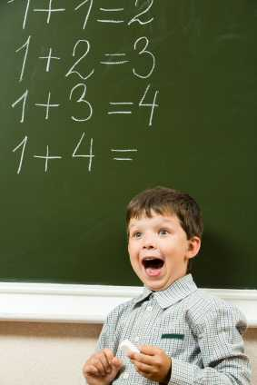
Feelings
How does this boy feel?
Why do you think he feels like that?
What makes you feel happy in school?

Slide 8
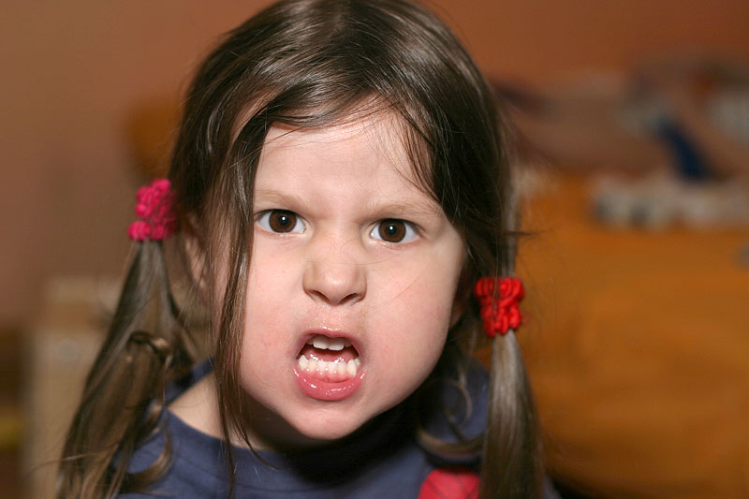
Feelings
How does this girl feel?
Why do you think she feels like that?
What other words mean the same as cross?

Slide 9
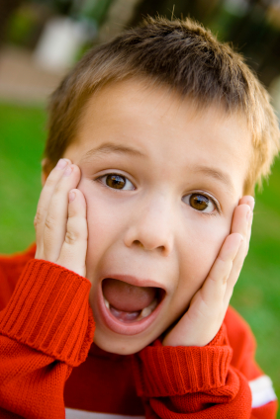
Feelings
How does this boy feel?
Why do you think he feels like that?
What makes you feel scared?

Slide 10
Feelings
happy
angry
sad
scared

Slide 11
Feelings:
Talk about how you feel?
What makes you feel happy, sad, scared and cross?
How do you feel about starting Year 1? What are excited or worried about?

