Slide 1
Transport
Identify and explore the different types of travel and transport.

Slide 2
Transport: What does it mean?
Transport means to move
from one place to another.

Slide 3
Key Vocabulary
Transport
Traffic
Car
Bus
Train
Aeroplane
Helicopter
Boat/ship
Bus
Water
Air
Land

Slide 4
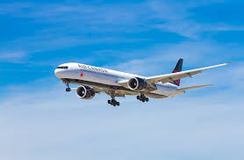
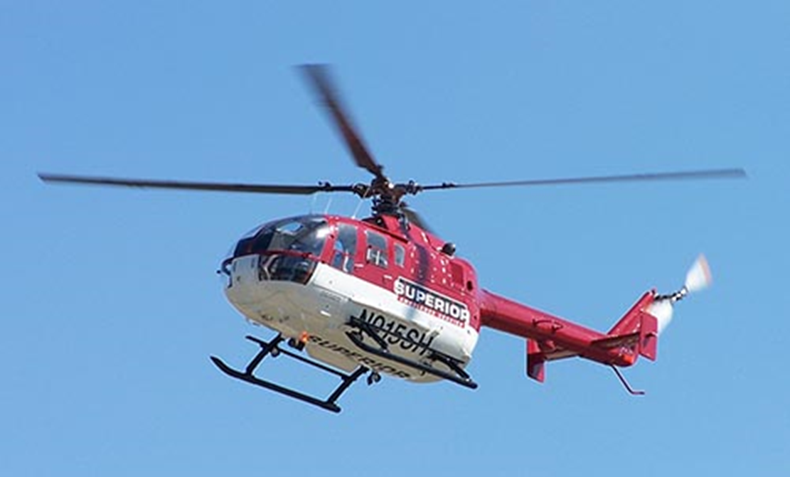
Air
What travels in the air?
Helicopter
Aeroplane

Slide 5
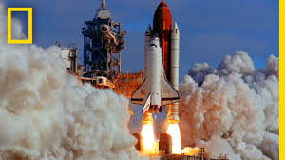
Air
Can you think of other ways to transport through the air?
Rocket

Slide 6
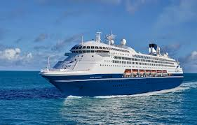
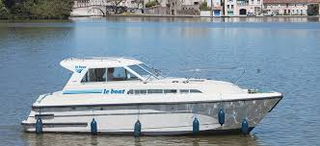
Water
What types of transport travel in the water?
Ships
Boats

Slide 7
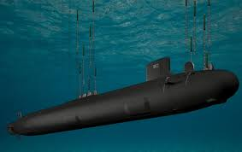
Water
Can you think of any other types of transport that can travel in the water?
Submarine

Slide 8
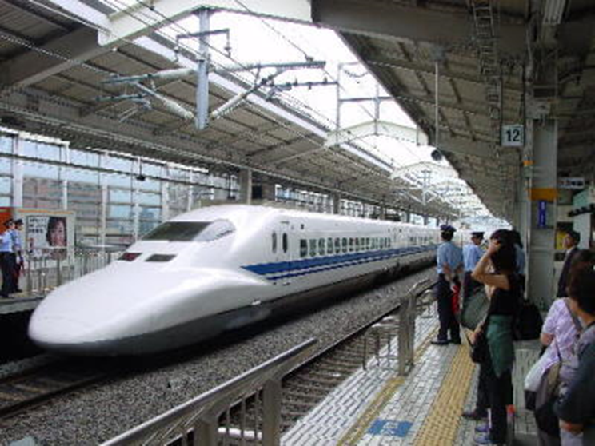
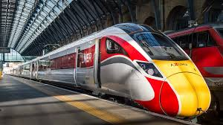
Land
What types of transport travel on land?
Train

Slide 9
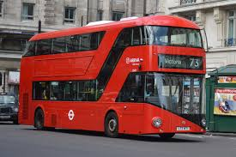
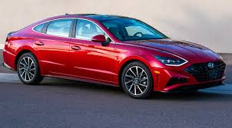
Land
What types of transport travel on land?
Car
Bus

Slide 10
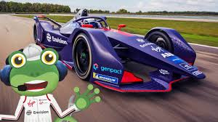
Land
Can you think of any other types of transport that can travel on land?
Racing car

Slide 11
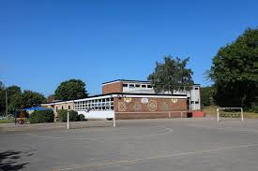
How do you travel to school each day?

Slide 12
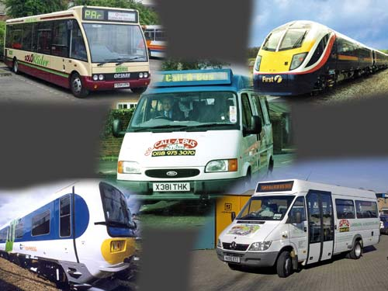
How would you like to travel?

Slide 13

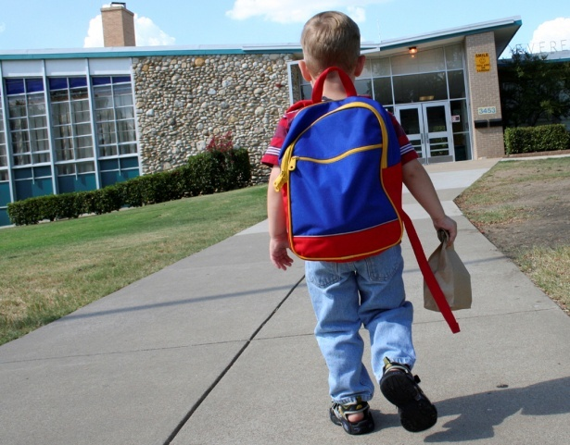
Can you sort the different types of transport into 3 groups: Air, Land and Water? See sheet attached

