Slide 1
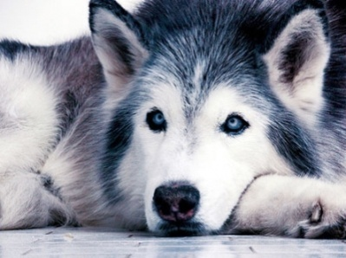
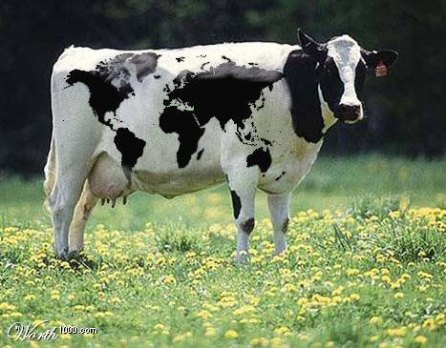
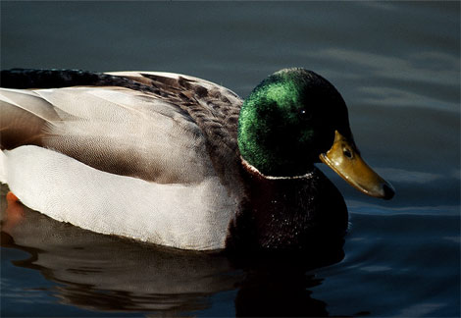
Living Things
Can you tell which are living and which are not living?

Slide 2
Living things:
Living things are alive. For example trees, people, dogs, cats and bees.
Non-living things:
Non-living things have never been alive. For example anything metal, stone or plastic.

Slide 3
Is it alive?
Find out how to tell the difference between things that are alive, not alive and have never been alive.
https://www.bbc.co.uk/bitesize/topics/z6882hv/articles/zs73r82

Slide 4
Look at the following slides and say if they are living or non living

Slide 5
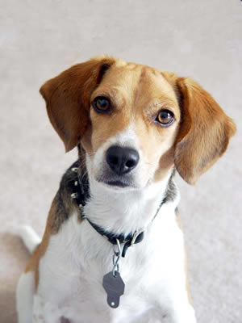
Dog

Slide 6
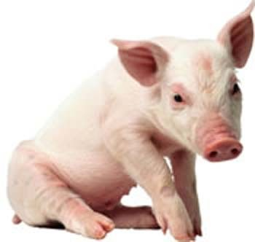
Pig

Slide 7

Teddy bear

Slide 8
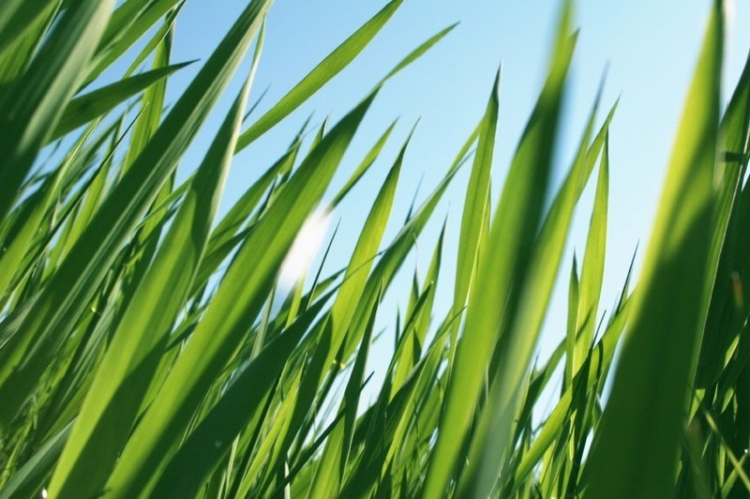
Grass

Slide 9

Football

Slide 10
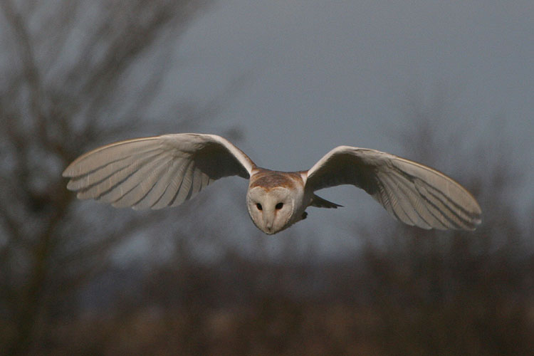
Owl

Slide 11
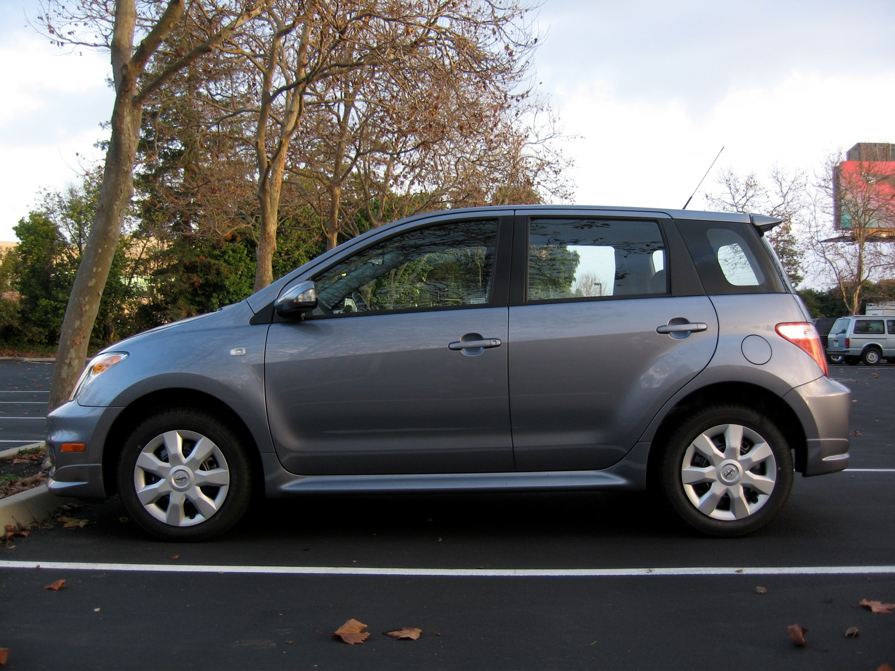
Car

Slide 12
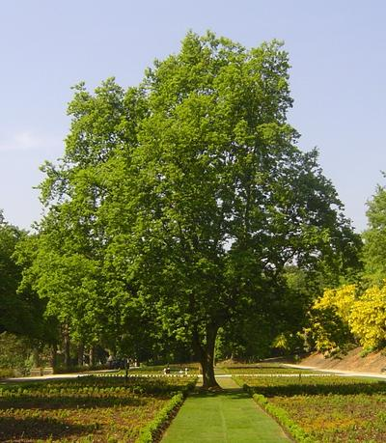
Tree

Slide 13
Duck

Slide 14
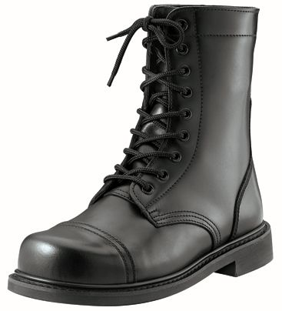
Boot

Slide 15
How many did you get right?

Slide 16
What is similar and different about these two living things?
Dog
Pig

Slide 17
Tree
Duck

Slide 18
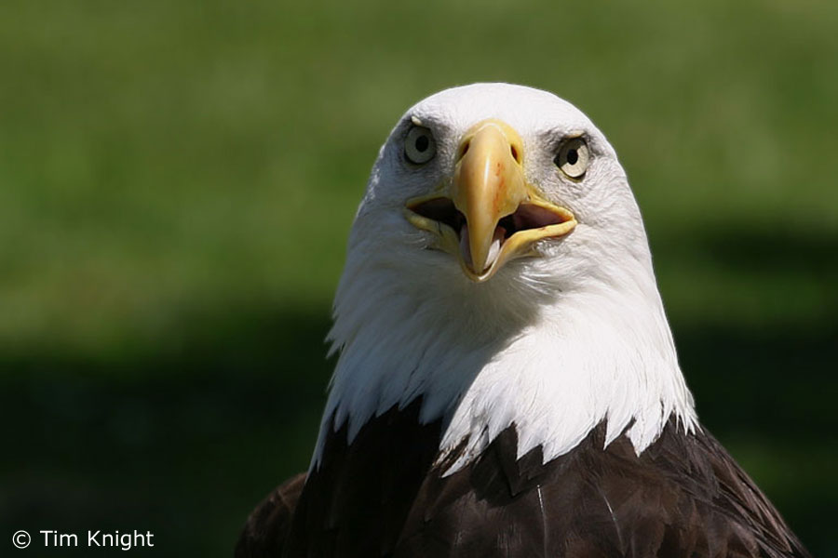
Owl
Eagle

Slide 19
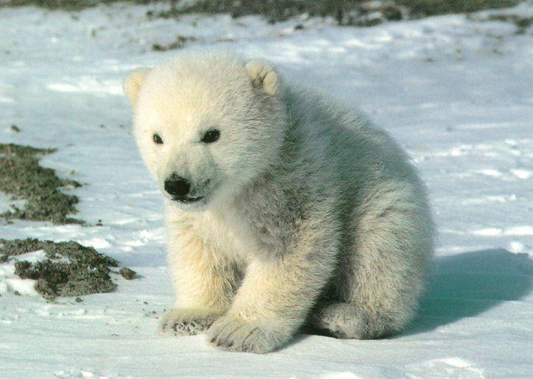
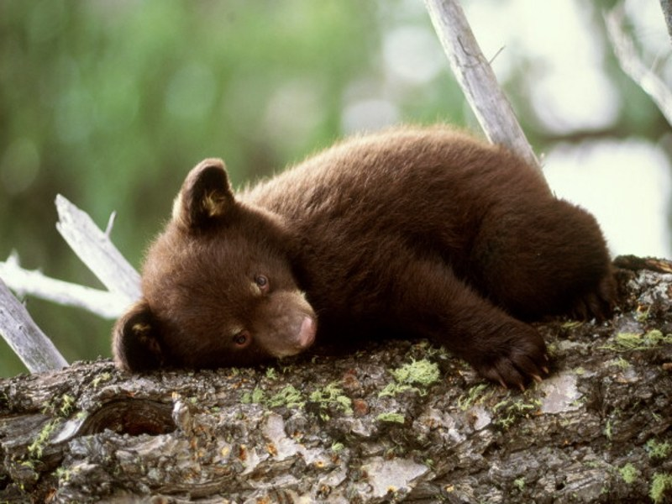
Bears

Slide 20
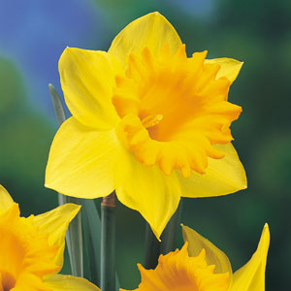
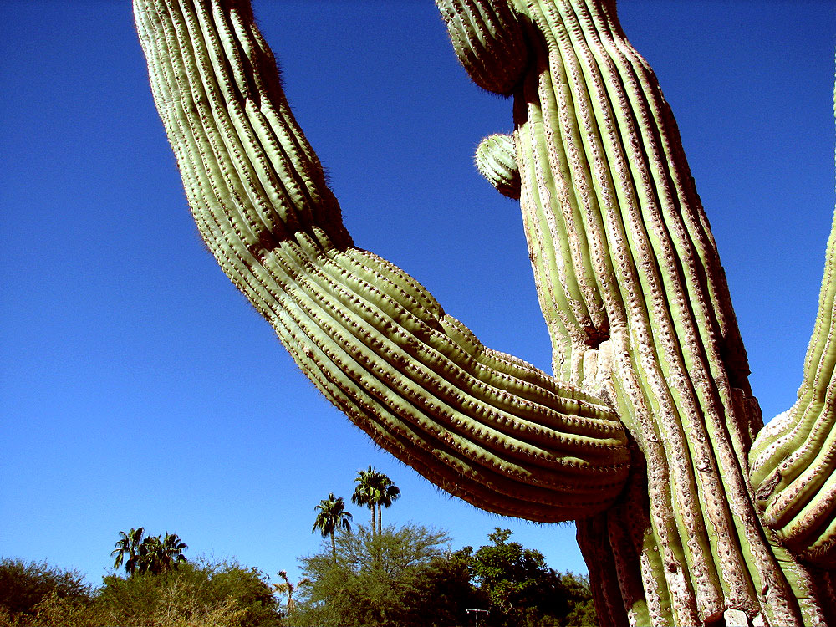
Plants

Slide 21
What do all of these humans have in common?
Can you spot any differences between them?

Slide 22


