Slide 1
English 6.7.20

Slide 2

Extended writing
This week, you are going to plan, draft and write
a tale of fear.

Slide 3

Let’s remind ourselves of the stories we have read.
https://www.literacyshed.com/chaperon-rouge.html
https://soundcloud.com/talkforwriting/red/s-pgmsBkkwTq6

Slide 4
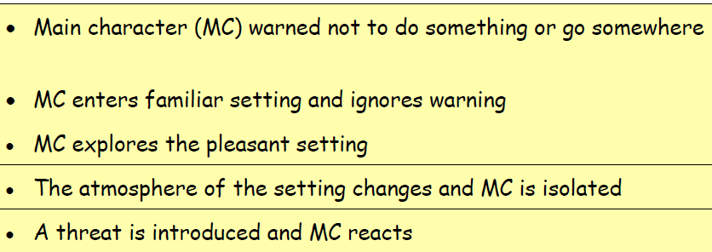
Planning your story
Red combines the patterns found in a tale of
fear with those associated with a warning story.
When we look at the under lying pattern, it
looks like this:

Slide 5

Planning
Once you have identified the pattern of the
story, the possibilities are endless. Let
imagination run free. Mind map lots of ideas
and then decide which captures your interest as
a writer.

Slide 6

Top Tips
Describe something familiar to you
e.g. a garden, your school, your local town, a park .....

Slide 7

Ideas
Let your ideas flow – don’t worry about spelling, handwriting or presentation...you can go back and edit this later.

Slide 8


Stimulus
Use a stimulus(e.g. picture)–an image will help
you focus in on the detail and describe what is
there.

Slide 9

Use a well-known story
When you are planning your own story, you may
like to replicate the idea of taking a traditional
tale and turning it into a tale of fear for an older
audience.

Slide 10
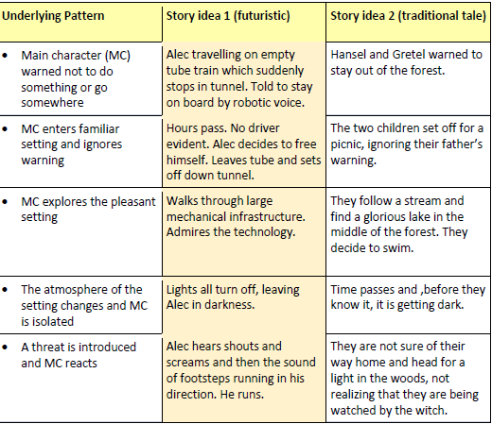
Here are some stories below to open your mind to the world of possibility:

Slide 11
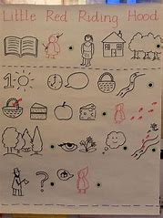
Planning
Using the underlying pattern, plan a story of
your own. You may like to draw upon your wider
reading and imagination.
Use planning tools such as a storyboard or a
story map.

Slide 12
Writing
You are going to write your tale of fear.
What will you need to include?

Slide 13
Description of the characters and setting
Use adjectives to describe your character:
What do they look like?
What is their personality?
Use adjectives to describe your settings:
Where is it?
What is the atmosphere?
How does it change?

Slide 14

Techniques to build tension such as:
short sentences
rhetorical questions
show not tell

Slide 15
Punctuation
capital letter and full stops
commas
apostrophes
colons
semicolons
Parenthesis - dashes, brackets and commas

Slide 16
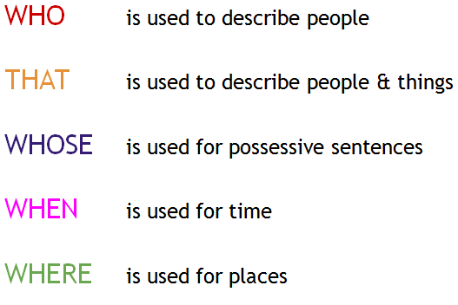
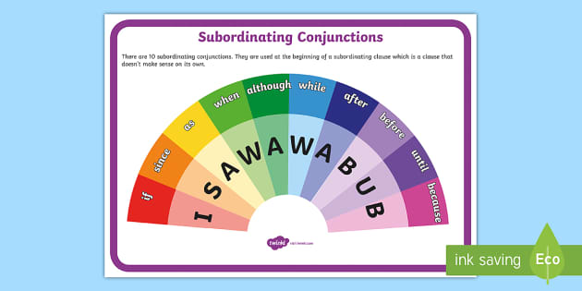
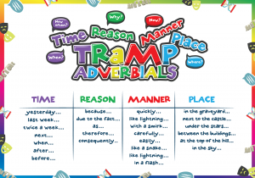
Sentence structure
Use relative clauses
Use subordinate clauses
Use adverbial phrases

Slide 17
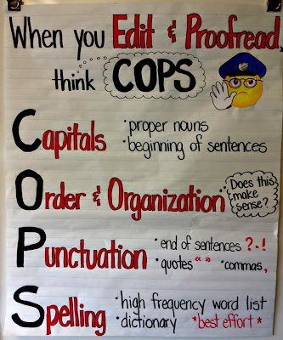
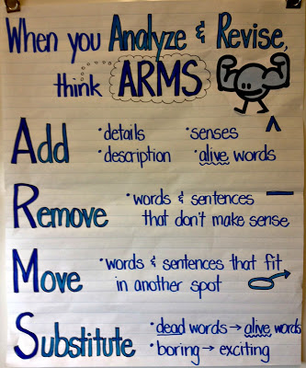
Editing

