Slide 1
Famous scientists
Santorio Santorio
(yes, he did have the same first and last name)

Slide 2
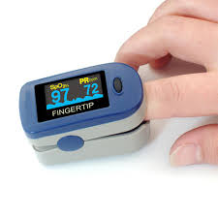
THE JOURNEY OF THE PULSE METER
We are going to learn about Santorio Santorio and how he compared people’s pulses with a pulsilogium.
We will be making a pulsilogium.

Slide 3
Why is it useful to know someone’s heart rate?

Slide 4
Heart rate is important because the heart's function is so important. The heart circulates oxygen and nutrient-rich blood throughout the body. When it's not working properly, just about everything is affected. Heart rate is central to this process because the function of the heart is directly related to heart rate.

Slide 5
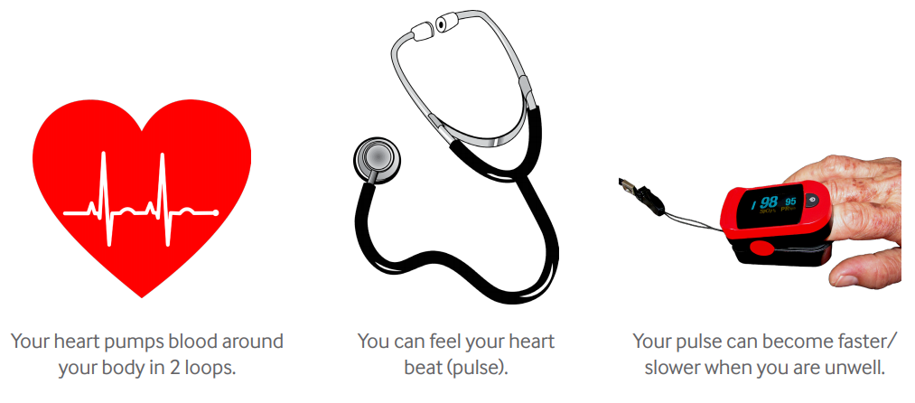

Slide 6
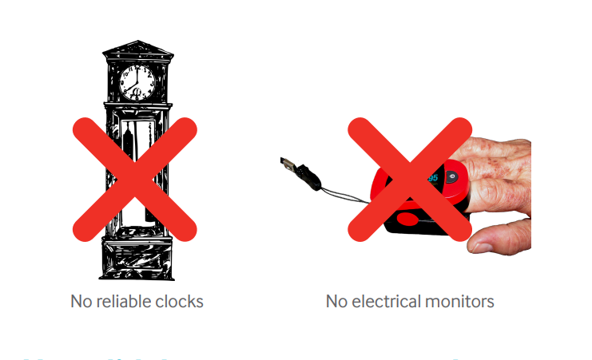
WHAT DID PEOPLE ALREADY KNOW?
Before Santorio, scientists already knew:
  A person has a pulse that can be felt through the skin.
  A patient’s pulse might change when he/she is unwell.
  The ‘period’ of a pendulum (the time it takes to swing) is determined by its length.

Slide 7
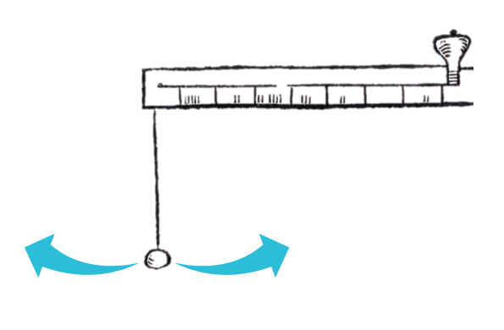
Santorio discovered:
That a swinging pendulum has a regular ‘beat’
The time taken (period) for a pendulum to swing out and back depends upon the length of the string.
  Your turn… How can you make a pendulum swing faster/slower? Hint: try changing the length of the pendulum. Have a go!

Slide 8
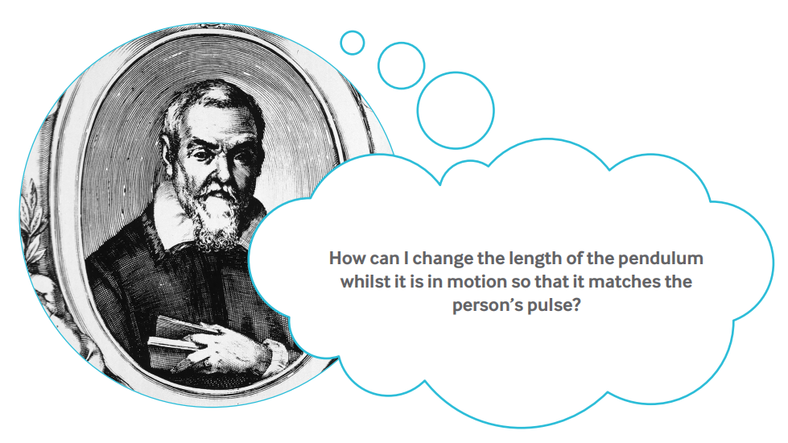

Slide 9
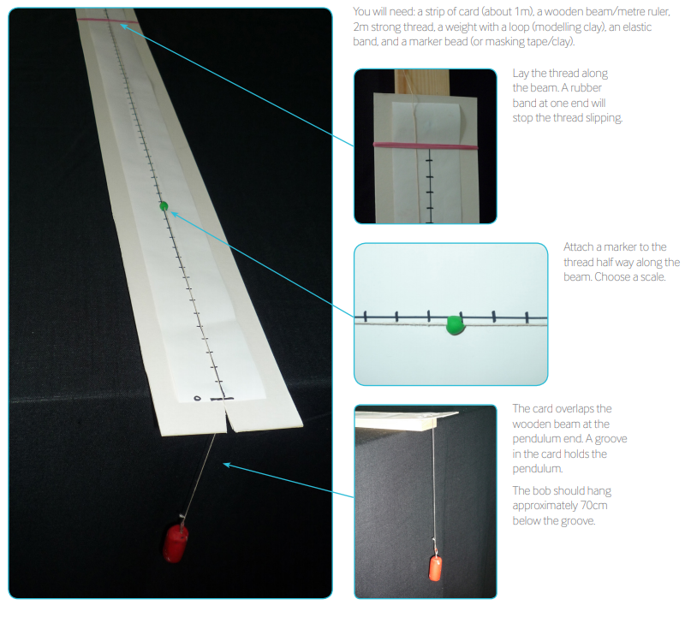

Slide 10
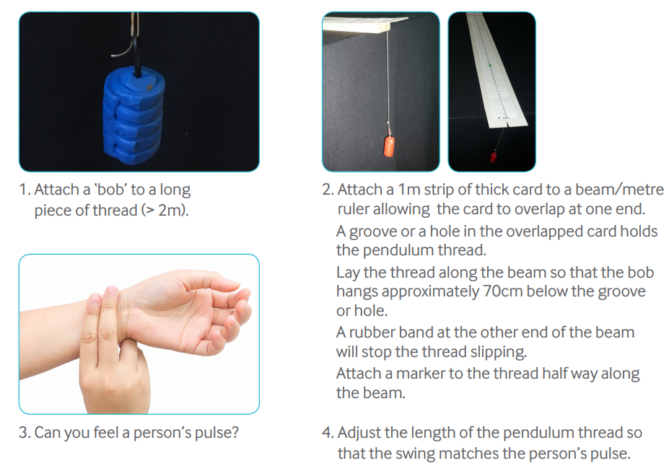

Slide 11
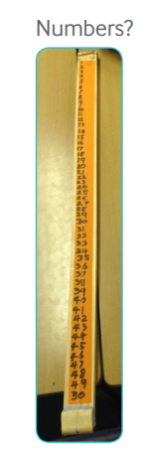
Santorio’s diagrams do not show what scale he used on his beam so we do not know what units he used to ‘measure’ pulse.
You need to choose a scale for your pulsilogium. Now you can record the patient’s pulse.

Slide 12
WHAT DID OTHER SCIENTISTS DO NEXT?
Nowadays we have accurate clocks. Any doctor anywhere can measure a patient’s pulse by counting the beats per minute. Oximeters measure the oxygen content of blood without needing to take a blood sample. They are routinely used in hospitals and clinics today for this purpose and to measure pulse. Electrocardiograms (ECG) are used today to detect heart (cardiac) problems. EGGs detect tiny electrical changes on the skin arising from the heart beating.

Slide 13
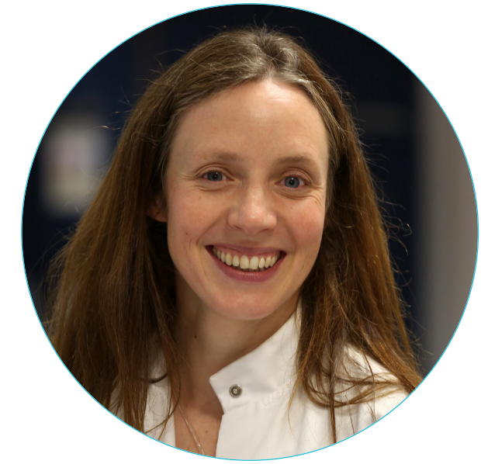
WHAT ARE CURRENT SCIENTISTS DOING?
Dr Kat Dibb is studying the grooves in heart cells that spread the electrical pulse of a heartbeat. Heart failure can result in loss of these structures. This research could lead to the development of new treatments to prevent dangerous heart rhythms from occurring.

Slide 14
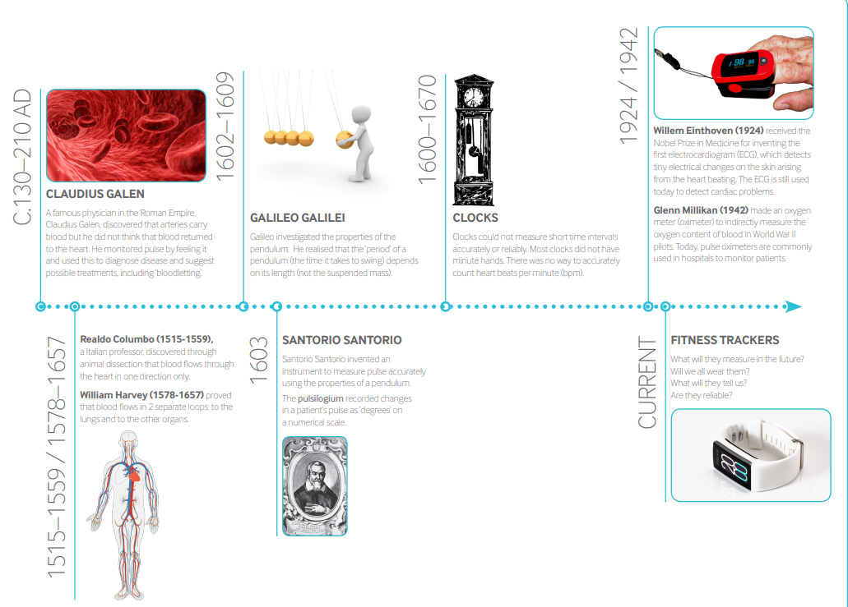
A timeline for measuring pulse

