Slide 1
Y5 English 6.7.20

Slide 2
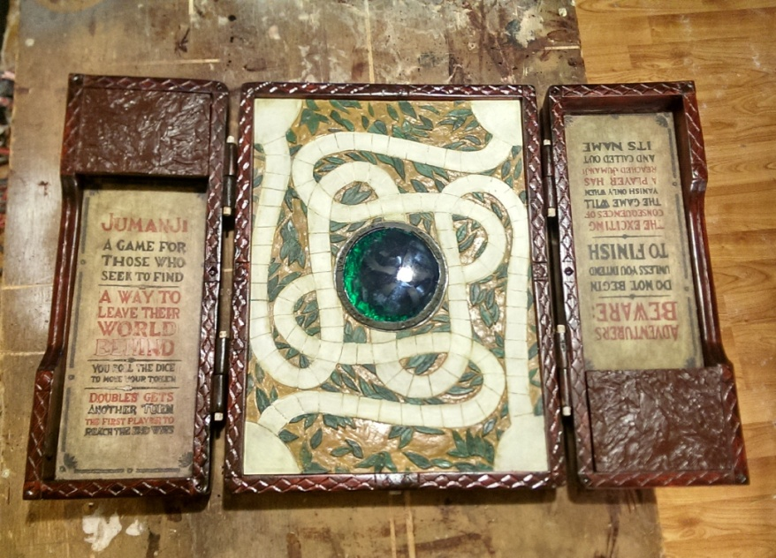
Extended writing
This week, you are going to plan, draft and write
your finding tale.

Slide 3
Let’s remind ourselves of the story we have read.
https://soundcloud.com/talkforwriting/game/s-7MBlxRcz8zL

Slide 4

Planning your story
Now let’s write a brand new finding tale. It doesn't
have to be set in school or involve a game. Here are a
few ideas to help your thinking. You could even write
about what happens when Billy investigates the game
the next time it’s wet play!

Slide 5
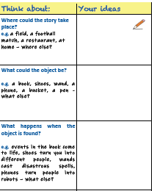

Slide 6
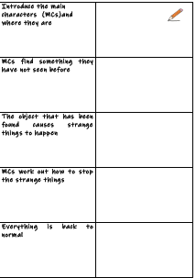
Planning

Slide 7

Ideas
Let your ideas flow – don’t worry about spelling, handwriting or presentation...you can go back and edit this later.

Slide 8



Stimulus
Use a stimulus(e.g. picture)–an image will help
you focus in on the detail and describe what is
there.

Slide 9
Planning
Using the underlying pattern, plan a story of
your own. You may like to draw upon your wider
reading and imagination.
Use planning tools such as a storyboard or a
story map.

Slide 10

Writing
You are going to write your finding tale
What will you need to include?

Slide 11

Description of the characters and setting
Use adjectives to describe your character:
What do they look like?
What is their personality?
Use adjectives to describe your settings:
Where is it?
What is the atmosphere?
How does it change?

Slide 12

Techniques to build tension such as:
short sentences
rhetorical questions
show not tell

Slide 13
Punctuation
capital letter and full stops
commas
apostrophes
colons
semi-colons
parenthesis - dashes, brackets and commas

Slide 14
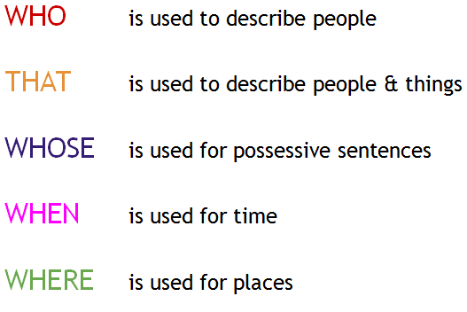
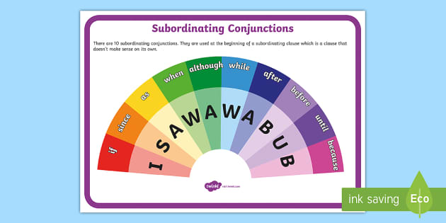
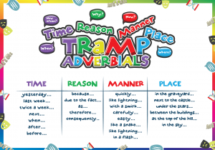
Sentence structure
Use relative clauses
Use subordinate clauses
Use adverbial phrases

Slide 15
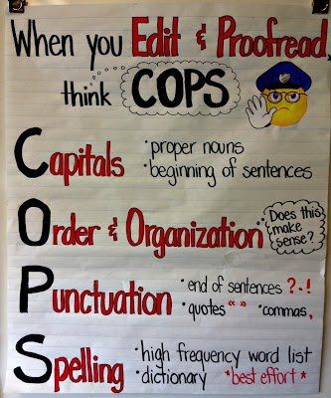
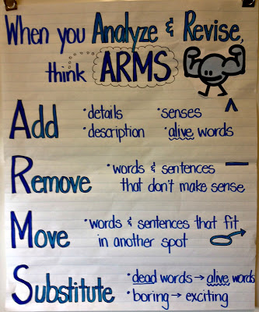
Editing

