Slide 1
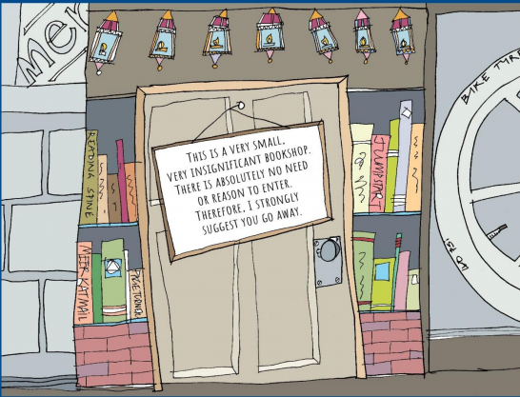
Year 3 and 4 English Home Learning ​
Week Commencing 6th July 2020

Slide 2
Parent notes – We understand how writing a plan and then moving on to writing a story can develop over a few days.
This week the planning is not broken down into 5 days worth of lessons as it has been in previous weeks.
This week we have the planning stage, writing stage and some extension activities.

Slide 3

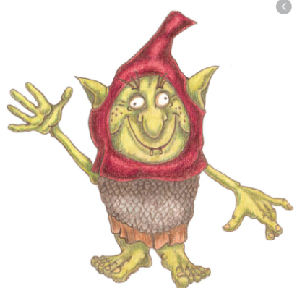
Last week, you were introduced to the story of ‘The impossibly possible Bookshop’. By this stage you will have created your own goblin character and thought about what your goblin might like to eat and drink.
You should know your character pretty well by now!

Slide 4
This week you will be planning and writing your own version of ‘The Impossibly, Possible Bookshop.’
By Friday you will have your own version of the story.
Our first task today is to make sure we are familiar with the original story.
Please have another read through ‘The Impossibly, Possible Bookshop.’

Slide 5
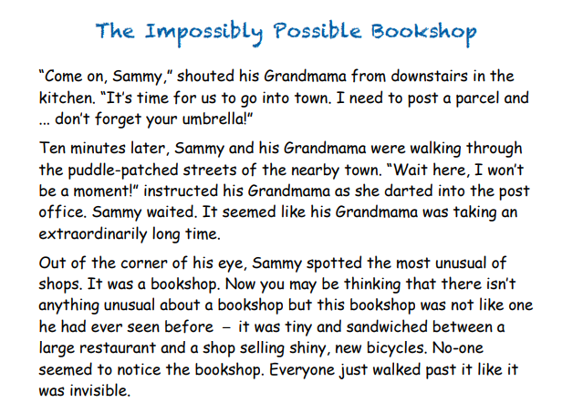

Slide 6
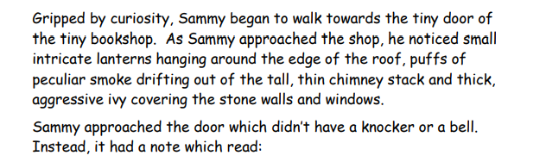
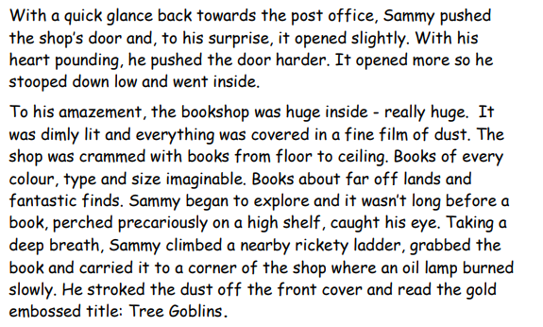

Slide 7
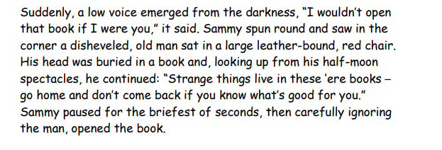
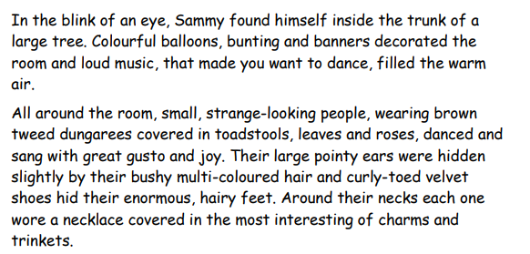

Slide 8
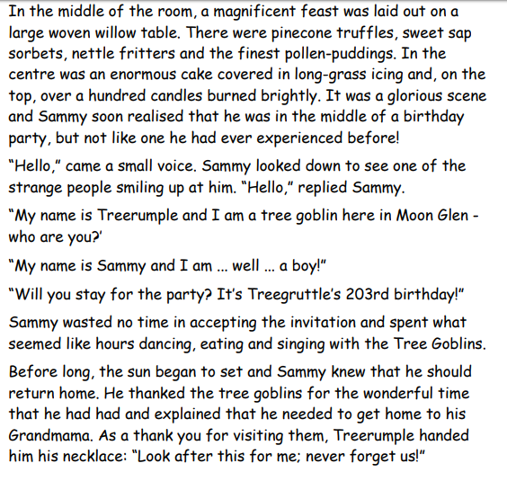

Slide 9
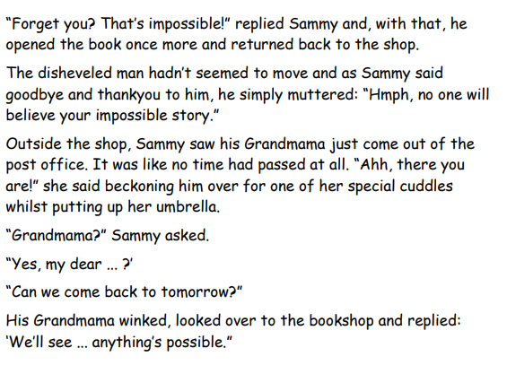
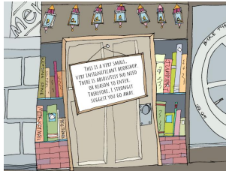

Slide 10

Can I plan my own portal story?
First we are going to look at the basic plan for a portal story and compare this with the basic plan for ‘The Impossibly, Possible Bookshop’ story.

Slide 11
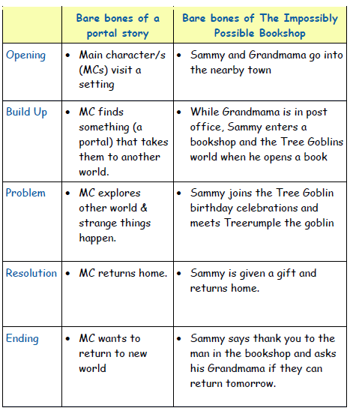
If possible, it would be helpful to have a copy of the story printed next to you whilst you read through the plan. This means you will be able to see which paragraph links to the different parts of the plan.

Slide 12
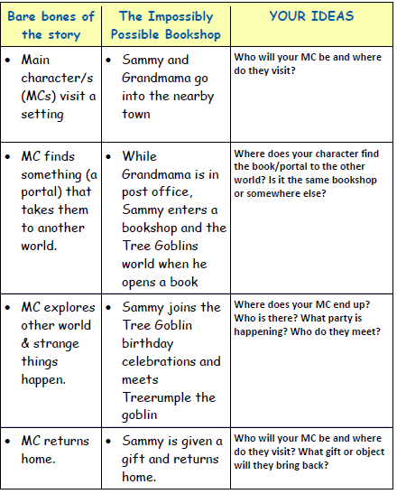
Now it is your turn. Using the plan above, you are going to have a go at planning your own portal story.
Opening
Build Up
Problem
Resolution

Slide 13
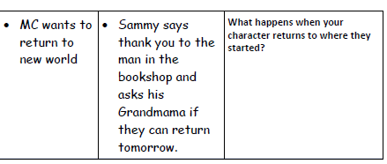
Ending
Sometimes it can be hard to create your own story ideas. On the next slide, you will find some ideas to help you when planning your story.

Slide 14
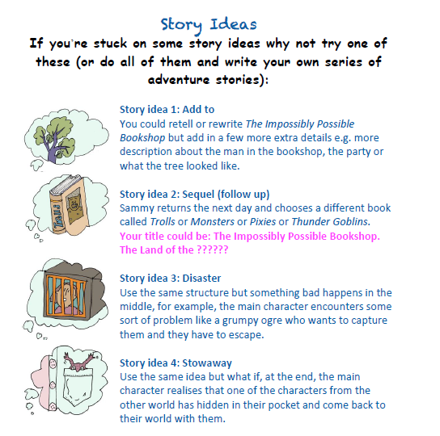

Slide 15
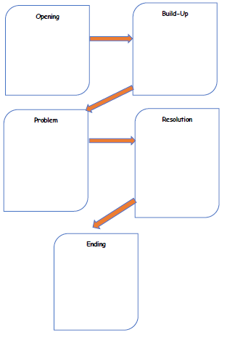
Remember, when you are planning, you only need to make notes or write short sentences.
Your plan could contain some vocabulary ideas too so that you do not forget any great descriptive words.

Slide 16
L.C Can I write my own portal story?
Today, is your time to write your own portal story.
Remember to have your plan in front of you. A dictionary and a thesaurus could be useful too.
Don’t forget all of the different things we have been focusing on this half term. Your teachers will be looking out for these when you send in your writing.
Capital letters and full stops
Fronted Adverbials (Don’t forget the comma)
Speech (Don’t forget inverted commas, a variety of speech verbs, commas, punctuation inside the inverted commas)
Prepositions
Conjunctions

Slide 17
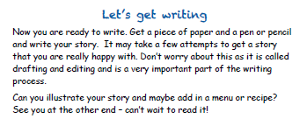

Slide 18
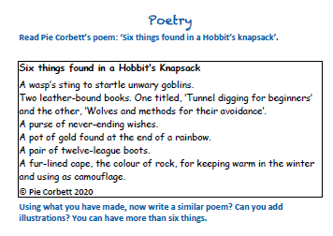
Extension Activities

Slide 19
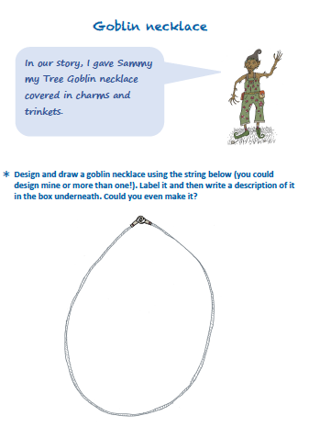

Slide 20
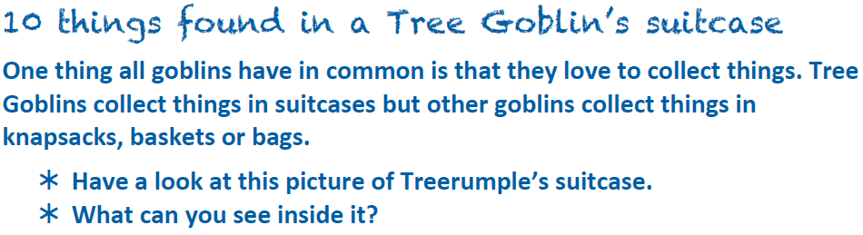
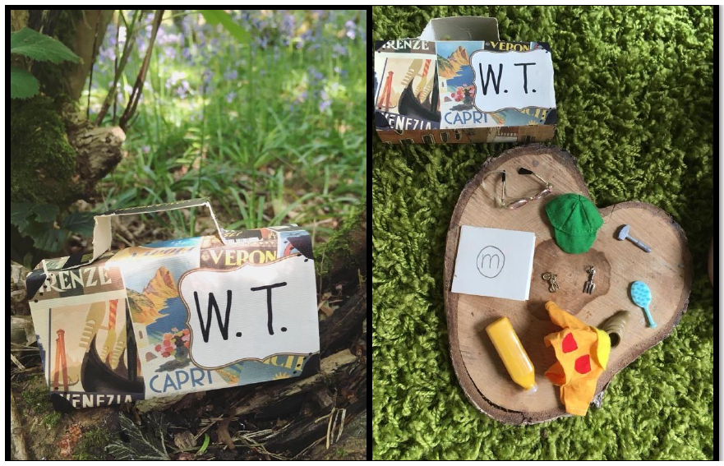
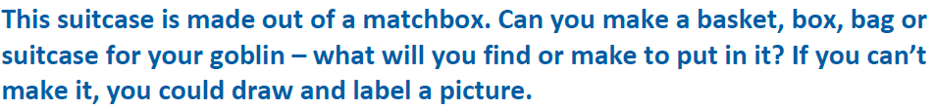

Slide 21



