Slide 1
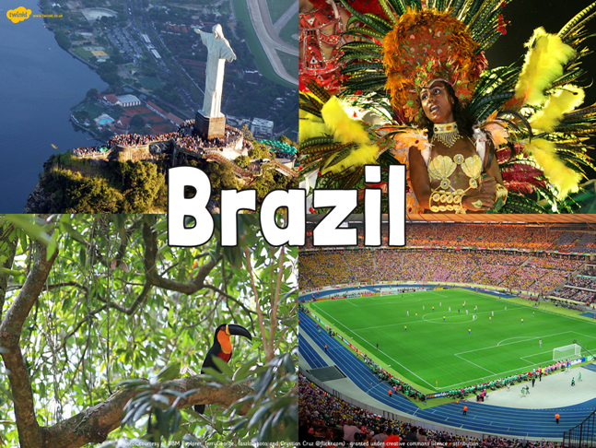
Week 6

Slide 2
Brazil – what do you know?
Name two countries in South America which do not share a border with Brazil?
If you swam in the ocean from Copacabana Beach in Rio, which ocean would you be swimming in?
What is the name of the city which is within the Amazonian region?
Why is Rio known as a city with two halves?

Slide 3
Brazil – what do you know?
Name two countries in South America which do not share a border with Brazil? Ecuador and Chile
If you swam in the ocean from Copacabana Beach in Rio, which ocean would you be swimming in? South Atlantic Ocean
What is the name of the city which is within the Amazonian region? Manaus
Why is Rio known as a city with two halves? Because favelas sit next to very wealthy areas

Slide 4

LC: Can I explore the culture of Brazil?

Slide 5
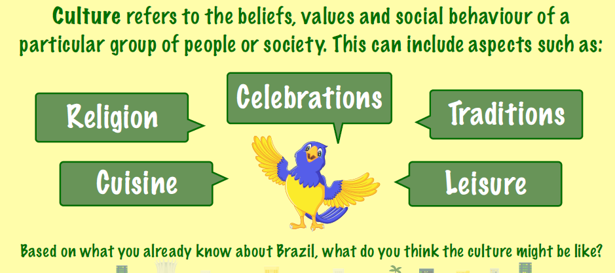

Slide 6
Food and Drink
Brazil has a wonderful variety of traditional foods influenced by its mix of many cultures.
Lunch is usually the biggest meal of the day, especially outside of Rio de Janeiro
Brazil’s unofficial national dish is a thick stew called ‘feijoada’, made with black beans (‘feijao’) and pork.
The recipe came to Brazil with the slaves who arrived from Africa in the 16th century. It is cheap to make, uses leftover food. Originally, it used every part of the pig, even the ears, tails, feet and nose!

Slide 7
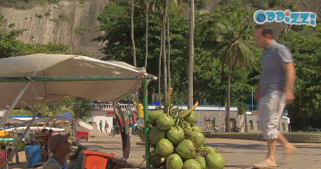
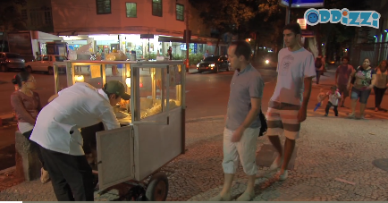
Street Food
Street food is popular in Brazil – you will find popcorn stands and fresh coconuts for sale in many places.

Slide 8
Festivals / Carnivals
Carnival is a very famous Brazilian festival. It takes place in February / March every year – the dates change as it is linked to the religious calendar.
Carnival begins on the Friday before Ash Wednesday and continues up to and including Ash Wednesday itself. One of the biggest street parties during Carnival takes place on the day before Ash Wednesday, called Mardi Gras (meaning ‘Fat Tuesday’ – a name that relates to the feasting that takes place on this day)
Everyone in Brazil celebrates carnival – offices, schools and shops close for anything up to 10 days.

Slide 9
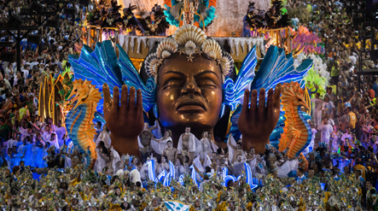
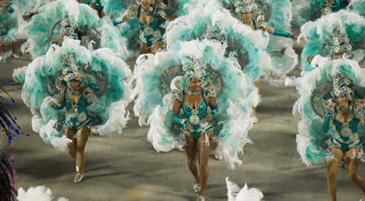
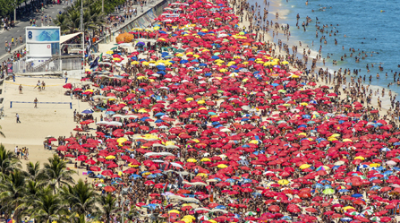
People spend more money at Carnival than they do at Christmas and party more than they do for New Year.

Slide 10
The Samba
Click on this link for a tutorial into dancing the Samba – the most popular dance at Carnival in Brazil.
If you are at home / have space in the classroom – have a go!
https://www.bbc.co.uk/bitesize/clips/z2wg9j6

Slide 11
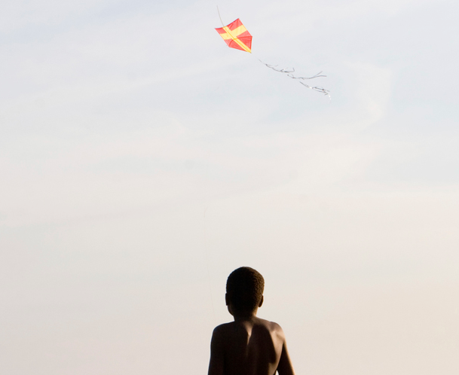
Sports and Leisure
Kite-flying is one of the most popular pastimes in the poorer neighbourhoods of Brazil’s cities and is enjoyed by young and old. Brazilians will happily fly kites from a Rio beach, or from a small patch of scrubby green grass in São Paulo.
In all big cities you’ll see kites being flown from the rooftops of the slum areas – often so many at a time that the kites get tangled!

Slide 12
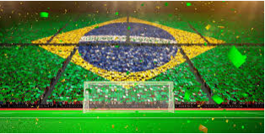
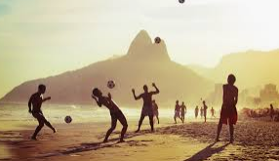
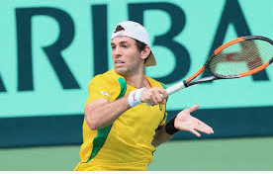
Sports
Sport is a national passion. Brazil hosted the 2014 FIFA World Cup and the 2016 Olympic Games in Rio.
Some of the most popular sports nationally include football – Brazil’s national sport, together with volleyball, motor-racing and tennis.

Slide 13
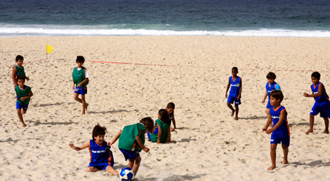
Football
The most popular and widespread sport in Brazil is, undoubtedly, football. Children play football everywhere in Brazil, from school playing fields to busy street corners, on the beach and in overgrown, abandoned car parks

Slide 14
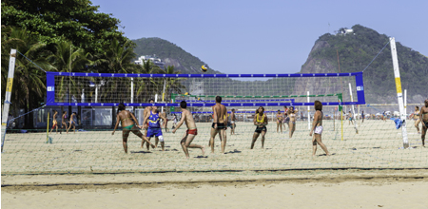
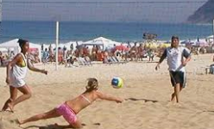
Volleyball
Volleyball is the second most popular sport in Brazil, with the Brazilian national teams – men and women’s – among the strongest in the world.
Brazil also dominates the sport of beach volleyball.
Children learn the game by watching older players practise on the sands. If they can afford it, some will attend private escolinhas de vôlei (volleyball schools).

Slide 15
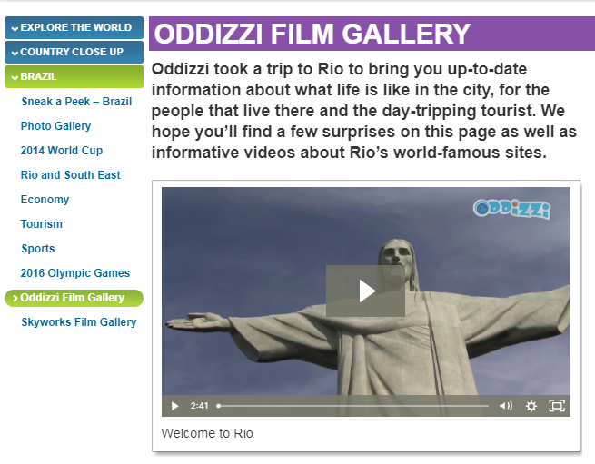
For videos about Brazilian culture go to www.oddizzi.com
Free Log in at the moment
Username: Homeschool Password: Oddizzi
Go to the country close up section and choose Brazil
Scroll down to here

Slide 16
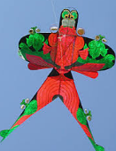
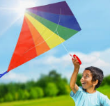
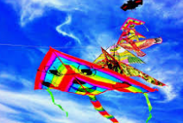
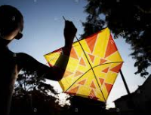
Task choice 1
Children in Brazil make their own kites to fly – can you design a kite to be flown over the city of Rio?

Slide 17
Task choice 2
Carnival is huge in Brazil –
  Design your own carnival costume (it can be as flamboyant as you like).
  Design your own poster to promote the carnival in Rio de Janeiro for 2021.
  If you are at home, why not send some of your designs to the school magazine?

