Slide 1
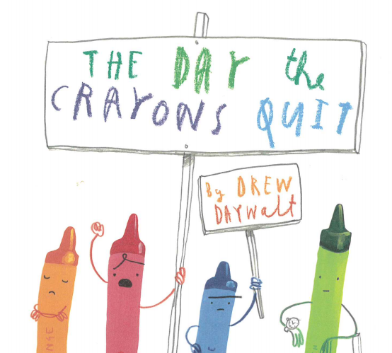
Week 3

Slide 2
A copy of the PowerPoint story and link have been included again if you need them to support your learning.
Read
‘The Day The Crayons Quit’ (separate Power Point )
You may also wish to watch this:
https://www.youtube.com/watch?v=489micE6eHU

Slide 3
Lesson 1

Slide 4
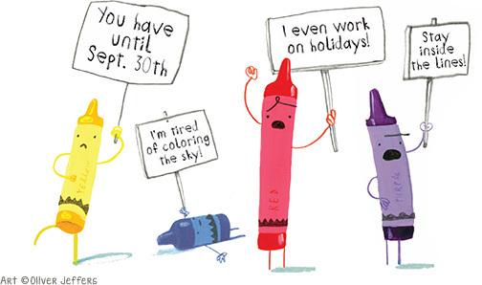
Duncan’s crayons decided to ‘quit’ for a range of different reasons. Some were overworked, exhausted and needed a little rest whilst others felt a little sad and ignored!
Lesson 1

Slide 5
Lesson 1
What items in your house might feel like quitting?
These could be items in your pencil case that feel over or under used?
Maybe it’s things that belong in your bedroom? Or the kitchen?
It could be items in your wardrobe or toy cupboard.
Start to think about how these items might be feeling?
What reasons would they give for quitting?

Slide 6
Decision time!
Lesson 1
wardrobe
Now choose one of the categories that appeals to you most.
Make sure that you choose an idea that has lots of items and reasons for wanting to quit.
toy box
Kitchen
bedroom
pencil case
book shelf

Slide 7
1. think of several items that fall into your chosen category.
Try to think of some items that maybe feel a little lonely, sad and neglected as they aren’t used often and those which possibly feel a little overused or taken for granted.
2. Around each item, thought-shower the jobs and feelings each item has.
Lesson 1
Using your chosen theme:
See the next slide for a bit of help!

Slide 8
For example:
wellington boots
Lesson 1
Chosen theme: Footwear
sandals
trainers
party shoes

Slide 9
For each item in your category, give some reasons…
Get bored and lonely as have to live I a special box to keep me clean.
Always getting dirty.
Never get to go anywhere posh. It’s like you’re ashamed of me.
Party shoes
trainers
Even when I eventually get to go out I have to be sooooo careful not to get scratched or dirty!
Exhausted from 2 PE days a week and 5 after school clubs! Not to mention weekends.
Laces are always coming undone.
Only ever get to go out on really special occasions.

Slide 10
Lesson 2

Slide 11
Return to your plan from the previous lesson. Choose one of the items that you found it the easiest to think of lots of feelings and reasons why they might quit.
Write a letter from the item, just like Duncan’s crayons did. Remember, your item might actually be writing to you!!!
Remember to include what is wrong with the way you (as the item) are being used at the moment and how you would like to be treated in the future.
Lesson 2

Slide 12
Lesson 2
Dear ...,
I am your ...
I am writing because I feel ...
You have been ... and I am ...
I don’t like it when you ...
In future, please could you …
Yours truly,
…
You may find these sentence/paragraph openers helpful when organising your letter.
Don’t forget, you can return to the original book and remind yourself of some of the letters the crayons wrote.

Slide 13
Lesson 3

Slide 14
Checking and editing your work!
Lesson 3
It is always important to take time to check back through your own work. Yesterday you were the writer, today be the reader!
Use your finger to track through each word, checking for spellings and punctuation.
Are there any words you can improve? Think about better, more ambitious vocabulary. Remember, you don’t need to rub words out- simply put a line through the original word and replace with a better word above.
Did you miss any words out? Add these words in using ^
Did you spot any spelling mistakes? Or are there some word you know that aren’t quite correct but you need a little help with
Have you remembered to extend some of your sentences with a conjunction?

Slide 15
Writing or drafting an original piece of work and then editing and improving it is all part of the writing process.
There is the option to then re-write your final letter in best, also focussing on handwriting and presentation.
You may even wish to add some illustrations.
Lesson 3
We would love to see some of your letters. Snap shots of the different stages of writing would be great. You may even wish to bring your letter to life and read it to us via a video, using different expression in your voice to really portray how your item is feeling.
12HP@bramhopeprimaryschool.co.uk
12F@bramhopeprimaryschool.co.uk
12G@bramhopeprimaryschool.co.uk

Slide 16
Lesson
4 & 5

Slide 17
As we come to the end of our ‘The Day the Crayons Quit’ focus, here are some final options of tasks you may choose
to enjoy…

Slide 18
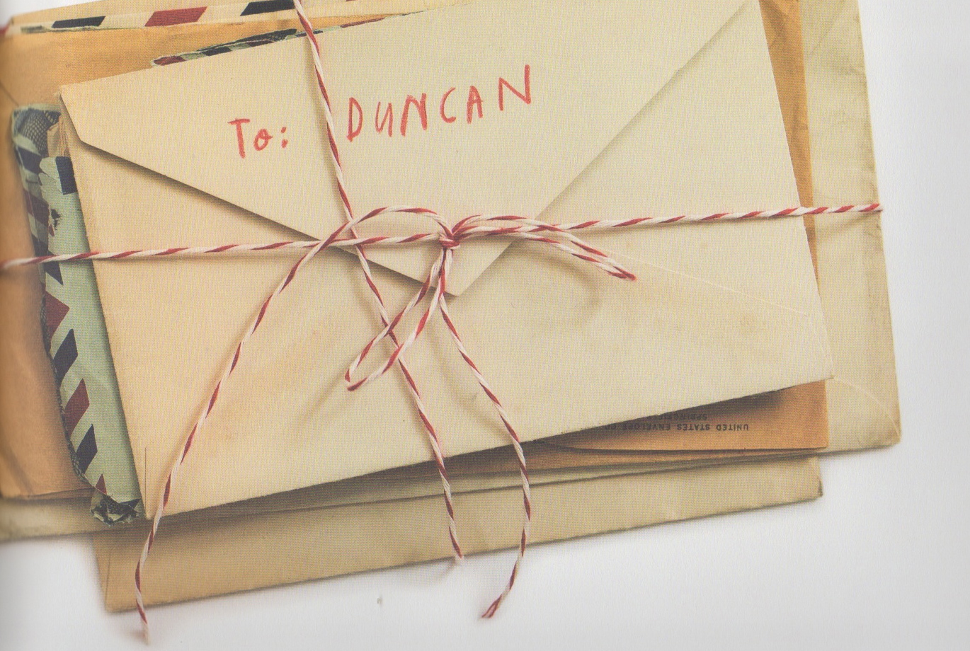
Write some more letters from the items you selected.
Maybe you could end up with a pile of letters just like Duncan did!

Slide 19
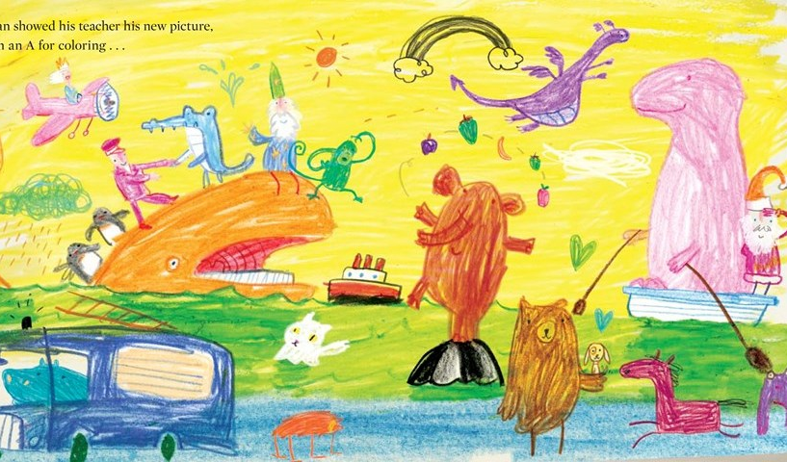
Take a look at where Duncan has taken into account the thoughts and feelings of the crayon
Look at the final two-page spread picture in the book.
Which objects has Duncan coloured in the ‘wrong’ colours and why do the children think he chose these particular colours to use?
How has Duncan responded to the crayons’ complaints in this picture?
Can you spot all the places in this picture where Duncan has taken account of a particular crayon’s complaint?

Slide 20

Enjoy the sequel to the book,
‘The Day the Crayons Came Home’
https://www.youtube.com/watch?v=XKmJ2NRhcgo
How is this one similar / different? Which do you prefer? Why?
Maybe you could write a book review for this version.

Slide 21
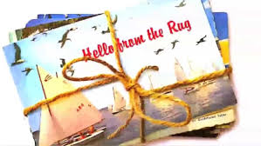
Maybe you could write a postcard or a set of postcards for your items wanting to come home?
Or a postcard from an item that often goes missing in your house (a toy car that ends up underneath the sofa, a missing sock or shoe from a pair etc).

Slide 22

The End

