Slide 1

Using an Apostrophe of Possession with Singular and Proper Nouns

Slide 2
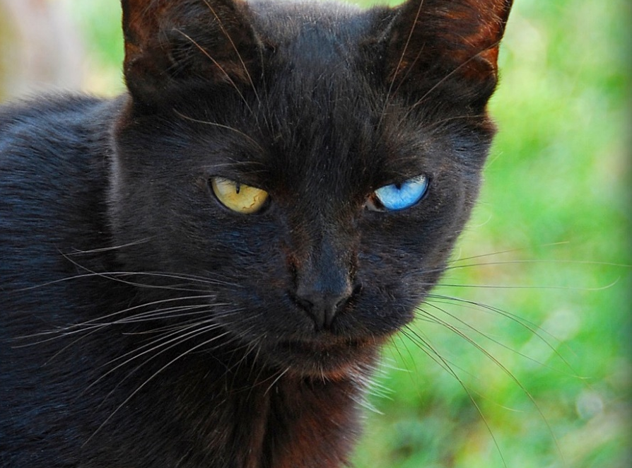
Apostrophes
An apostrophe is the same shape as a comma (,) but placed above the line (‘).
In this Presentation, we will explore the first use of apostrophes.
Apostrophes show two things:
That one thing belongs to another.
That some letters of a word have been left out to shorten the word.

Slide 3

Showing Possession
Apostrophes can be used to show that something belongs to someone or something. This is called possession.
When we are talking about one thing, we call this singular.
For example, a man or a bike.
When we need to say that something belongs to something singular, we put an apostrophe and then an ‘s’ at the end of the name it belongs to.
e.g. the man’s bike.

Slide 4

Showing Possession
We also use an apostrophe and an ‘s’ to show when something belongs to a proper noun (a name that begins with a capital letter).
e.g. India’s national flag has three horizontal stripes on it.

Slide 5

Apostrophes of Possession
The next few slides show examples of how to use apostrophes of possession with singular and proper nouns.

Slide 6
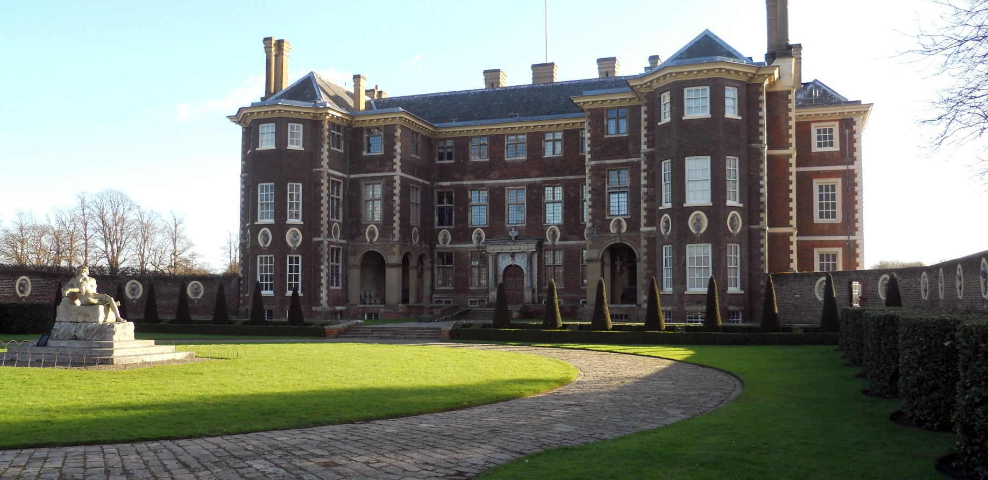
Apostrophes of Possession
Catherine’s house is old and large.

Slide 7

Apostrophes of Possession
The cat’s eyes are different colours.

Slide 8
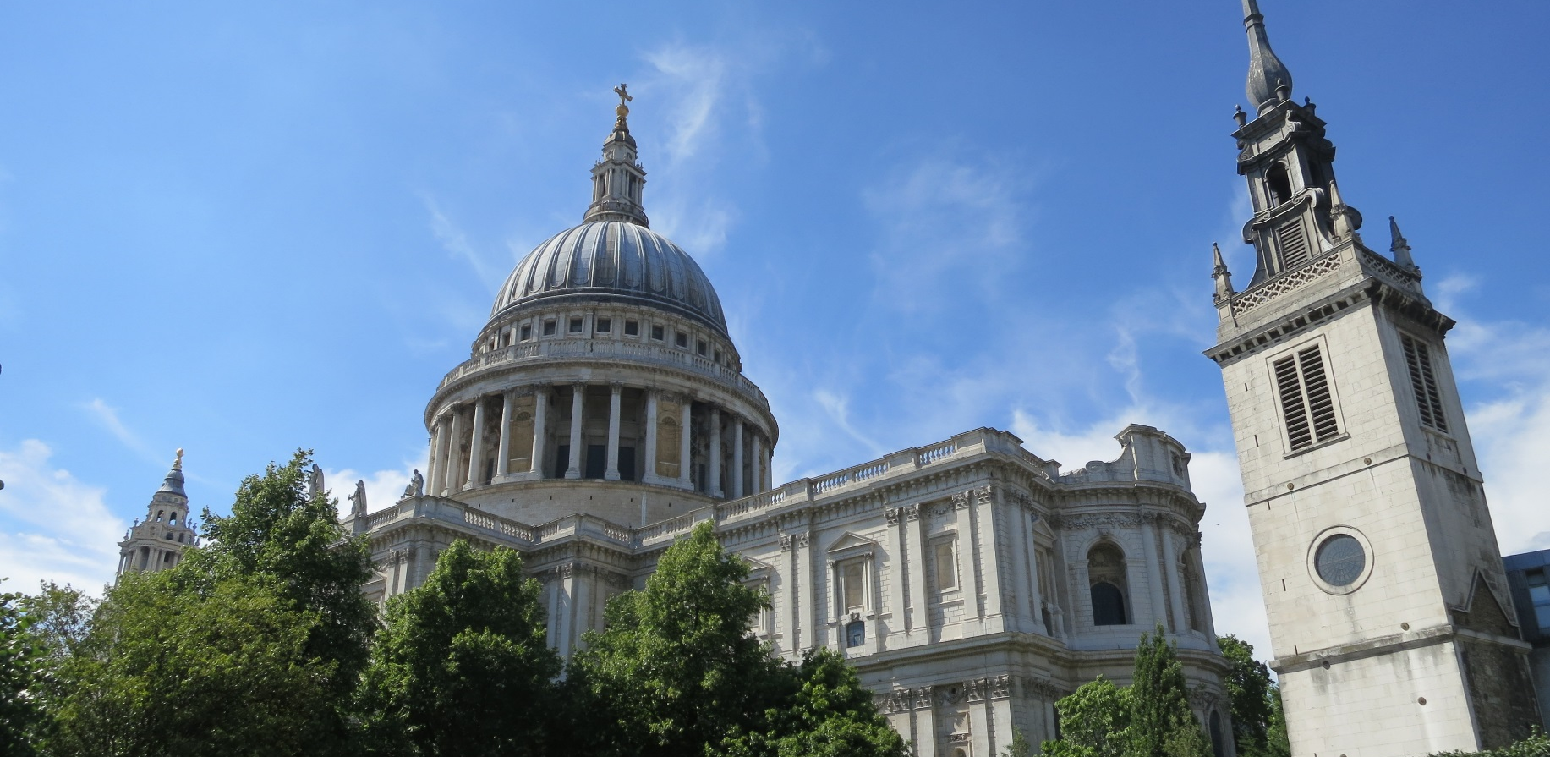
Apostrophes of Possession
St Paul’s Cathedral is in central London.

Slide 9

Apostrophes of Possession
Rachel’s favourite sport is running.

Slide 10
Apostrophes of Possession
The forest’s light is always changing.

Slide 11

Apostrophes of Possession
The Statue of Liberty is probably one of America’s most
famous landmarks.

