Slide 1
English 29.6.20

Slide 2

Reading
L.C. Can I answer comprehension questions?

Slide 3
Reading
We are now going to revisit the story and try to dig a little deeper. For each, you will need to go back and find evidence in the text that supports your opinion. Try to form a calculated, cohesive response. For some questions, it may help if you follow this simple pattern:
1. Answer the question with a statement.
2. Back up your statement with evidence found in the text.
3. Explain how the evidence supports your statement.

Slide 4

Strategy 1 : Summarising
In no more than 30 words, write a summary of the story Red. Think about the key events that are instrumental in the story.

Slide 5

Strategy 2 : Questioning
Re-read the story and make a list of six questions that you have as a reader. You may like to question the character’s actions as well as the author’s intent.

Slide 6
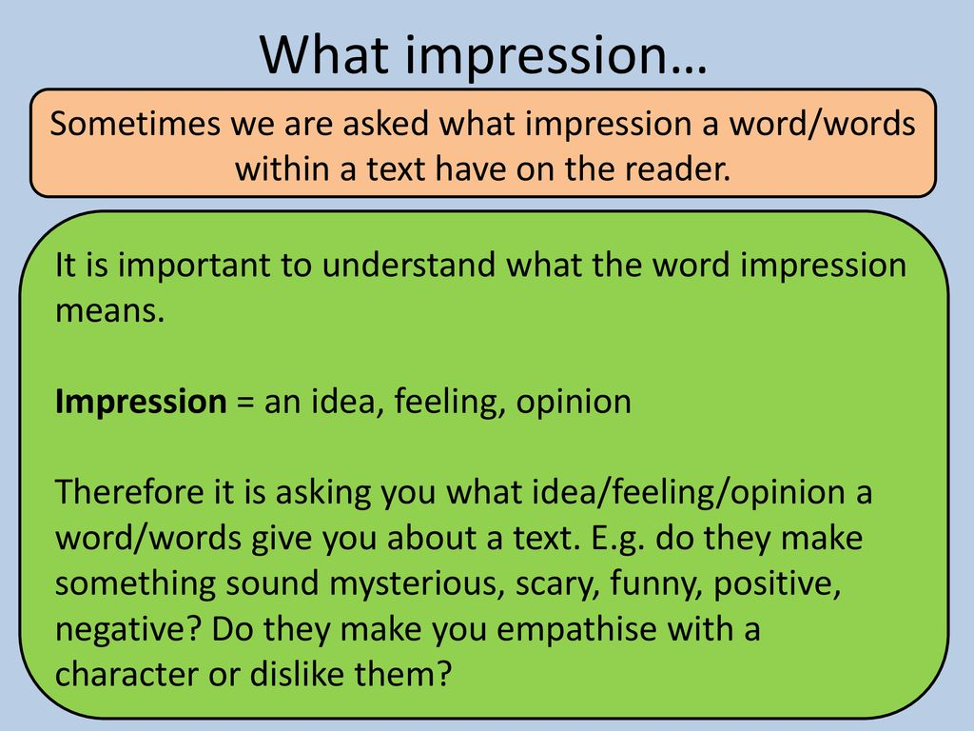
Strategy 3 : Clarifying meaning
What is your impression of Red at the beginning of the story? What led you to this opinion? How does your impression of Red change as the story unfolds?

Slide 7

Strategy 4 : Predicting
The story ends on a cliff-hanger. What do you think will happen next and what led you to this prediction? Have a go at writing the next paragraph of the story.

Slide 8
Grammar
L.C. Can I analyse effective writing tools?

Slide 9
Tales of fear
A tale of fear has to evoke an intense emotion in the reader. It has to have the reader on the edge of their seat, desperate to find out what is going to happen next.
To do this, we need to be able to analyse the tools that authors use to create this desired effect.

Slide 10
Tales of fear
Once we have identified these tools, we can then use them in our own writing.
Think about how they intensify the situation through the use of suspense, action and description in the final paragraphs.

Slide 11
Analysis
Analysing the text almost line-by-line, let’s see how many tools we can identify that help intensify the feeling for the reader.

Slide 12
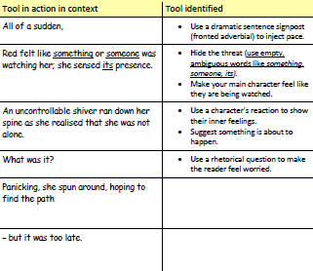

Slide 13
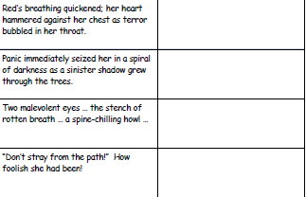

Slide 14
Tool in action
Go back through the story and highlight any other tools you can find that add to the intensity of the story.

Slide 15
Writing
L.C. Can I practise writing a tale of fear?

Slide 16

Writing
Before you have a go at writing your own tale of fear, it is important to practise some of the tools.
From the toolkit we generated, a s well as the tools you have magpied from other novels, choose 4 or 5 to explore through short-burst writing. Use the stimulus below to create a paragraph or two that evokes fear in the reader.

Slide 17
Example:
Kate held her breath. She knew it was listening. Fear clawed at her stomach, but she had to stay silent. Sinister shadows crept across the stone-cold walls. It was getting closer; she was trapped. Suddenly, the lights turned off, plunging her into darkness.

Slide 18
Spelling
L.C. Can I use vocabulary in context?

Slide 19
Vocabulary
1. strenuous
2. legendary
3. rotund
4. enthralling
5. monumental
6. stupendous
7. cache
8. exuberant
9. exterminate
10. lethargic
What do these words mean?
Write a definition.
Write them in a sentence.

