Slide 1
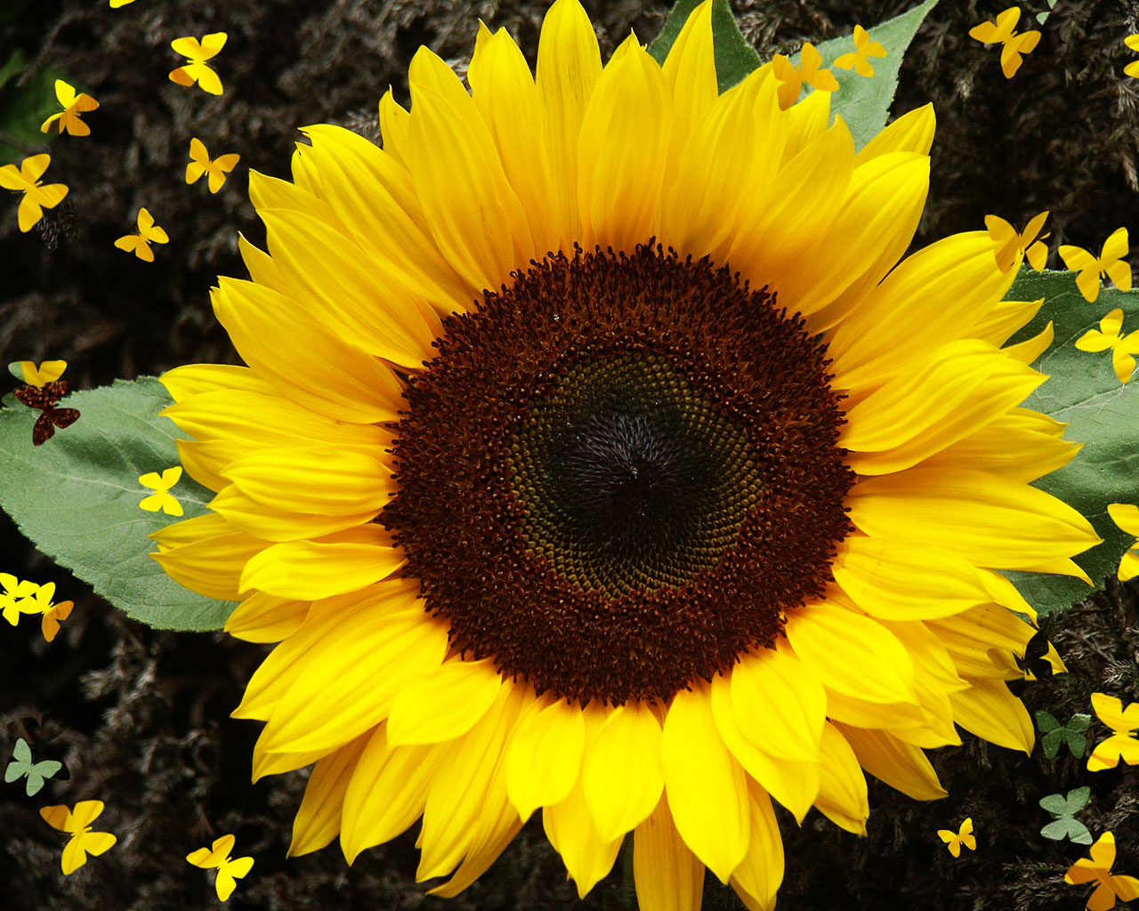
The Life Cycle
of a Sunflower

Slide 2
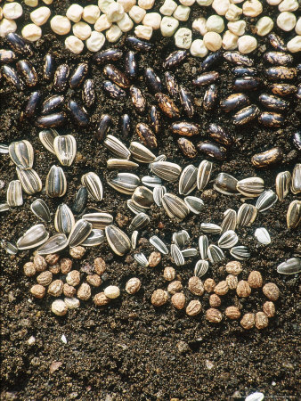
.1.
The sunflower seeds are planted in the soil.

Slide 3
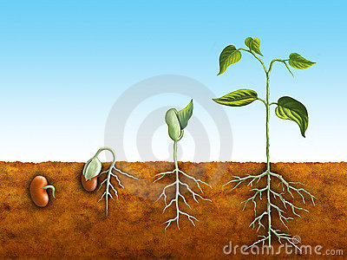
.2.
The seed begins to germinate.
The roots begin to grow down and the shoot begins to grow up.

Slide 4
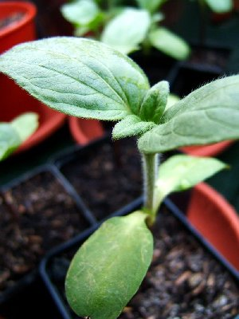
.3.
After about a week, the seed begins to grow into a plant. This is called a seedling.
The plant grows taller and taller and the leaves become bigger and bigger.

Slide 5

.4.
After about 3 weeks the seedling turns into a flower and the sunflower continues to grow even taller.

Slide 6
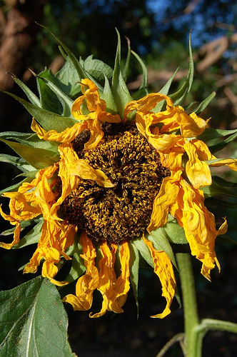
.5.
When the weather becomes colder the sunflower will start to die.
The flower will turn brown and the petals will eventually fall off.

Slide 7
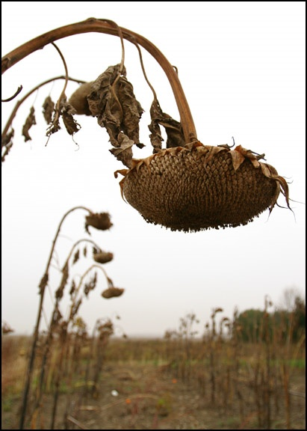
.6.
When the flower is completely dead, the seeds will fall out of the dead sunflower head onto the soil.
As they land in the soil they will replant themselves and when the summer begins again these seeds will start the cycle all over again and become a new sunflower.

Slide 8
1. Seeds are planted in the soil.
2. The seeds begin to germinate.
3. Seedlings begin to appear.
4. The seedling becomes a flower.
6. The flower dies and the seeds fall into the soil. The cycle begins again.
5. The petals turn brown and the plant begins to die.

