Slide 1

Español

Slide 2
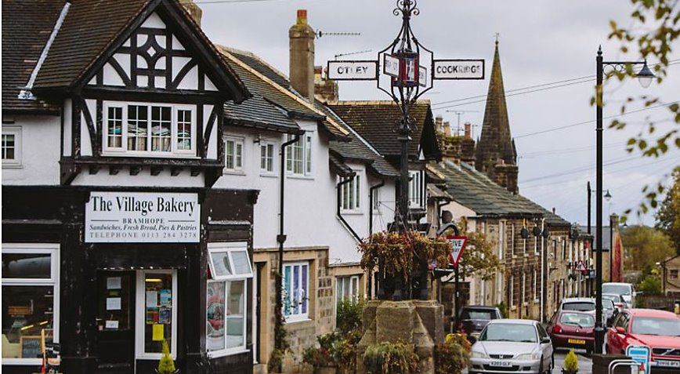
Mi pueblo, My village

Slide 3
22.6.20 Let’s recap
How many of the places ‘en mi pueblo’ can you remember from last week?
park
café
pharmacy
florist
medical centre
bakery
newsagent
hairdresser’s
church
school
butcher’s
bank
hospital
supermarket

Slide 4
Mi pueblo, My village
park
café
pharmacy
florist
medical centre
bakery
newsagent
hairdresser’s
church
school
butcher’s
bank
hospital
supermarket
el parque
la cafetería
la farmacia
la floristería
el centro médico
la panadería
el puesto de diarios
la peluquería
la iglesia
la escuela
la carnicería
el banco
el hopsital
el supermercado

Slide 5
Mi pueblo, My village
Today you are going to draw and label a map of a village and include all the places we have been learning in our vocabulary list.
You can also include 3-5 things that you would like to have in your dream village. It might be a cinema, a football stadium, a gaming studio, a library.
I’ve put some of the Spanish vocabulary on the next slide or you can look words up on Word Reference.
https://www.wordreference.com/es/translation.asp
Colour in your map

Slide 6
Extra vocabulary
cinema
theatre
ice cream parlour
water park
football pitch
sweet shop
gaming studio
unicorn shop
library
tennis court
lake
traffic lights
zebra crossing
roller skating rink
ice skating rink
car park
el cine
el teatro
la heladería
el parque acuático
el campo de juego
la caramelería
el estudio de videojuegos
la tienda de los unicornios
la biblioteca
la cancha de tenis
el lago
el semaforo
el pase de cebra
el pista de patinaje
el pista de patinaje sobre hielo
el aparcamiento

Slide 7
29.6.20
Over the next few weeks, you are going to write sentences to describe your village; what it's got, what it hasn't got and where places are.

Slide 8
The definite and indefinite article
So far, the list of places in your village have been written with the definite article 'the' eg the bank, the school etc using the Spanish el/la ie. el banco, la escuela
To write sentences about your village, you will also have to use the indefinite article 'a' eg a bank, a school
The Spanish for 'a' is un/una eg un banco, una escuela
Remember 'el' is used for masculine (boy) words and 'la' is used for feminine (girl) words
So, 'un' is used for masculine words and 'una' is used for feminine words
2 tasks this week

Slide 9
Task 1 – all year groups
Choose 10 words from your list and change the definite article of el/la to the indefinite article of un/una
Hint: where you have used el, you should change it to un and where you have used la, you should change it to una

Slide 10
Task 2 – all year groups
In preparation for next week's task, start to think about how you would say and write a sentence for what is in your village using the indefinite article 'un/una'. Eg...
In my village there is a...
En mi pueblo hay un/una...
Think about and say 5 sentences and we will write about them next week
Year 5/6 - From previous work, think about how you would make these into negative sentences:
In my village, there isn't a...
You will have to use the word 'no', where will it go in the sentence?

