Slide 1
Famous scientists
Michael Faraday

Slide 2
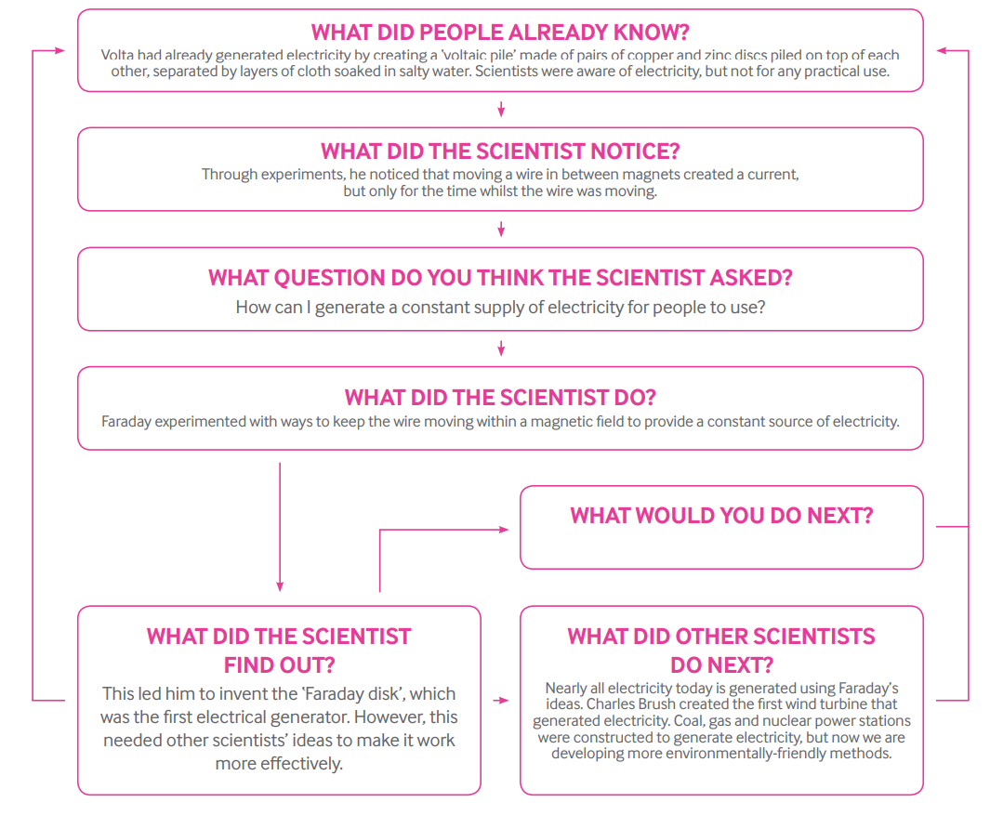
Before and after Faraday

Slide 3
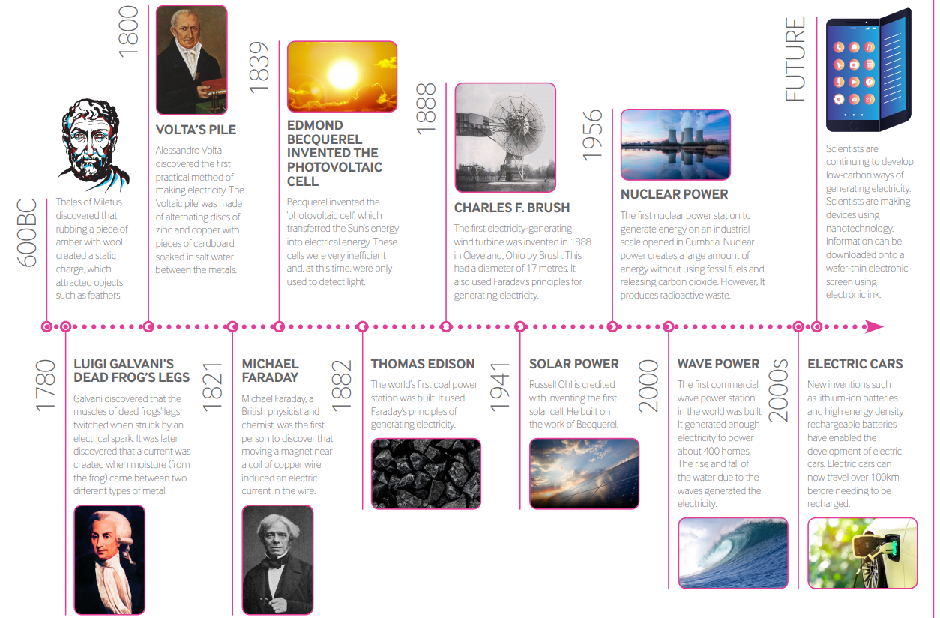
A timeline for the generation of electricity

Slide 4
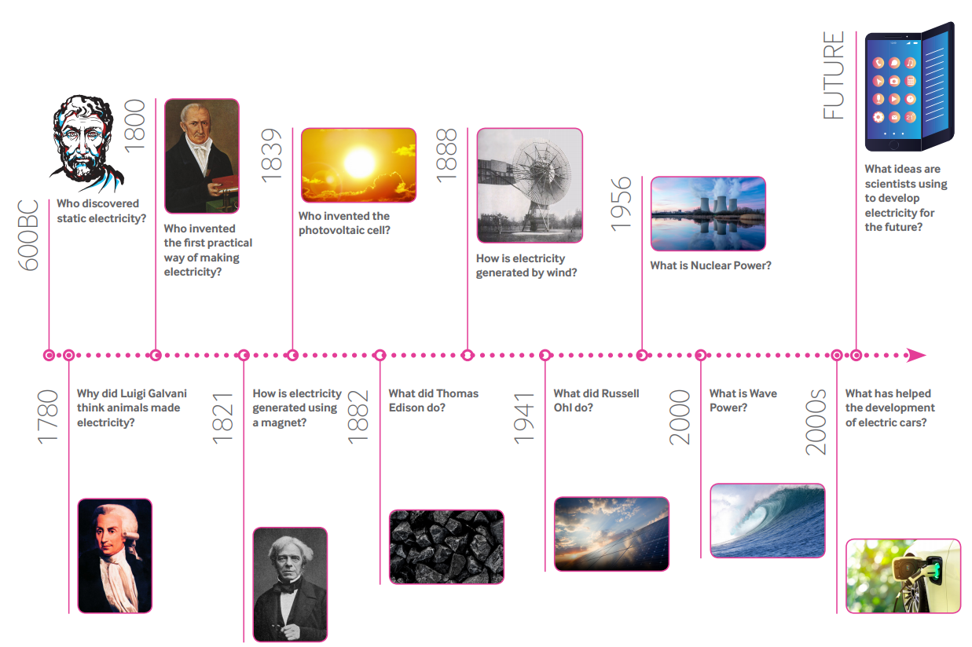
Complete our own electricity timeline; write in your own style.

Slide 5
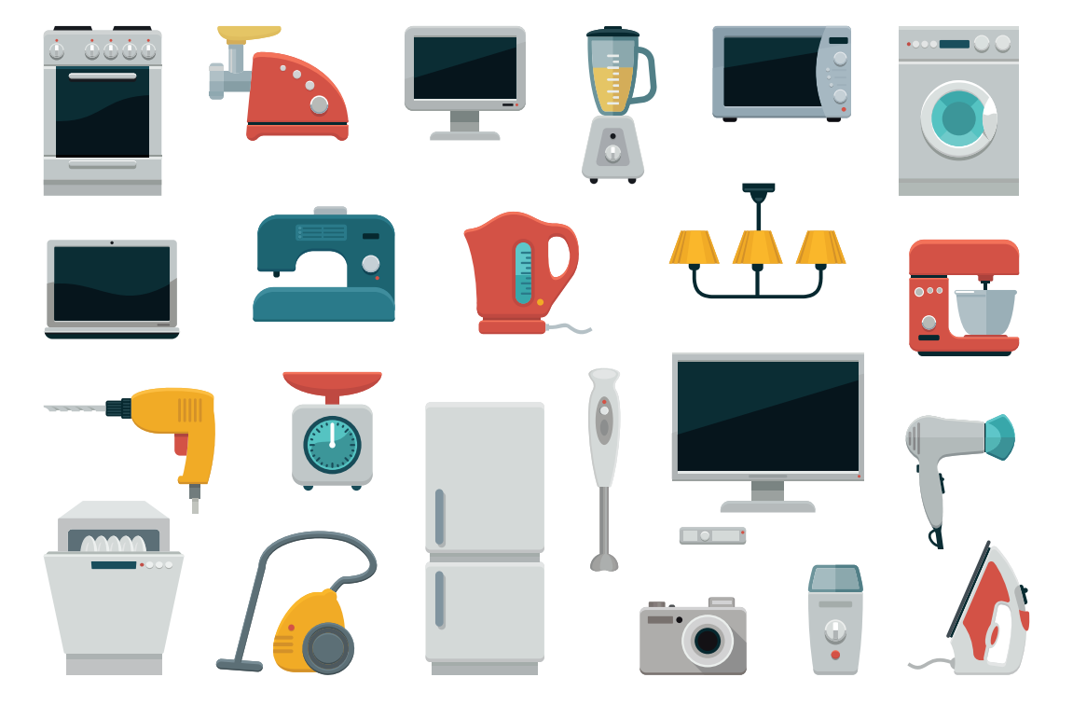
What do you use electricity for?
Could you live for a day without it?

Slide 6
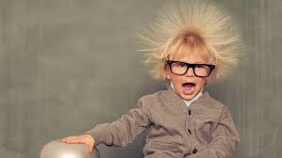
Have you ever experienced static electricity?
The first discovery of static electricity was in 600 BC, when Thales of Miletus found that rubbing a piece of amber with wool created a static charge, that attracted objects like feathers.

Slide 7
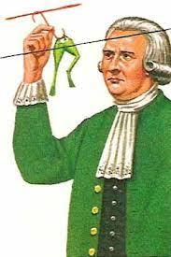
What did the scientists notice?
In the 1780s, Luigi Galvani (a biologist) performed experiments involving frogs. While cutting a frog’s leg, Galvani’s steel scalpel touched a brass hook that was holding the leg in place. The leg twitched. Galvani was convinced that he was seeing the effects of what he called animal electricity.

Slide 8
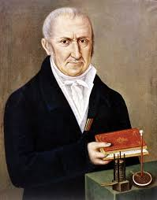
Alessandro Volta (a stern looking man)
Alessandro Volta was an Italian physicist, chemist, and a pioneer of electricity. Volta was able to repeat the results of Galvani’s experiment, but he was not convinced it was the frog’s leg that was making electricity.
Volta repeated Galvani’s experiments many times with many different materials. From these experiments he came to the conclusion that it wasn’t the frog’s leg that produced electricity, but the two different metals. The frog’s leg just showed the presence of the electricity

Slide 9
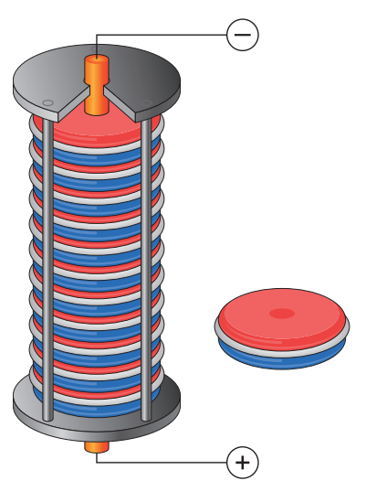
The first battery- electricfying!
In 1800, after lots of experimenting, he developed the first battery. It consisted of a pile of zinc and silver discs and between alternating discs, a piece of cardboard that had been soaked in saltwater. A wire connecting the bottom zinc disc to the top silver disc could produce repeated sparks. No frogs were injured in the production of a voltaic pile!

Slide 10
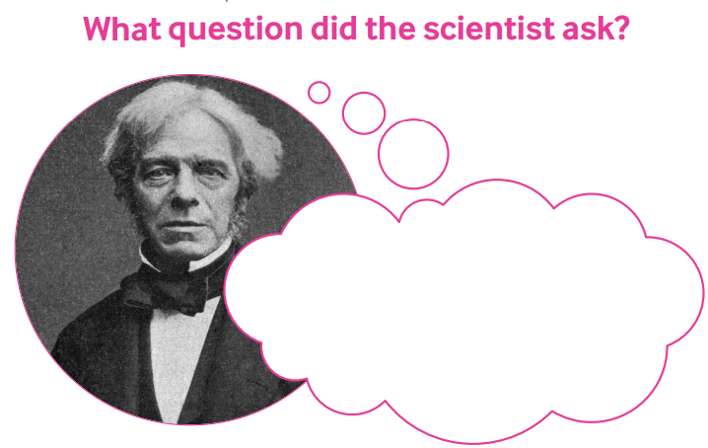
Michael Faraday, a British physicist and chemist, discovered that moving a magnet near a coil of copper wire produced an electric current in the wire.

Slide 11
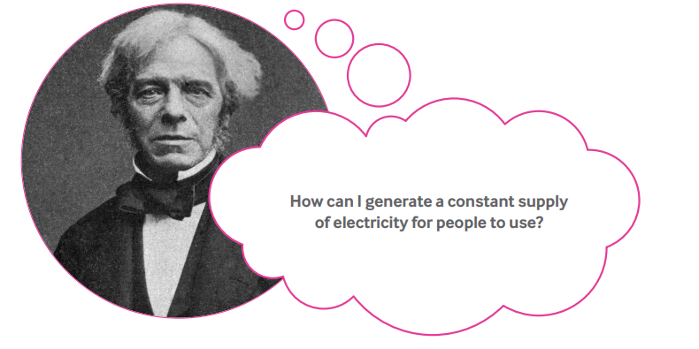
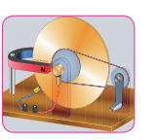
This led him to invent the Faraday disc which was the first electrical generator. However, this needed other scientists’ ideas to make it work more effectively.

Slide 12
Plan for the future
A lot of electricity is generated by burning fossil fuels or by using nuclear fuels, which have drawbacks. Do you know what these are?
However, we now have electric cars, solar panels on our school roofs and batteries that last for weeks. These also have drawbacks.
Renewable energy is now being developed internationally. Electricity is generated using the sun, wind, waves, and even from food waste.

Slide 13
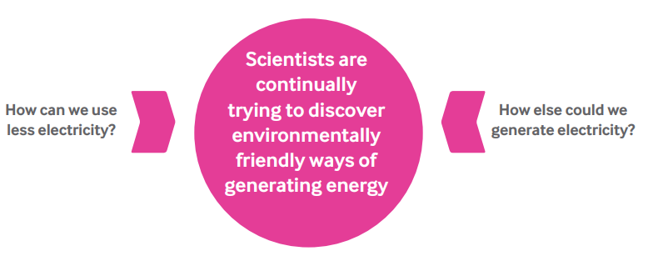
WHAT WOULD YOU DO NEXT?

Slide 14
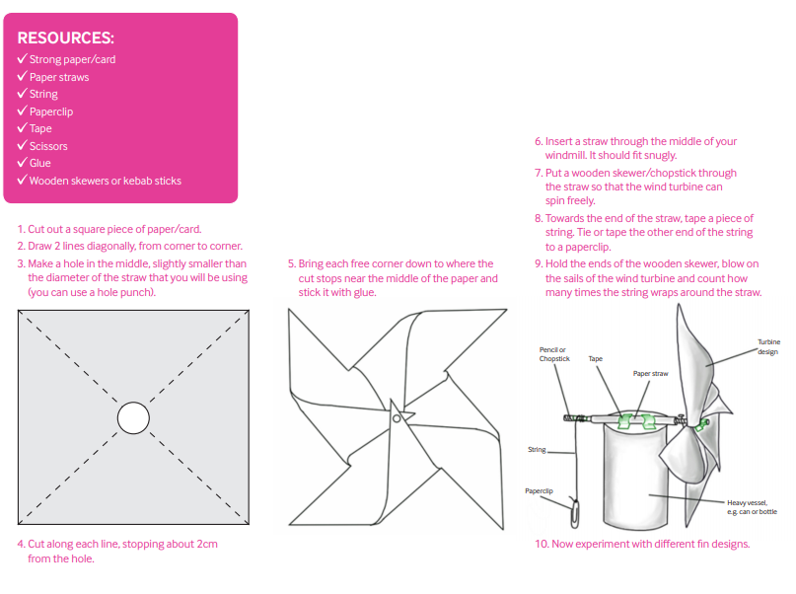
Create your own wind turbine

Slide 15
Research Faraday using the links
https://www.dkfindout.com/uk/science/famous-scientists/michael-faraday/
http://www.bbc.co.uk/history/historic_figures/faraday_michael.shtml
https://www.britannica.com/biography/Michael-Faraday

