Slide 1




How can I keep my money safe?
Presentation

Slide 2
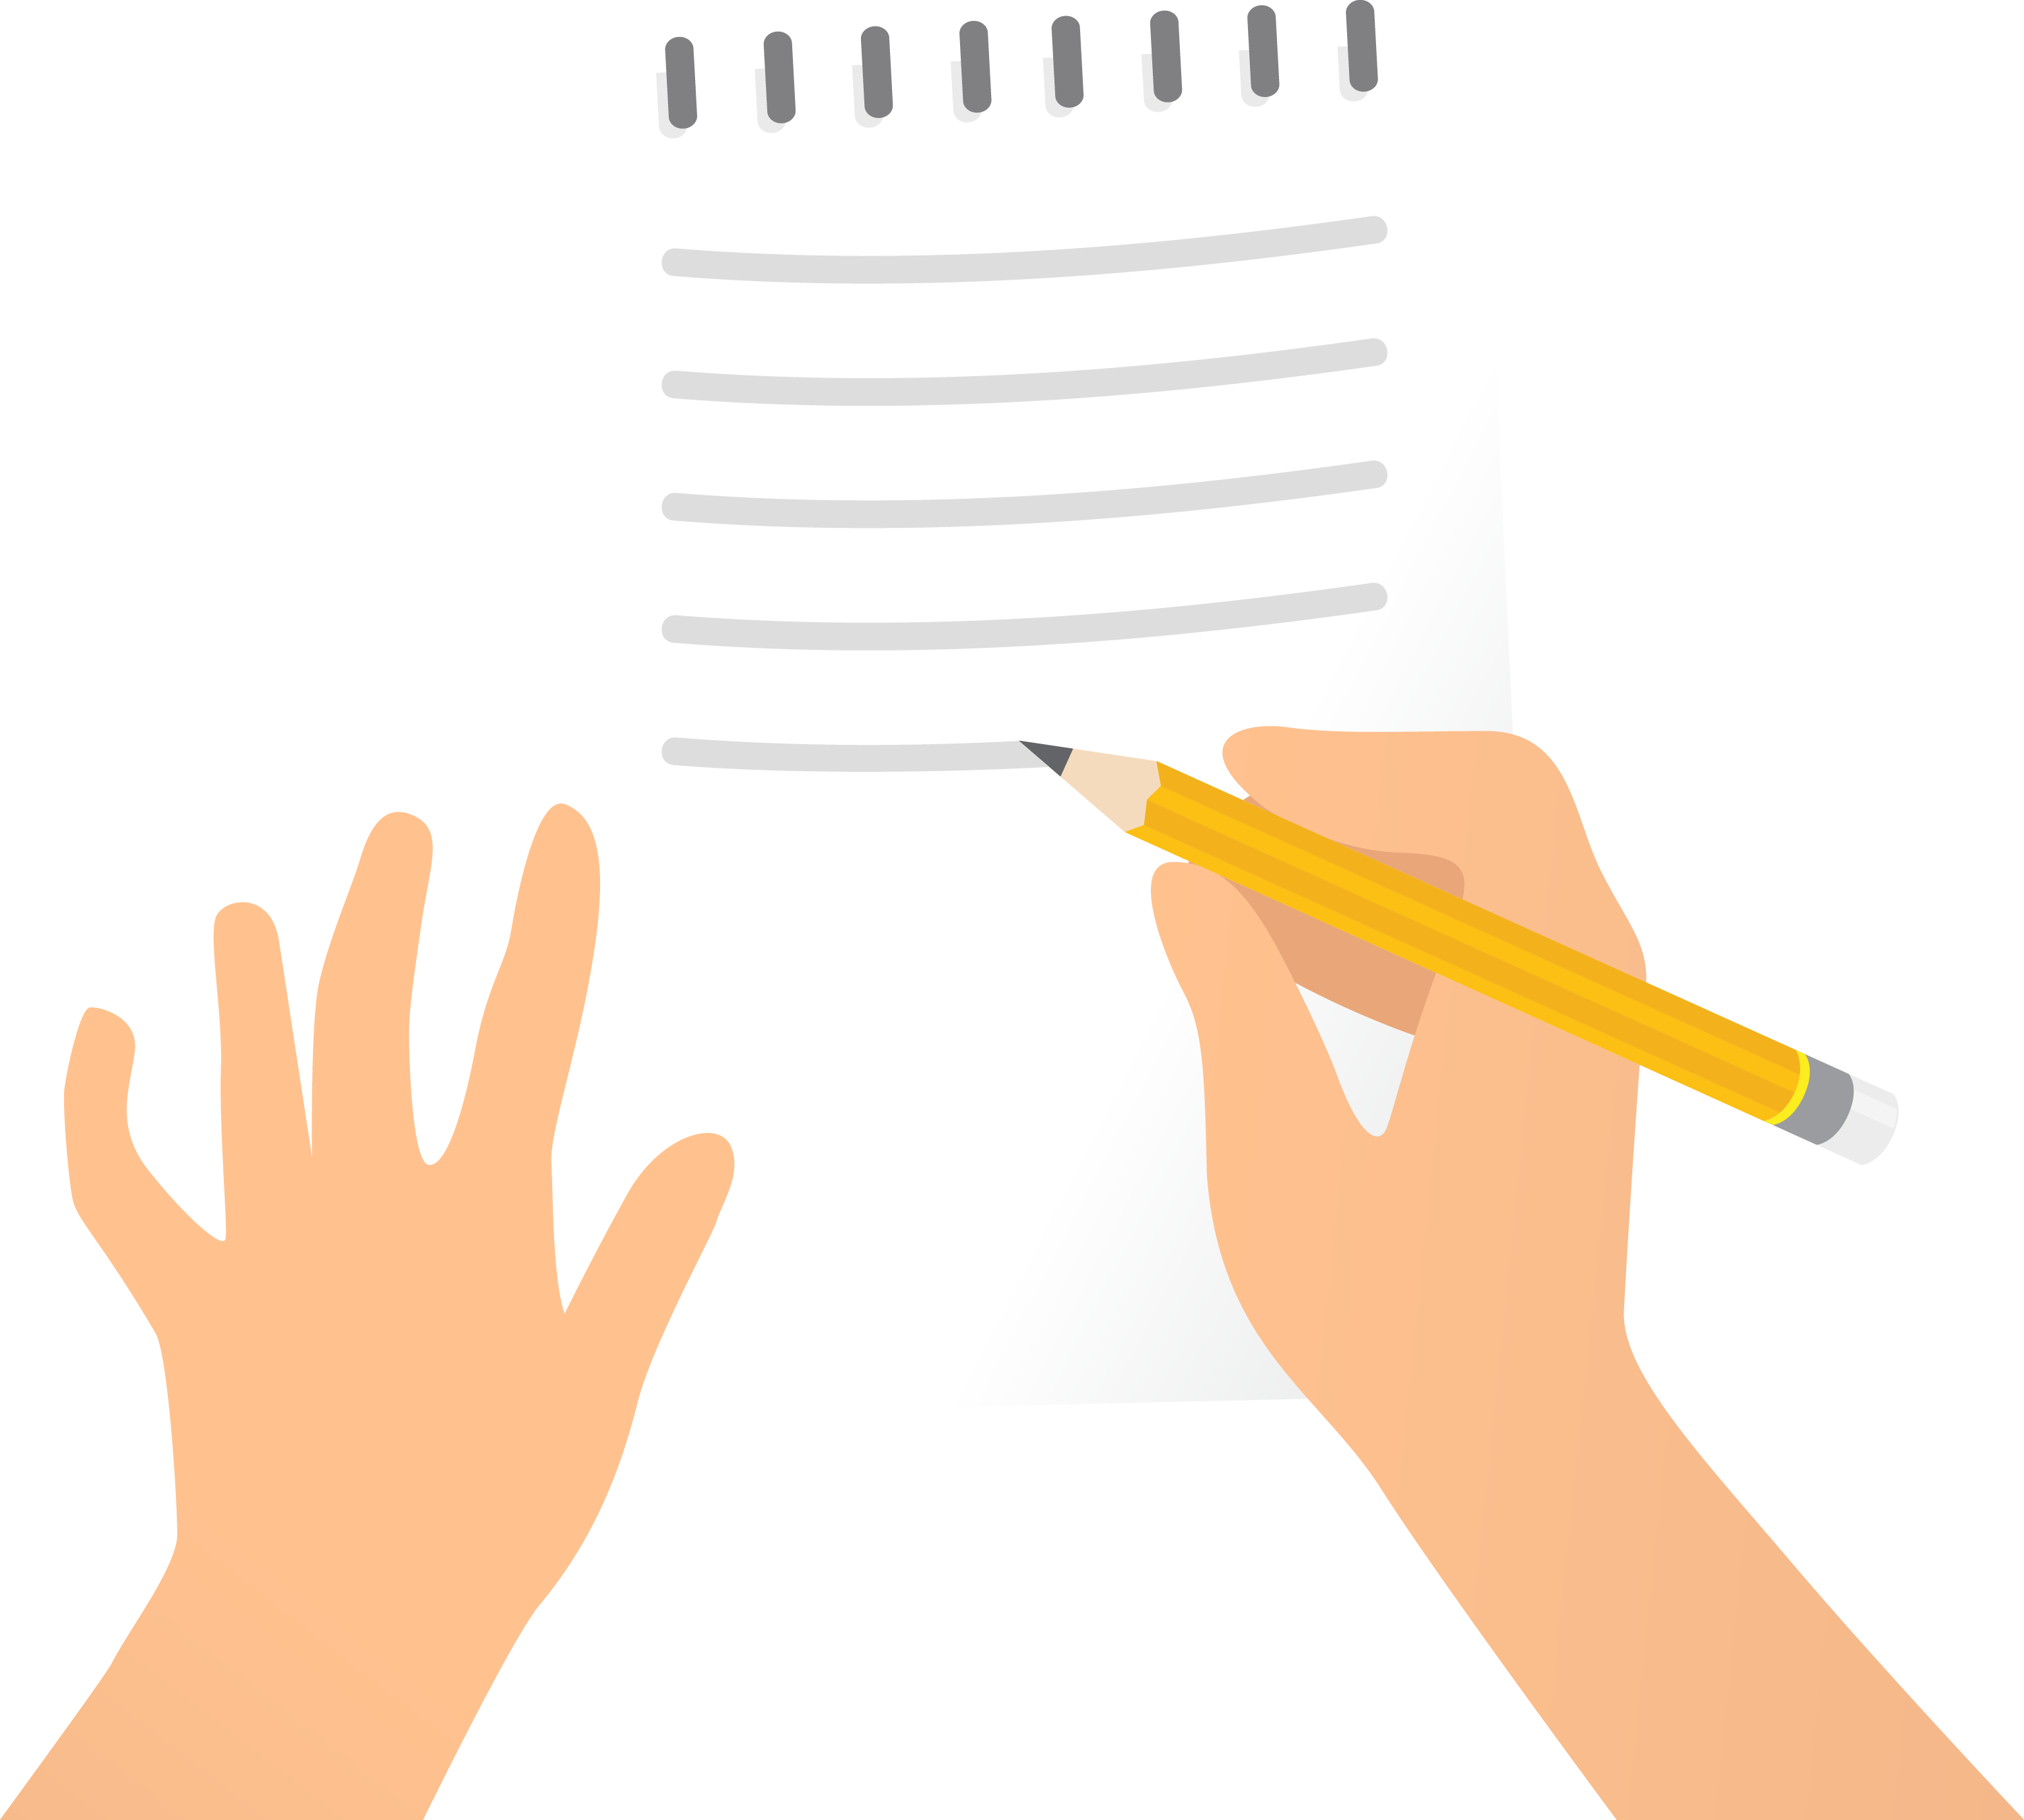
Your thoughts
Create a list of the reasons people use a bank account

Slide 3

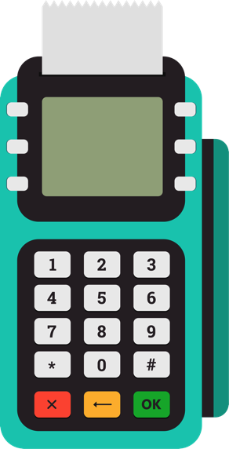
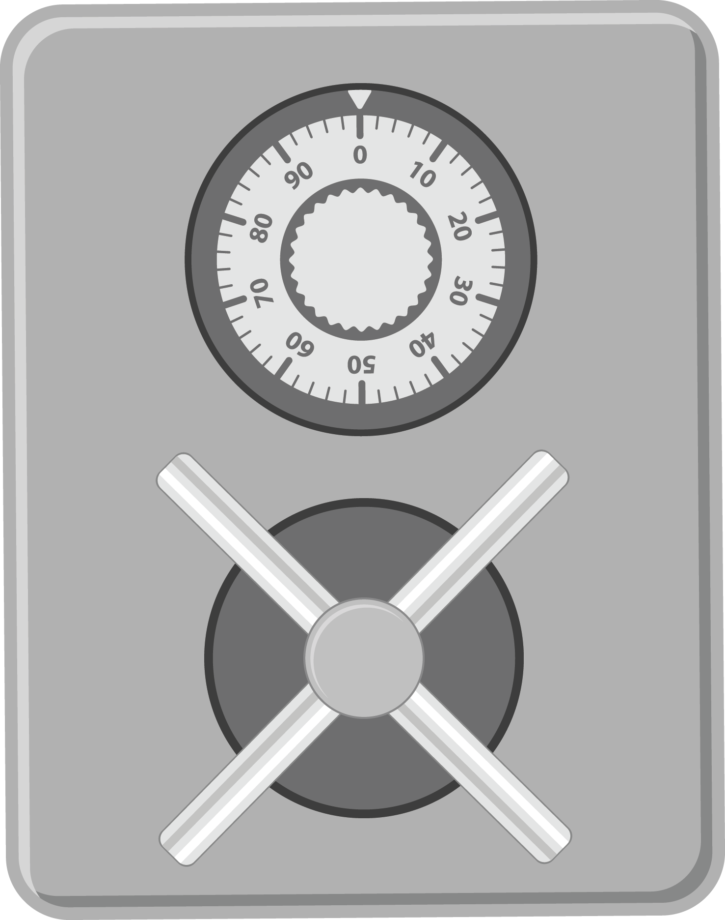
Main reasons to use a bank account
Safety
Your money
is protected
You can use cards, which
is safer than carrying lots
of cash
Convenience
Easier to get paid for work
Easier to pay for big things such as gas and electricity bills
You’ll have a record, in your statement, of all the money you spend and add to your account
Savings
Can help you
to increase
your money
Can be put
aside for a
large expense,
or for a
rainy day
Also, if you have an account, banks can offer other services

Slide 4


What is a scam?
Warning!
Scam ahead!
Can you think of any examples?

Slide 5
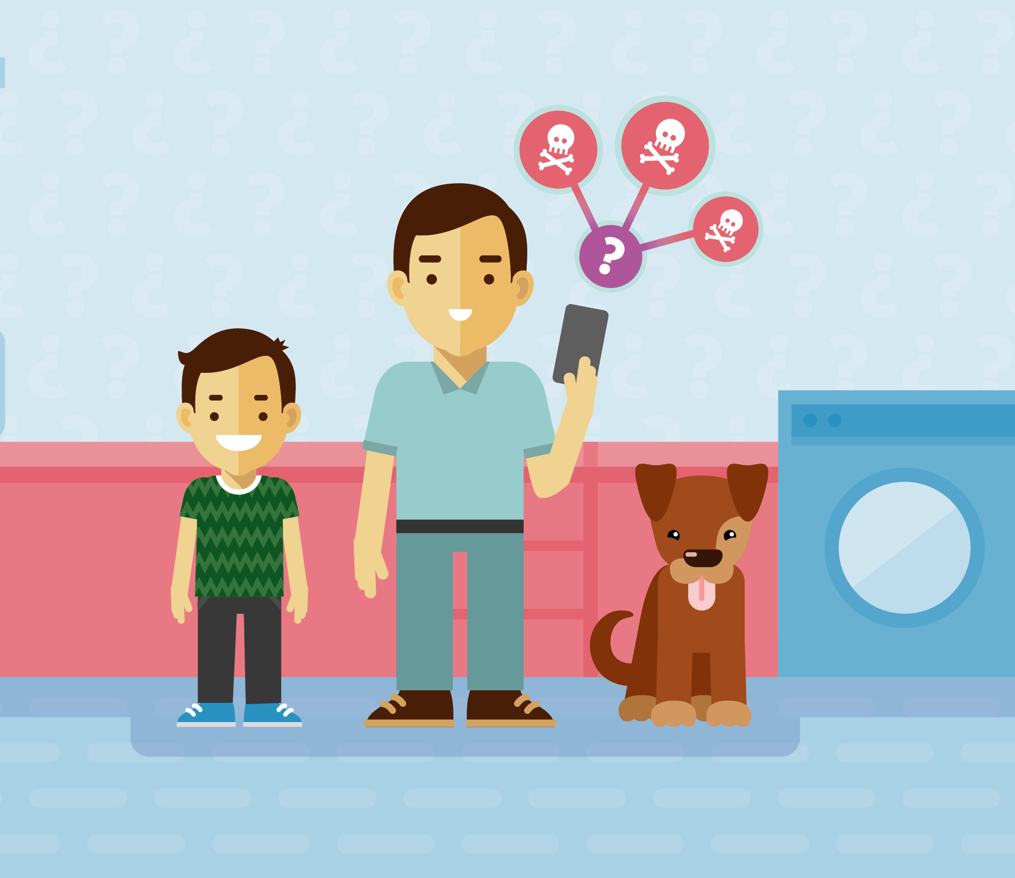
Scams
Fake offers or companies that
trick people into giving their
personal details and/or money
Not new and are always changing and becoming
more sophisticated
Often target
people through:
  Emails
  Text messages
  Online banking
  Mobile payments
  Post
Can be hard to spot

Slide 6
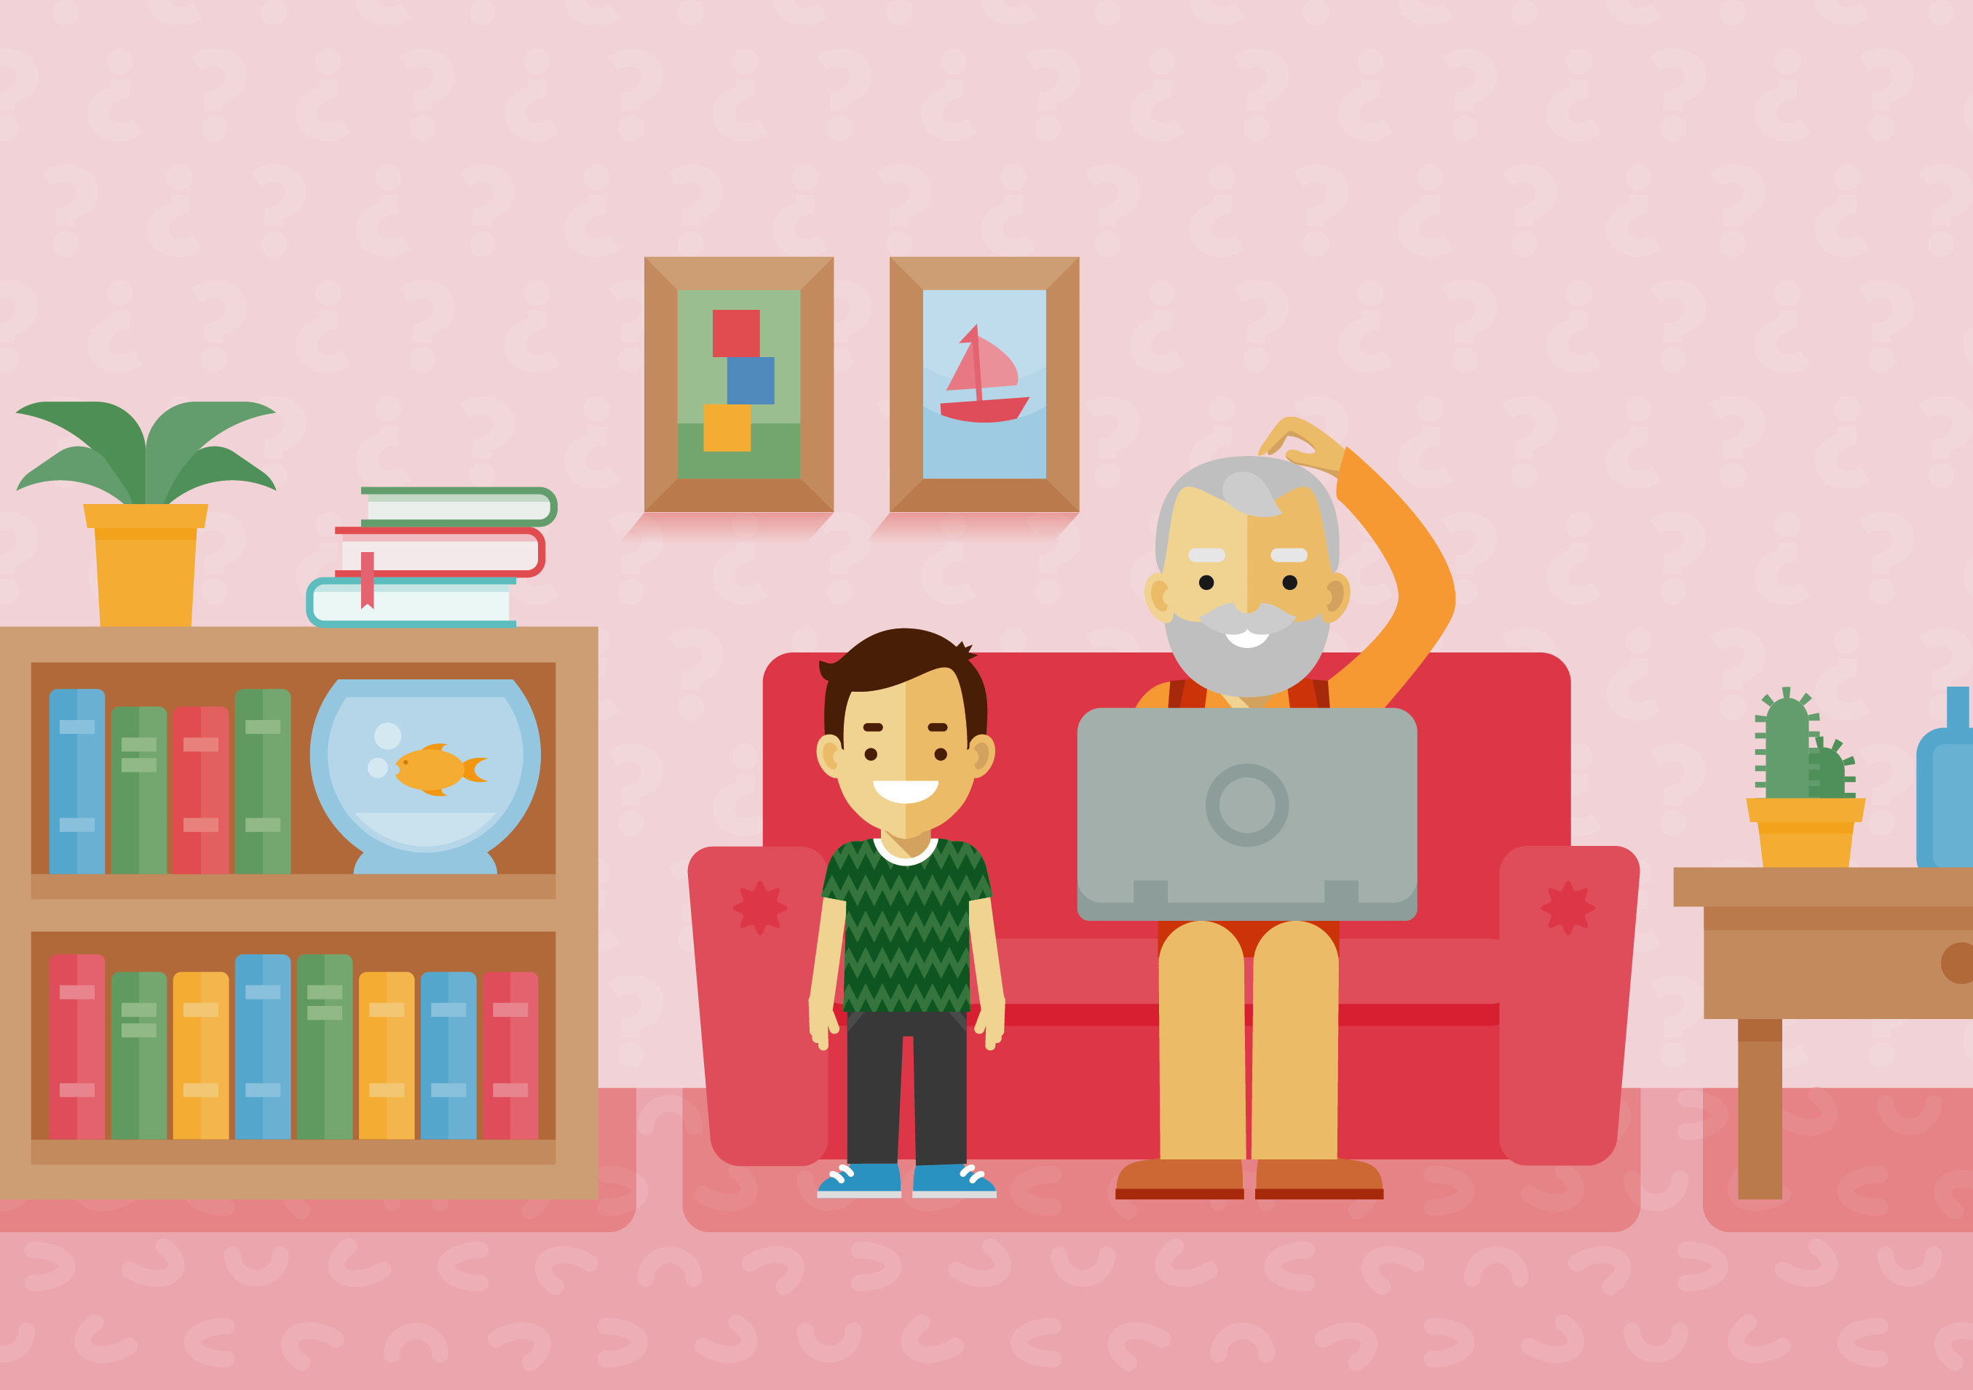
What do you think victims of scams should do?

Slide 7
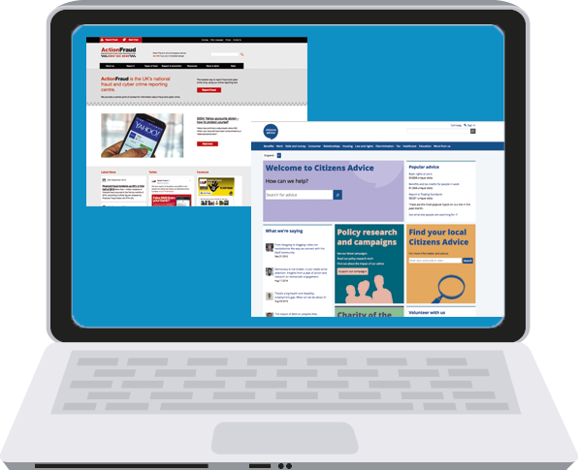
What do you think victims
of scams should do?
Citizens Advice provides advice to people when they need it, for problems they are facing. They do it for free and don’t tell anyone the information that you share with them.
They also make sure all information is fair.
People should make sure they seek help and are not embarrassed. There is lots of support and information available.
Action Fraud is the UK’s national centre for fraud and cybercrime.
You should use them to report fraud if you have been scammed, or have been a victim of cybercrime.

Slide 8
What do you think victims
of scams should do?
Banks will help support you if you have been the victim of a scam, such as if there is unusual activity on your account. If you receive a suspicious email or text pretending to be from your bank, you should let your bank know.
There is lots of support and information available. People should make sure they
seek help and are not embarrassed.
You can report spam texts directly to your mobile phone provider by forwarding the message to 7726. It’s free of charge.

Slide 9
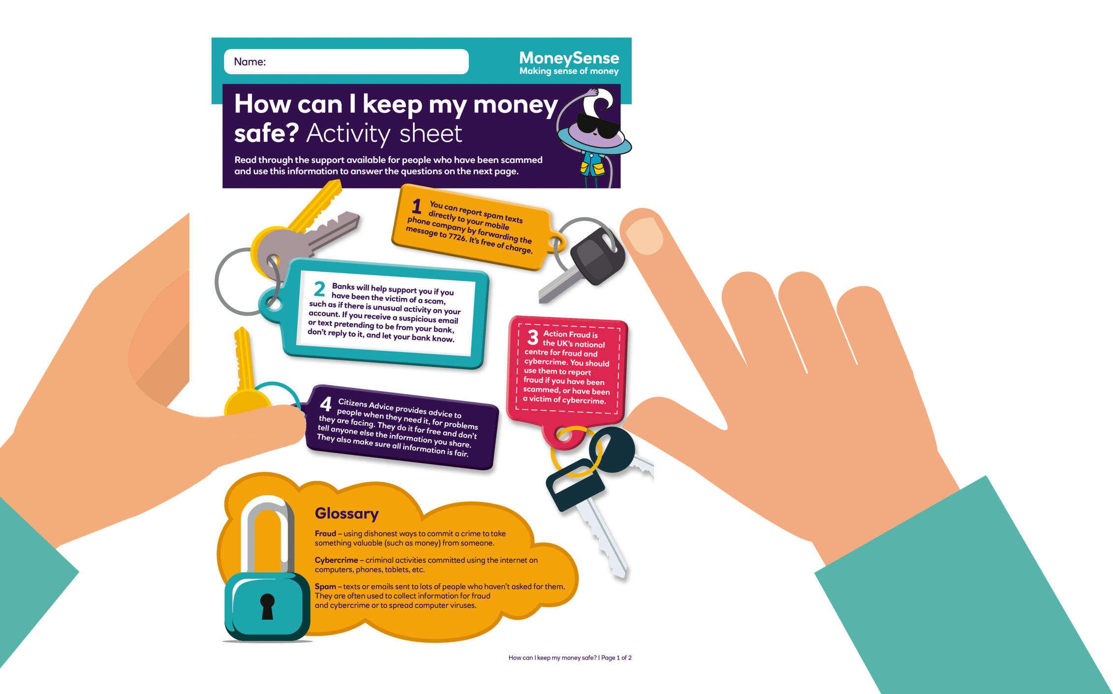
‘How can I keep my money safe?’ activity sheet

Slide 10

Share your advice
What main piece of advice would you give someone who is spending money online?

