Slide 1
Y5 English
29.6.20

Slide 2
Reading
L.C. Can I answer comprehension questions?

Slide 3
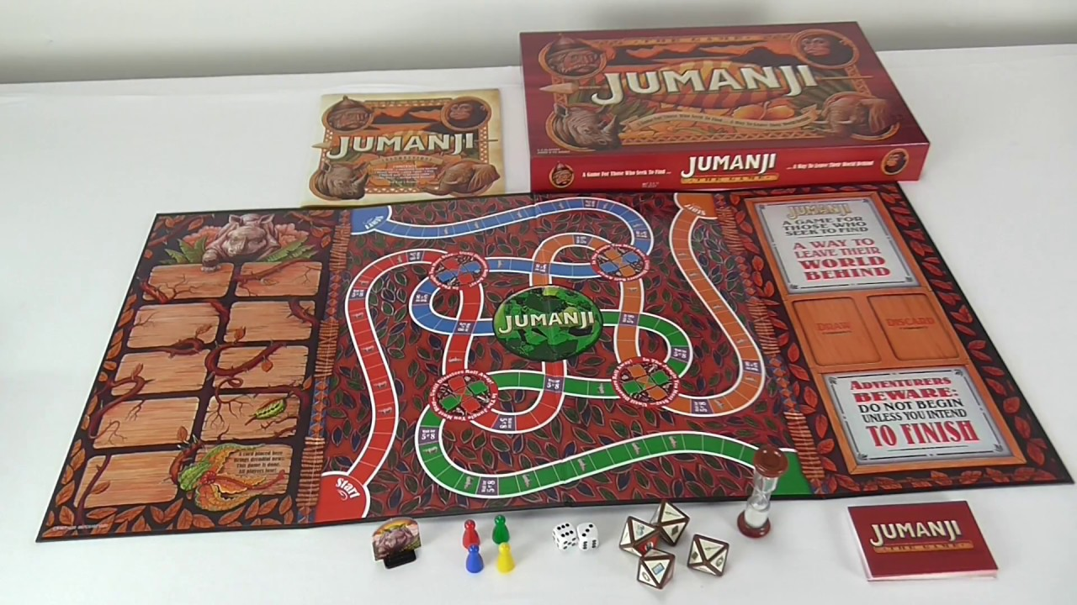
Listen to the story of The Game.
https://soundcloud.com/talkforwriting/game/s-7MBlxRcz8zL

Slide 4
The Game
Danny and Susie were bored. It was wet play again and it felt like they
hadn’t seen the playground for weeks. Rivers of greasy rain streaked the
classroom windowpanes and pooled to make gigantic puddles in the centre
of the netball court. Another lunchtime inside was clearly stressing Mrs
Allbright, as she seemed to be tense and a bit more snappy than usual.
She sat at her desk with a steaming cup of tea and marked books with
the ferocity of a wild beast. To top it all, every good game was being used
and only the tub of dominoes was left. Everyone knew that half of them
were missing and the other half had been chewed by the school ‘Reading
Dog’. Danny and Susie searched the classroom for something to do.

Slide 5
The Game
To their dismay, the comic box was empty, the iPads had been snapped
up by Freya and her gang and Billy seemed to have started a
resurgence of the game Slap, which didn't look like fun at all. As the
two friends squeezed past the art table to get to the wet-play books, a
tatty, cardboard box fell from the top shelf of the bookcase. Susie
picked it up.
“I’ve never seen this game before,” she said, wiping the dust from the
unusual lid. It was embossed with intricate patterns and around the
edges were pictures of animals, insects and other strange creatures.
“An animal game? Boring!” said Danny, already losing interest.
“Oh come on, let’s play. There’s nothing else to do,” suggested Susie,
smiling widely and shaking the box. They sat down in a quiet corner,
lifted the lid and took out the board.

Slide 6
The Game
“Looks simple enough,” said Danny, ever impatient, as he set the
counters onto the start line. They were jungle animals: a rhino and a
jaguar. He also shuffled the game cards and laid them in a neat pile.
“Let’s just start and learn as we go.”
Susie went first. She grasped the dice and threw them down onto the
centre of the board. An eight! She moved her rhino eight paces, to
land on an orange-coloured square. It showed a picture of a giant
tarantula.
She lifted a game card and read it out. “If you do not catch this beast,
I predict…then you’re on the menu for its next feast.” She stared at Danny and
shrugged. “I don't get it!” she said.
At that moment, the table began to shake, the windows rattled and the
floor vibrated. Everyone stopped what they were doing and the room fell
silent.

Slide 7
The Game
“EARTHQUAKE!” shouted Billy, bursting into laughter. He soon stopped,
as in a blink of an eye, an enormous spider, bigger than a horse, shot out
of the game and landed in the centre of the crowded classroom. Everyone
froze. Its enormous, hairy legs were tensed, ready to pounce and its
whole body seemed to pulse. Eight, bulging eyes scanned the room and
then …
It sprung into action. It crushed the tables, smashed the windows and
flung children all around the classroom with a flick of its legs. It powered
towards Mrs Allbright as she stood rooted to the floor in terror. The
room was filled with shrieks of panic and despair.
“What shall we do?” shouted Danny desperately, pressing himself tightly
against the wall.

Slide 8
The Game
“Read the instructions,” ordered Susie. “We have to stop it!”
Quickly, they scrabbled around to find the box underneath all the mess.
They rescued it from under a pile of maths books and scanned the
upturned lid to read the instructions. All the while, the spider got closer
and closer to their teacher. It stretched out its forelegs, ready to grab
her. Her eyes widened in horror as she realised what was coming next.
“It says we’ve got to throw two sixes to end the game,” screeched Danny,
looking pale. Susie grasped the dice again. She threw and she threw and
she threw. No luck. She glanced up and saw the spider had her teacher in
its grasp. Its striped legs were holding her in a vice-like grip. She threw
again and then again, faster and faster each time and then, just as she
was losing all hope, TWO SIXES!

Slide 9
The Game
Suddenly, out of nowhere, there was a loud hissing sound. It pierced
the air and everyone covered their ears. A flash of light streaked
through the classroom and the game rattled into life. It started to suck
everything into a vortex in the centre of the room: the mess, the
children, the spider, Mrs Allbright. There was an almighty boom and
then … nothing.
Danny and Susie opened their eyes. Everything was back to normal;
even Mrs Allbright was back in her chair, marking with the ferocity of a
wild beast. Then the bell went.
“Pack up, Class 5!” ordered Mrs Allbright. “Science starts in two
minutes and we’re looking at animals in their habitats.”

Slide 10
The Game
Susie looked at Danny and raised her eyebrows. They carefully packed
the contents of the game back into the box. Everything went in except
the dice and the animal counters, which Susie wrapped in a paper towel
and placed into the bin instead. They put the lid on the box and lifted it
high up onto the bookshelf. They never wanted anyone to play that game,
ever again!
Everyone settled down to afternoon lessons. Everyone, that was, except
Billy. He had spotted something on top of the bookshelf that he’d never
noticed before and he intended to investigate it, the very next time they
were in for wet play …

Slide 11
Questions
1. Does The Game remind you of any other stories that you know? List them.
2. Danny and Susie had a good choice of things to do at wet play time. Is that TRUE or FALSE?
3. Find and copy a word that is closest in meaning to disappointment.
4. Write down two things that the children are doing in the classroom.

Slide 12
Questions
5. Is Mrs Allbright the teacher in the class?
YES or NO? What are the clues to suggest this?
6. Why might another lunchtime inside be stressing Mrs Allbright?
7. Look at this comment from Danny: “An animal game? Boring!” said Danny, already losing interest. Why might Danny think the game would be boring?

Slide 13
Questions
8. What were the three signs that something bad was going to happen once the game started?
9. List the things the spider did once it was out of the game:
10. The text says: “Her eyes widened in horror as she realised what was coming next.” What might Mrs Allbright be thinking at this point?

Slide 14
11. Why did Susie put the dice and counters into the bin?
12. Billy spotted the game on the shelf at the end of the story. What do you predict might happen the next time it’s wet play?

Slide 15
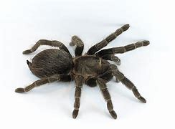
Writing
L.C. Can I describe a setting?

Slide 16
Describing a setting
Where else could this story happen? Try a new
setting for The Game.
Change the classroom setting to somewhere
else.
Where could this happen? Plan a new idea by
making notes or drawing. What will
come out of the game in the new setting and
what will it do once it’s released?

Slide 17
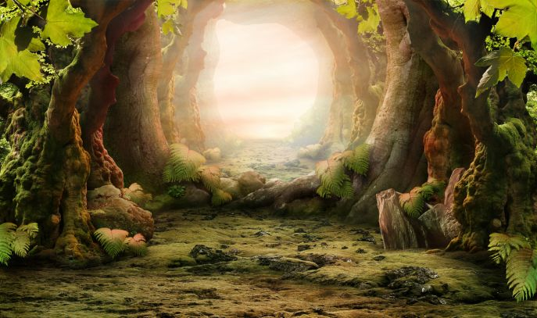
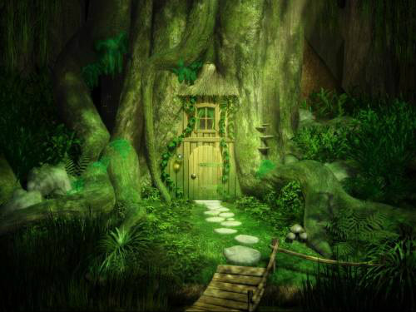
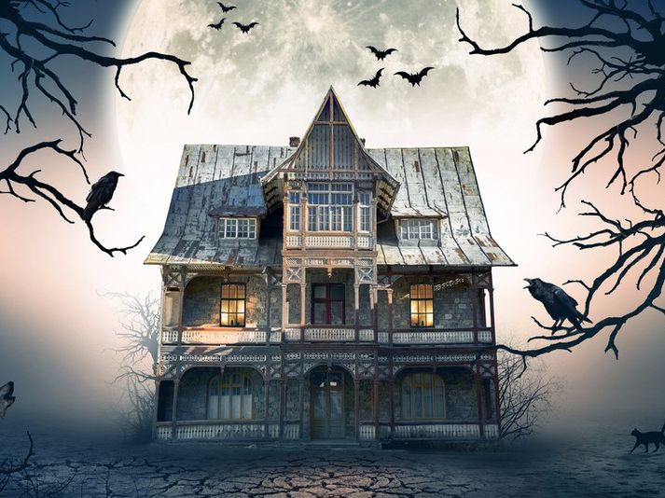
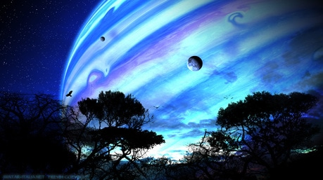

Slide 18
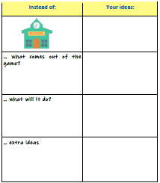

Slide 19
Describing a setting
Now write your new problem, set somewhere
else. Start with the first strange event, then
introduce the new threat and finally describe
what the threat does. Do this in your book.
Paragraph 1: Strange event
Paragraph 2: New threat
Paragraph 3: What does the threat do?

Slide 20
Grammar
L.C. Can I practise using SPaG terminology?

Slide 21
Write these sentences and underline the relative pronouns.
The cathedral, which was built centuries ago, had
colourful domes.
A button is something that closes a jacket.
Dua Lipa recorded a track with Calvin Harris, who is
a famous DJ.
We found the place where I used to go swimming
with Dad.

Slide 22
Write these sentences and underline the relative pronouns.
The cathedral, which was built centuries ago, had
colourful domes.
A button is something that closes a jacket.
Dua Lipa recorded a track with Calvin Harris, who is
a famous DJ.
We found the place I used to go swimming
with Dad. where

Slide 23
Rewrite this text and add hyphens in the correct place.
St. Basil’s Cathedral is famed for its multi
coloured domes. Visitors to Russia may choose
to stay in cheaper, self catered apartments
instead of paying the mind blowing prices at an
expensive hotel. Moscow, itself, is an around the
clock city with something to do anytime of the
day.

Slide 24
Rewrite this text and add hyphens in the correct place.
St. Basil’s Cathedral is famed for its multi-
coloured domes. Visitors to Russia may choose
to stay in cheaper, self-catered apartments
instead of paying the mind-blowing prices at an
expensive hotel. Moscow, itself, is an around-
the-clock city with something to do anytime of
the day.

Slide 25
Rewrite this piece of text and add capital letters and full stops in the correct places.
oscar has always been fascinated by architecture he has read many books about famous architects glass buildings interest him the most and he would like to study them when he is older

Slide 26
Rewrite this piece of text and add capital letters and full stops in the correct places.
Oscar has always been fascinated by
architecture. He has read many books about
famous architects. Glass buildings interest him
the most and he would like to study them when
he is older.

Slide 27
Which sentence is the most formal? Why?
I am delighted to inform you that your place at Lord Nicholas Secondary School has been accepted.
I’m pleased to tell you that you’ve got a spot at Lord Nicholas Secondary School.
You’ve got a place at Lord Nicholas Secondary School. Great stuff!

Slide 28
Which sentence is punctuated correctly? Why?
“It’s his debut today,” announced the commentator, “What a proud moment for his family.”
“It’s his debut today announced the commentator, “What a proud moment for his family.”

Slide 29
Which sentence is punctuated correctly? Why?
“It’s his debut today,” announced the commentator, “What a proud moment for his family.”
“It’s his debut today announced the commentator, “What a proud moment for his family.”

Slide 30
Which sentence is punctuated correctly? Why?
Earlier, in the day the scuba diver received his certificate – from his instructor – and posted a celebratory picture on Instagram.
Earlier in the day, the scuba diver received his certificate – from his instructor – and posted a celebratory picture on Instagram.

Slide 31
Which sentence is punctuated correctly? Why?
Earlier, in the day the scuba diver received his certificate – from his instructor – and posted a celebratory picture on Instagram.
Earlier in the day, the scuba diver received his certificate – from his instructor – and posted a celebratory picture on Instagram.

Slide 32
Write these sentences and underline the possessive pronouns.
The steward showed me around the new stadium and then we had a meeting in his office.
My mother loves working with animals, maybe she could look after your hamster next week.
We shall finally have what is rightfully ours!
Halle, you have left your coat on the peg.

Slide 33
Write these sentences and underline the possessive pronouns.
The steward showed me around the new stadium and then we had a meeting in his office.
My mother loves working with animals, maybe she could look after your hamster next week.
We shall finally have what is rightfully ours!
Halle, you have left your coat on the peg.

Slide 34
Spelling
L.C. Can I use words in context?

Slide 35
Vocabulary
1. ecstatic
2. plummet
3. despise
4. captivating
5. effervescent
6. raucous
7. tattered
8. incapacitate
9. eliminate
10. gape
What do these words mean?
Write a definition.
Write them in a sentence.

