Slide 2
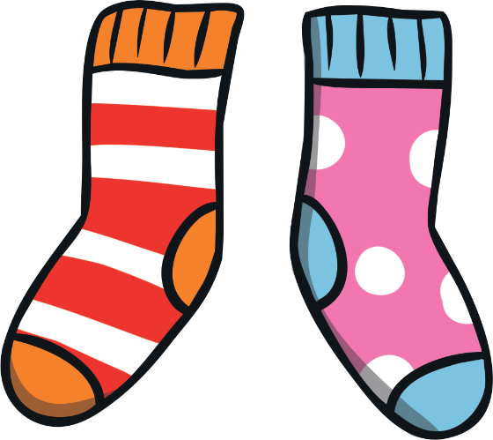
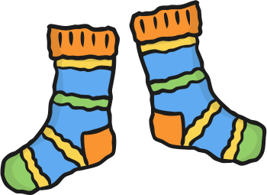
Odd Socks Day
Anti-Bullying Week starts with Odd Socks Day.
Why are we wearing odd socks on anti-bullying week?

Slide 3
Bullying: True or False?
Bullying is when an unkind thing happens only once.
Bullying is always hitting or kicking another person.
Bullying can be shouting at or teasing another person and using unkind words.
Bullying can be saying that somebody can't join in.
You can tell somebody is a bully by looking at them.
If you, or someone you know, is being bullied, you should keep quiet.
Nobody should be bullied.

Slide 4
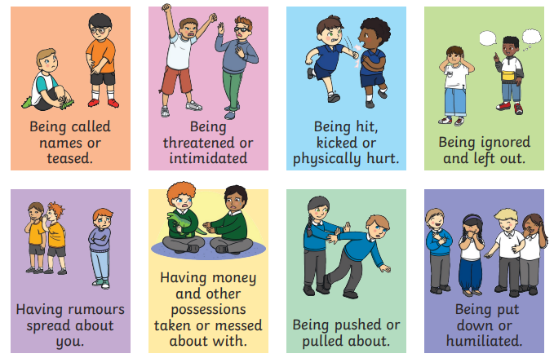
Bullying is hurting someone on purpose, and choosing to do it again, when you have been asked to stop.
Notes:
Differentiate for KS1 and KS2
Mention cyberbullying: Bullying that takes place over digital devices like mobile phones, computers, and tablets. Cyberbullying can occur through text messaging, emails, through instant messaging, chat rooms, online gaming and social networking sites. Cyberbullying includes sending, posting, or sharing negative, harmful, false, or mean content about someone else. It can include sharing personal or private information about someone else causing embarrassment or humiliation.

Slide 5
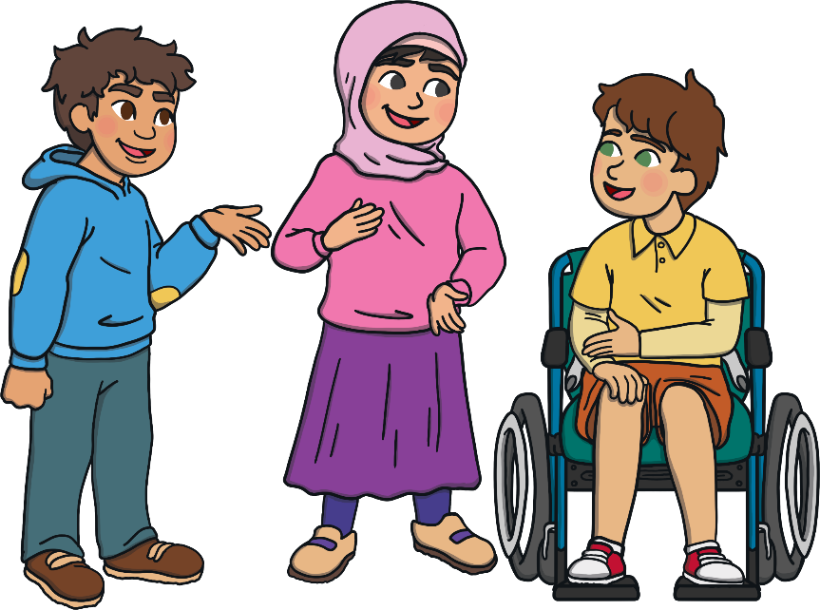
Why Does Bullying Happen?
Bullying sometimes happens because we are all different.
Bullies might be jealous of someone else’s talents.
Bullies might be jealous of other friendships.
Bullies might feel angry or bad about themselves.
Bullies might have been bullied or might not understand what
bullying is.

Slide 6
What should you do if you think you, or someone else, is being bullied?
At Bramhope, we take bullying very seriously.
Tell someone!
Can you name 5 grown ups you trust?
Your parents
Any adult at school
Other family
Friends
Sport club leaders
Brownie or cub leader

Slide 7
Anti-Bullying Week 2021
The theme this year is One Kind Word
Kindness feels good!
Choose to be kind!
Kindness spreads!
https://www.youtube.com/watch?v=oJQg2JyQ3mM

Slide 8
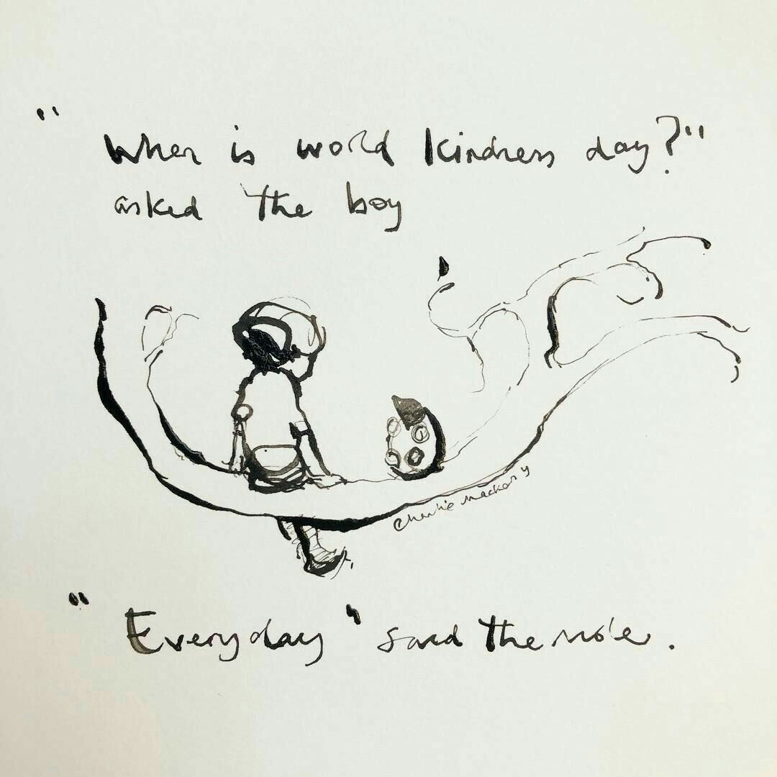
One Kind Word
Remember: Small actions can make a huge impact... ​
- Ask someone if they’re OK. ​ - Say you’re sorry.
- Hold the door. ​
- Give a compliment. - Smile!​
One kind word leads to
another. What kind word
or action could you pass
on today?

