Slide 1
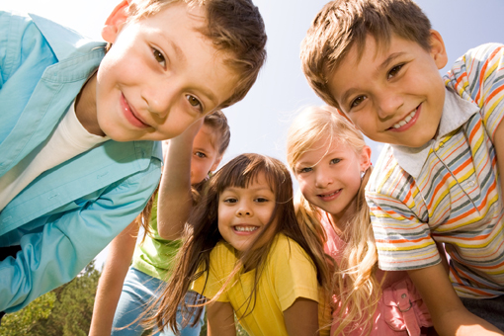
Our job at school is to give you the skills to keep you safe online.
Notes:
But it need not be a source of worry.
Our job as teachers and as parents is to help them to develop positive online behaviours. We are looking for them to thrive and be happy.

Slide 2
Each year, we ask you in class what some of the things that you do online and any rules you have. That helps us make sure we are giving you all the information you need to stay safe online.

Slide 3
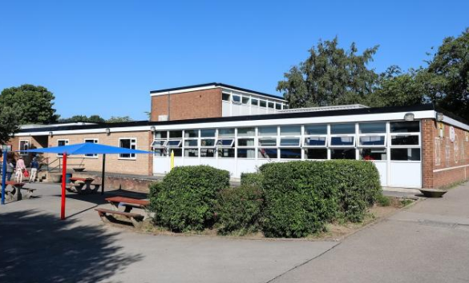
Our Children at BPS – Positives
“ I use web sites to help me with my homework”.
“ I know what to do if I see something I’m uncomfortable with”.
“I like to listen to my favourite videos on you tube.”
“It is fun to play games with my friends online”
Notes:
Our digital leaders have been working really hard to understand some of the positives and some of the concerns around use of online technology at home.
Our school context. After talking to children, what we know they are accessing and some of their concerns.
“ I use web sites to help me with my homework”.
“ I know what to do if I see something I’m uncomfortable with”.
“I like to listen to my favourite videos on you tube.”
“It is fun to play games with my friends online”

Slide 4
Here are some of the things we like to think about, when we are thinking about how you stay safe and happy online.

Slide 5
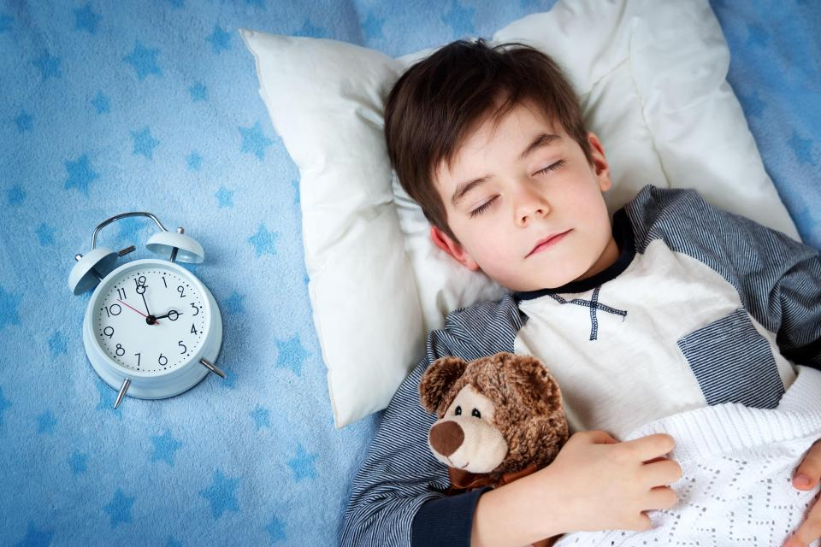
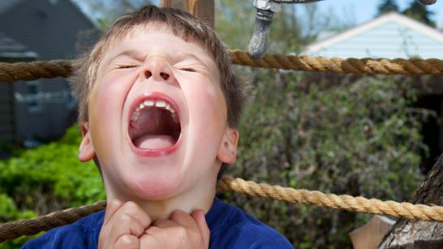
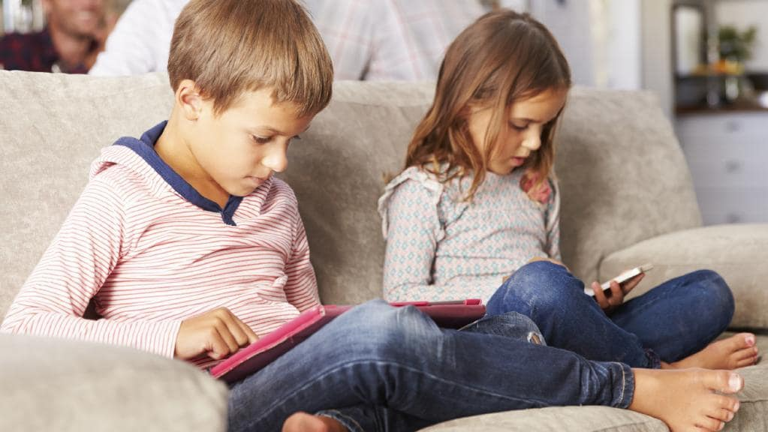
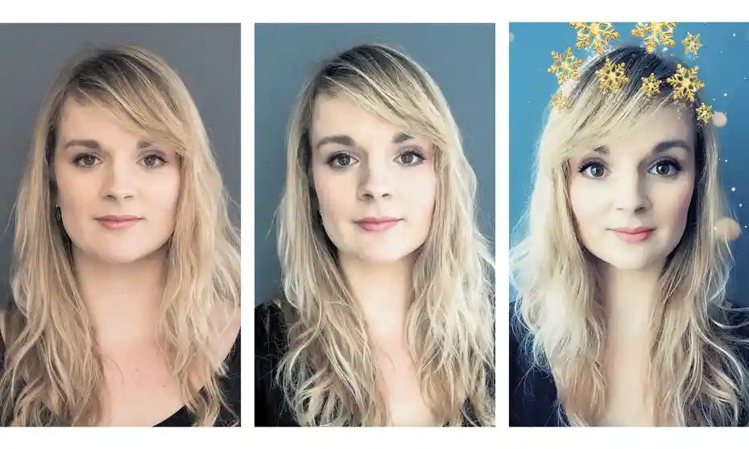
Well Being

Slide 6
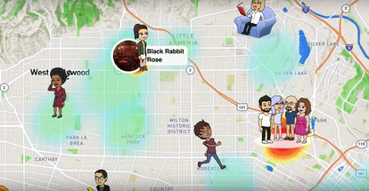
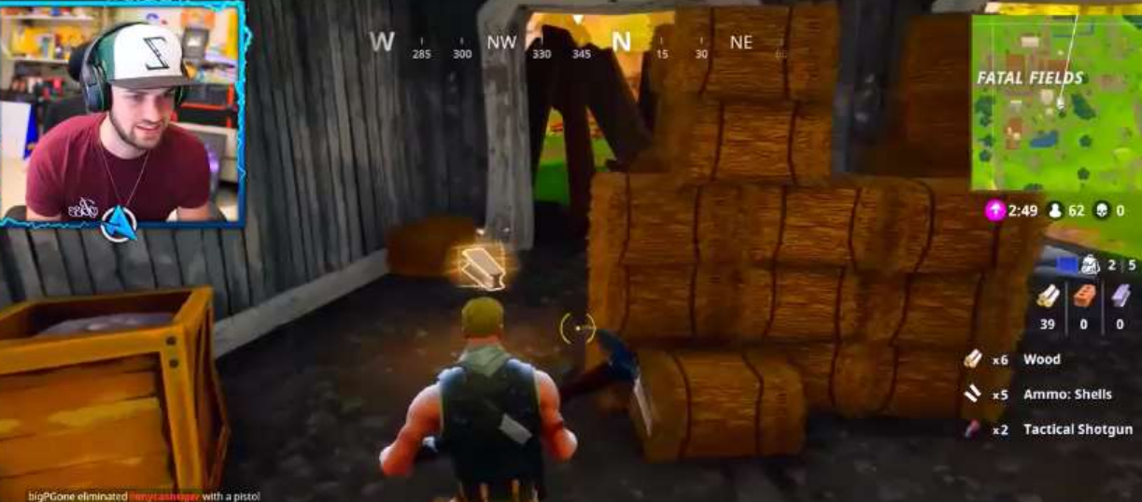
Making sure you are safe.

Slide 7
This week, your class teacher will talk about the time you spend online and completing a survey.
.

Slide 8
It will help us to understand what you are doing online so we can support you with our teaching next year.
.

Slide 9
Worries
If you have any particular worries that you don’t want to talk to the class about, you class teacher can talk separately to you and remember you can always speak to any member of staff about anything you are worried about online.

Slide 10
Year 5 Digital Leaders. Over the next few weeks, I’ll be looking to advertise for Year 5 digital leaders. If you wish to apply, tell your class teacher and I will arrange for you to fill out an application.
Notes:
2021-2022 move to Year 5 and Year 6

