Slide 1
Bramhope Primary School
Phonics and Reading Workshop

Slide 2
Our Phonics Programme
At Bramhope Primary School we teach children to read through daily focused teaching of phonics.
Our teaching of phonics follows the Department of Education’s programme ‘Letters and Sounds’, which is a systematic approach.

Slide 3
Vocabulary
Phoneme - the smallest unit of sound in a word, a or ai The English language is made up of 42 phonemes
Grapheme – graphical representation of a sound/phoneme. For some phonemes it could be more than one letter. t, sh, igh
Digraph (2 letters that make 1 sound) ai, th, ch chips
Trigraph ( 3 letters that make 1 sound) igh ear air chair
Blending for reading c-a-t = cat
Segmenting for reading cat = c-a-t
Grapheme Phoneme Correspondence (GPC)

Slide 4
Where do we start?
Phase 1 : listening skills (alliteration, rhyming words, syllables)
Phase 2 : s a t p i n (single sounds)
Phase 3: digraphs and trigraphs.
There are 6 phases in total.

Slide 5
Key Skills
Learning the letter sounds
Learning letter formation
Blending for reading Merging phonemes together to pronounce a word. Taught before shown letters – oral.
To read an unfamiliar word, a child must link a phoneme to each letter or letter group in a word and then merge them together to say the word = Grapheme Phoneme Correspondence (GPC) sh – o – p t– ai - l

Slide 6
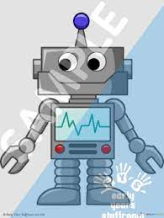
Robot talk m- a - t
ch- i - p
Code breaker
Phonics is like a code which is decodable e.g. c-a-t, cat. Children are taught to read the sounds in words and then how those sounds can be written down. Hearing the sounds is extremely important (counting sounds on fingers is something that the children enjoy and find helpful).
hop and pin have 3 sounds
shop, chin have 3 sounds but 4 letters
We use pure sounds.

Slide 10
We make it interactive and fun!
Learning the action for the sounds help to act as reminders and supports children's different ways of learning.
Weave your hand like a snake, making an ‘s’ shape, saying sssssss
We play different games.
Word hunts, silly soup, sorting activities and many more.

Slide 11
Tricky words
The children also practice reading (and spelling) tricky words such as: to, the, have, said and I.
We ask the children to identify the tricky parts.
These are words we cannot decode using phonics.

Slide 12
When will phonics be taught?
Our phonics sessions are daily and last for around 20 minutes.
We teach phonics whole class and then support the children through interventions, differentiated challenges, 1:1 reading and guided reading.
Phonics is taught straight after morning register each day.

Slide 13
What happens in a phonics lesson?
Revisit and review: recapping sounds previously taught to encourage quick recognition
Teach: teaching one sound at a time. We model how to say the sound, what the grapheme looks like and how to write it. We often teach a new ‘tricky word’.
Practice: practice reading or spelling words with the new letter.
Apply: read or write a caption (with the teacher) using one or more high-frequency words and words containing the new letter

Slide 14
Home reading scheme
To support reading in school, we have a home reading scheme which corresponds with our teaching of phonics.
The books in our school reading scheme are organised into phonic phases and sets from phase 1 up to phase 5 set 27. These correspond with ‘Letters and Sounds’ guidance.

Slide 16
Which set book will my child get? How do the sets work?
Your child will be given a book which closely matches their current level of learning.
The book will contain sounds/ phonemes that your child has learnt. The books will provide them with an opportunity to practise blending these sounds together to read words (c-a-t cat) and they will help your child to develop fluency and comprehension skills.

Slide 17
Which set book will my child get?
Teaching staff will assess the children’s reading level frequently to decide if a child has mastered a particular set and is ready to move on to the next set of books.
A confident reader would not have to read every book in every set. Whereas, a less confident reader may need to work through the sets systematically to give them more opportunity to develop fluency.

Slide 18
Phase 4 phonics
Children who are working on set 12 a and b are working at phase 4. In this phase no new sounds are taught.
Children spend this phase consolidating their knowledge of earlier sounds and practice blending together sounds to read longer words including, for example, CVCC words (consonant , vowel, consonant, consonant e.g. belt).

Slide 19
“Children who read for pleasure are likely to do significantly better at school than their peers, according to new research from the Institute of Education” (IOE). Sept 2013
Reading at Bramhope is taught through a number of activities in addition to phonics, these include 1:1 and group reading sessions plus lots of opportunity to share and enjoy books and stories.
Comprehension
As children become more fluent readers it is increasingly important to ask questions and discuss a book to clarify understanding.
In Reception we can develop comprehension through the books that adults read to children.

Slide 20
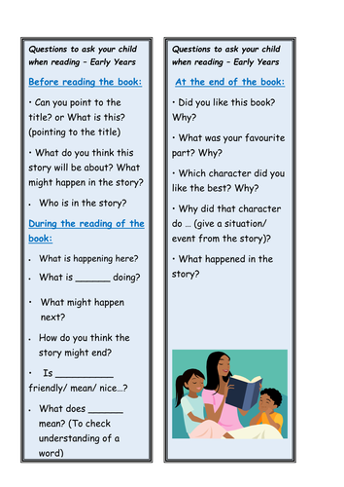

Slide 21
We are aiming for all children to be good at word recognition as well as having good language comprehension.

Slide 22
Parent support
Your support in your child’s learning is invaluable.
Ask your child about the sounds they have been learning. We will put these on the Reception learning page for you.
Play reading games. e.g. word bingo and pairs.
Please read with your child daily and add comments to your child’s reading journal to update us with their progress.
Try to find a time when your child is relaxed and not too tired. Try to find a time that works for your family and your routines. This could be the morning before school or just before bed.

Slide 23
My child doesn’t like reading. What can I do?
Try these strategies to help:
Ask your child to read to a teddy or help a doll to read.
Ask the child to be the teacher and ‘teach’ you to read.
Make the activity special – read in a cosy area of the house and perhaps give your child a warm drink to enjoy afterwards.

Slide 24
Where to go for more support?
https://letters-and-sounds.com/index.php/phase-2-introduction/
On our website there is a video of Mrs Lillitos (Bramhope’s Primary Mastery in English Lead Teacher) providing for ideas on how to help your child. 5 Tips for reading with your child
Our weekly learning updates will explain what sounds we have been learning that week.

Slide 25
When will we start getting reading books?
After half-term, we will start sending home reading books weekly.
We will send them home on a Thursday for you to read over the weekend and bring back on the Monday.
Please remember to bring it on Monday so that we can change it for you.
Please encourage your child to be ready to put their reading books and log in the box as they come into school.
Library books
Your child will choose a library book each Thursday to take home. Please enjoy it and return it the next Thursday.

Slide 26
Bug Club
We also have an online reading resource called Bug Club which we will be starting after half term. The office will send you your individual log-ins and then you will be able to access books at your child’s reading level.
We aim to update this every week but if you run out of books, please let us know.

Slide 27
Thank you for listening. Any questions?

